Slide 1


GPU-Acceleration of In-Memory Data Analytics
Evangelia Sitaridi, Thesis Defense
Columbia University

Slide 2
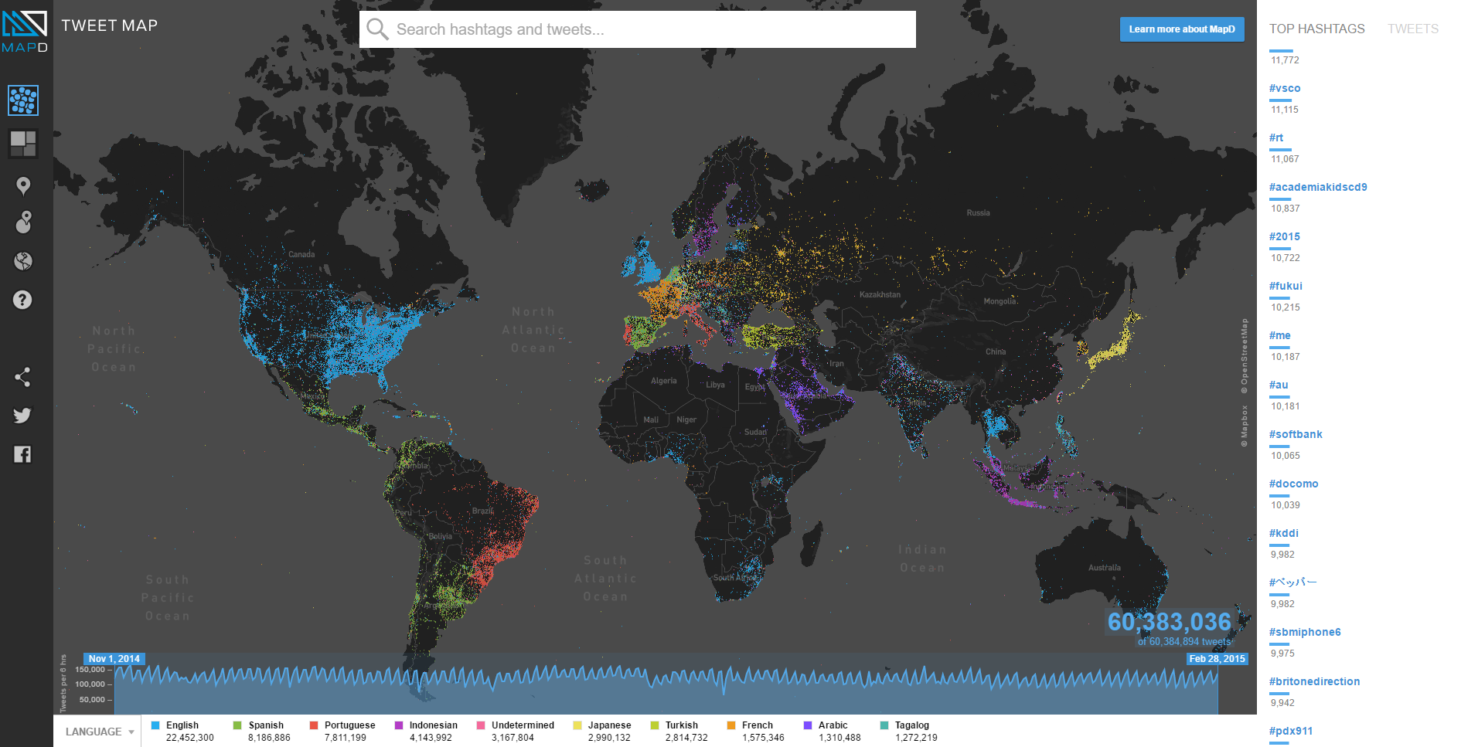
GPUs for Social Media Analytics
Search terms:
Match regexp: “/\B#\w*[a-zA-Z]+\w*/
debate
Filter location

Slide 3



More GPU Data Analytics Use-Cases
Online advertising
Digital advertising revenue surges!
Source: Interactive Advertising Bureau
Genome data
“The computing resources needed to handle genome data will soon exceed those of Twitter and YouTube”
  Source: http://www.nature.com/
Telecommunications
“Telecom sector’s use of data analytics tools expected to grow at a rate of 28.28% over the next four years”
Source: Technavio
Verizon using GPU start-up for database analytics

Slide 4
Interesting GPU Facts
Super-computer with accelerators (Source: Top500)
June 2014: 62 →June 2015: 90
  Top super-computer with accelerators (Source: Green500)
  June 2015: 32 top positions
  November 2015: 40 top positions
25% increase

Slide 5



Interesting GPU Facts
Super-computer with accelerators (Source: Top500)
June 2014: 62 →June 2015: 90
  Top super-computer with accelerators (Source: Green500)
  June 2015: 32 top positions
  November 2015: 40 top positions
Trend towards DBaaS
  IBM Soft-layer
  Microsoft Azure
  Amazon Web Services
25% increase

Slide 6
Challenges for GPU Databases
Special threading model → Increased programming complexity
  Which algorithms more efficient for GPUs?
  How much multiple code paths increase cost of code maintenance?
Special memory architecture
  How to adapt data layout?
Limited memory capacity
  Data transfer cost between CPUs and GPUs
    Through PCI/E link to the GPU
    From storage system to the GPU
  Seamless compression/decompression

Slide 7
Thesis Contribution
Rethink for GPU data processing
  Data layout
  Query execution
  Cost models
  Algorithmic evaluation
  Parallelism model
String matching (VLDB Journal & DaMoN 2016) (1), (4), (5)
  Sub-string matching: 3X speed-up & 2X energy savings against parallel state-of-the-art CPU libraries
  Regex matching: 2X speed-up (Haswell) - 5X (Intel Xeon Phi) against scalar code
Massively parallel decompression (ICPP 2016) – In collaboration with IBM Almaden & Watson
  2X speed-ups & 1.2X energy savings against multi-core state-of-the-art CPU libraries (4) , (5)
Conjunctive selection predicate optimization (DaMoN 2013) (2), (3)
  5X speed-ups against multi-core CPU implementations
Grouped aggregation in shared memory (DaMoN 2012) (1)
  10X speed-ups vs baseline layout

Slide 8
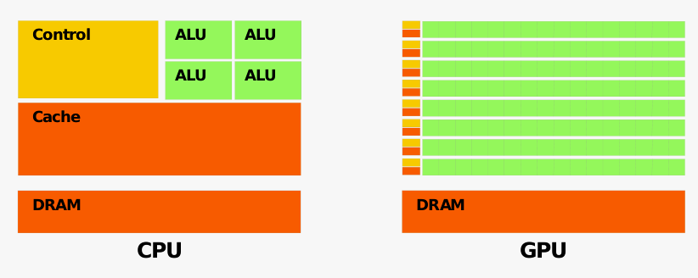
CPU-GPU Analogies
Goal: Low latency
Goal: High throughput
(overlapping different instructions)
CPU thread GPU warp
RAM Global memory
Tens of threads Thousands of threads
Hundreds of GBs capacity Few tens of GB

Slide 9
GPU Architecture
SM15
K40: 15 Stream Multiprocessors
…
SM2
Warp: Unit of execution
Warp scheduler
Warp scheduler
SM1
GPU Thread
Register File
Branch
…
1
1
1
1
1
1
1
1
if(condition)
…
…
…
…
a++;
1
1
else
…
…
b++;
1
1
1
1
…
…
1
…
1
1
1
…
1
1
1
endif
Branch complete
warp 1
warp n
CUDA Kernel
Shared Memory
Global Memory

Slide 10
Thesis Contribution
Rethink for GPU data processing
  Data layout
  Query execution
  Cost models
  Algorithmic evaluation
  Parallelism model
String matching (VLDB Journal & DaMoN 2016) (1), (4), (5)
  Sub-string matching: 3X speed-up & 2X energy savings against parallel state-of-the-art CPU libraries
  Regex matching: 2X speed-up (Haswell) - 5X (Intel Xeon Phi) against scalar code
Massively parallel decompression (ICPP 2016) – In collaboration with IBM Almaden & Watson
  2X speed-ups & 1.2X energy savings against multi-core state-of-the-art CPU libraries (4) , (5)
Conjunctive selection predicate optimization (DaMoN 2013) (2), (3)
  5X speed-ups against multi-core CPU implementations
Grouped aggregation in shared memory (DaMoN 2012) (1)
  10X speed-ups vs baseline layout

Slide 11
Text Query Applications
ACGTACCTGATCGTAGGATCCCAAGTACATCATTTC
ACC
Input
Search Pattern
GENOMIC DATA
Id | Address
3 | “9 Front St, Washington DC, 20001”
8 | “3338 A Lockport Pl #6, Margate City, NJ, 8402”
9 | “18 3rd Ave, New York, NY, 10016”
15 | “88 Sw 28th Ter, Harrison, NJ, 7029”
16 | “87895 Concord Rd, La Mesa, CA, 91142”
“*3rdAve*New York*”
Search Pattern
DATABASE COLUMNS
    Q2,9,13,14,16,20 of TPC-H contain expensive LIKE predicates

Slide 12
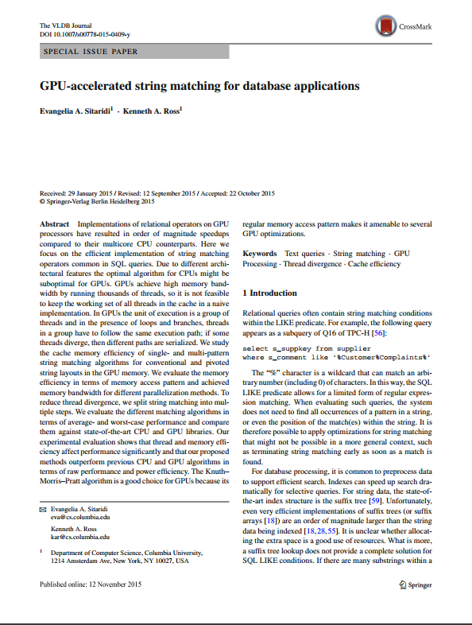
Optimization
EXECUTE STRING MATCHING ON THE GPU
Chapter 4/5
Special Issue Paper on Data Management on Modern Hardware
VLDB Journal

Slide 13
GPU Limiting factor: Thread Divergence
T0
T1
T2
T3
T4
T5
T6
T7
Group / warp
Grouped execution
CGTAGAAGACGTACGTACCAT
  Match pattern AGA
Threads matching different strings
CTAAACCGAGTAAAGACGTATG
ATAAGTACCAGAAACTGGTTTC
AAACAGATTGGCCAATCGTACG
ATAAGTACCACGGTTAAATCCA
  T4 no match: Slows down remaining threads!
CAGAAAACCTGGGATGGCCTAA
AGTCAGAAAACCTTGGATCGTC
TATACCAGAGGTTCCAGTCACA
Worse case algorithm complexity aggravated on GPUs

Slide 14
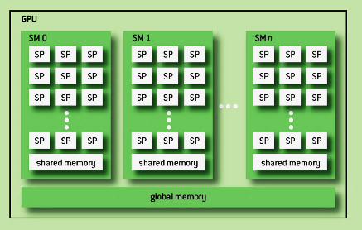
GPU Limiting factor: Cache Pressure
Threads matching different strings
Warp size: 32
Stream Multiprocessors: 15
#Warps in each SM: 64
Cache footprint: 30720 cache lines
L2 Capacity: 12288 cache lines
x
>>
Tesla K40 architecture
Smaller cache size per thread than CPUs: Need improved locality!

Slide 15
GPU Limiting factor: Boundary Overhead
Segmentation: Multiple threads match the same string
  Improved locality
  Reduced divergence
    Threads coordinate and complete search when match found
T0 T1 T2 T3
Match 3-character pattern!
ATAAGTACCGTACGTAACGTAAAAGTAACGT
T4 T5 T6 T7
CCAGTACCGTAATTACGTAAAGTAGGACGTAC
Detect matches spanning different segments→ Boundary overhead

Slide 16
Adapt Memory Layout: Pivoting Strings
Baseline (contiguous) layout
CTAACCGAGTAAAGAACGTAAACTCATTCGACTAAACCGAGTAAAGA…
Pivoted layout
CTAAACGTCTAA…CCGAAAACACCG…GTAATCATAGTA…AAGATCGAAAGA…
  Split strings in equally sized pieces
  Interleave pieces in memory → Improve locality
  CTAAACGTCTAA…CCGAAAACACCG…GTAATCATAGTA…AAGATCGAAAGA…
(1) Data layout
String 1 String 2 String 3
Initially: Each warp loads a cache line (128 bytes)
  T0 T1 T2
Partial solution: Threads might progress in different rate

Slide 17
Adapt Memory Layout: Pivoting Strings
Baseline (contiguous) layout
CTAACCGAGTAAAGAACGTAAACTCATTCGACTAAACCGAGTAAAGA…
Pivoted layout
CTAAACGTCTAA…CCGAAAACACCG…GTAATCATAGTA…AAGATCGAAAGA…
  Split strings in equally sized pieces
  Interleave pieces in memory → Improve locality
  CTAAACGTCTAA…CCGAAAACACCG…GTAATCATAGTA…AAGATCGAAAGA…
(1) Data layout
String 1 String 2 String 3
In presence of partial matches some threads might fall “behind”
  T0
  T1 T2
Memory divergence!
Partial solution: Threads might progress in different rate

Slide 18
Background: How to Search Text Fast?
Knuth-Morris-Pratt Algorithm
i=5
j=5
Input:
ACACATACCTACTTTACGTACGT
Step 6
ACACACG
Pattern:
Character mismatch
ACACATACCTACTTTACGTACGT
Step 7
i=5
j=1
ACACACG
Shift pattern
Shift pattern table
-1
0
0
1
2
3
4
Advance to the next character:
a) If the input matches to the pattern
b) While there is a mismatch shift to the left of the pattern
Stop when the beginning of the pattern has been reached

Slide 19
Transform Control Flow of KMP
Shift pattern table
-1
0
0
1
2
3
4
Knuth-Morris-Pratt Algorithm
i=5
j=5
Input:
ACACATACCTACTTTACGTACGT
Step 6
ACACACG
Pattern:
Character mismatch
While Loop
ACACATACCTACTTTACGTACGT
i=5
j=3
ACACACG
Mismatch→ Shift pattern
ACACATACCTACTTTACGTACGT
i=5
j=1
ACACACG
Mismatch→ Shift pattern
…
ACACATACCTACTTTACGTACGT
Step 7
i=6
j=0
ACACACG
Shift pattern
KMP Hybrid: Advance input in pivoted piece size

Slide 20
GPU vs. CPU Holistic Comparison
select s_suppkey
from supplier
where s_comment like ’%Customer%Complaints%’
Performance Metrics
  Price ($)
  Performance (GB/s)
  Performance per $
  Estimated energy consumption
Evaluate three systems
  CPU only system
  GPU only system
  CPU+GPU combined system

Slide 21
GPU vs. CPU Holistic Comparison
 | GPU | CPU (Boost BM) | CPU (CMPISTRI) | CPU+GPU
Price ($) | 3100 | 952 | 952 | 4052
Performance (GB/s) | 98.7 | 40.75 | 43.1 | 138.7
Energy consumed (J) | 1.27 | 2.49 | 2.35 | 1.78
Performance/$ | 31.89 | 42.8 | 45.28 | 34.25
Circle best column value per row
CPU: Dual-socket E5-2620 – Band. 102.4 GB/s
GPU: Tesla K40 – Band. 288 GB/s
Design system by choosing the desired trade-offs

Slide 22
Thesis Contribution
Rethink for GPU data processing
  Data layout
  Query execution
  Cost models
  Algorithmic evaluation
  Parallelism model
String matching (VLDB Journal & DaMoN 2016) (1), (4), (5)
  Sub-string matching: 3X speed-up & 2X energy savings against parallel state-of-the-art CPU libraries
  Regex matching: 2X speed-up (Haswell) - 5X (Intel Xeon Phi) against scalar code
Massively parallel decompression (ICPP 2016) – In collaboration with IBM Almaden & Watson
  2X speed-ups & 1.2X energy savings against multi-core state-of-the-art CPU libraries (4) , (5)
Conjunctive selection predicate optimization (DaMoN 2013) (2), (3)
  5X speed-ups against multi-core CPU implementations
Grouped aggregation in shared memory (DaMoN 2012) (1)
  10X speed-ups vs baseline layout

Slide 23
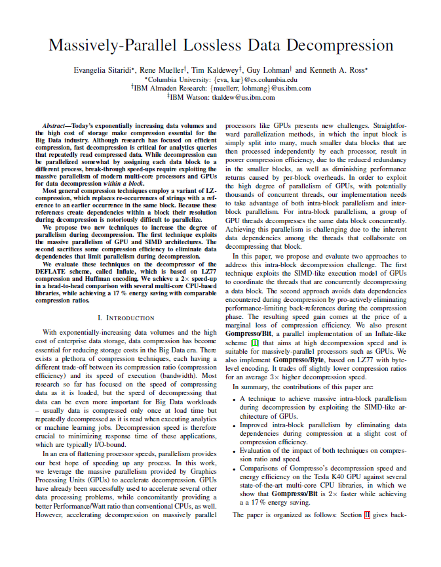
Optimization
Trade-off Compression ratio for faster decompression
Chapter 6
Massively-Parallel Lossless Data Decompression
ICPP 2016

Slide 24
Why Use Compression?
Data volume doubles every 2 years
  Data retained for longer periods
  Data retained for business analytics
  Gartner Blog: “Through 2018, 90% of deployed data lakes will be useless”
Make better utilization of available storage resources
  Increase storage capacity
  Improve backup performance
  Reduce network bandwidth utilization
Decompression speed more important than compression speed
Notes:
A data lake is a storage repository that holds a vast amount of raw data in its native format until it is needed. While a hierarchical data warehouse stores data in files or folders, a data lake uses a flat architecture to store data.
Source: AWS

Slide 25
Background: LZ77 Compression
ATCATCATTACTACAATGTTGATAATCAGCTATGAGTGATCGGGCCGGGCCT
Sliding window buffer
Unencoded lookahead characters
Input characters
Find longest match
Output
ATCATCATTACTACAATGTTGATAATCAGCTATGAGTGATCGGGCCGGGCCT
…
0
1
2
3
ATTACTAGAATGT(2,5)…
ATTACTAGAATGT TACTAATCTGAT CGGGCCGGGCCTG
Sliding window buffer
Literals
Unmatched characters
Backreferences (Position, Length)
Sliding window buffer
Unencoded lookahead characters
ATCATCATTACTACAATGTTGATAATCAGCTATGAGTGATCGGGCCGGGCCT
Sliding window buffer
Unencoded lookahead characters
Unencoded lookahead characters
Notes:
LZSS minor extension to LZ77--

Slide 26
LZSS Decompression
Background: LZ77 Compression
W | I | K | I | P | E | D | I | A | . | C | O
Window buffer contents
Tokens
(0,4)M(5,4)COMM…
WIKI
M
EDIA
COMM
Input data block
Output data block

Slide 27
How to Parallelize Decompression?
>1000 threads available!
Data block 1
Thread 1
Data block 2
Thread 2
…
…
Split input file in independent blocks
Input file
Naïve approach performance 200 MB/s << 250 GB/s (K20x)

Slide 28
GPU LZ77 Decompression
Improve utilization: Group strings of literals with the following back-reference
CCGA(0,2)CGG(4,3)AGTT(12,4)
Tokens
Compressed input
Uncompressed output

Slide 29
GPU LZ77 Decompression
1) Read tokens (parallel)
CCGA(0,2)CGG(4,3)AGTT(12,4)
Tokens
Compressed input
Uncompressed output

Slide 30
GPU LZ77 Decompression
2) Write literals (parallel prefix sum)
CCGA(0,2)CGG(4,3)AGTT(12,4)
CCGA CGG AGTT
Tokens
Compressed input
Uncompressed output

Slide 31
GPU LZ77 Decompression
3.2) Write uncompressed output:
CCGA(0,2)CGG(4,3)AGTT(12,4)
CCGACCCGGCCCAGTTCCGA
Tokens
3.1 ) Compute uncompressed output
Compressed input
Uncompressed output
Problem: Back-references processed in parallel might be dependent! →
Use voting function __ballot to detect dependencies

Slide 32
How to Handle Thread Dependencies?
(5) Parallelism model
MRR
Write literals (parallel)
While(!all backreferences written)
  Check dependencies satisfied (parallel)
  Copy back-references w/o pending dependencies
Tokens
CCGA(0,3)T(4,4)
Second loop: Dependencies satisfied
Bandwidth: 7 GB/s
DE
CCGA(0,3)T(0,3)T
A) Compression
Only search for matches w/o dependencies
B) Decompression
Copy back-references (fully parallel)
Tokens
Bandwidth: 16 GB/s
C
Uncompressed input
…CCGACGTTCCGT…

Slide 33
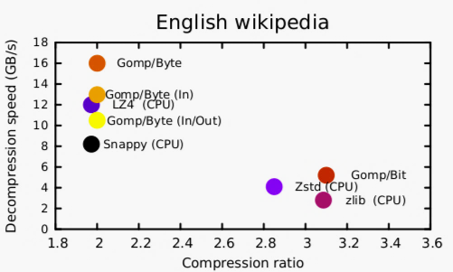
Decompression Skyline
CPU: Dual-socket E5-2620 – Band. 102.4 GB/s
GPU: Tesla K40 – Band. 288 GB/s
Byte-level encoding
Bit-level encoding
Notes:
Decompression speed vs Compression ratio
CPU indicated use 24 threads
Two encoding (more details in the thesis)
Bit-level perf. + energy consumption
Byte-level: Gompresso/Byte (limited by PCI/E) 1.5X faster than LZ4

Slide 34
Thesis Contribution
Rethink for GPU data processing
  Data layout
  Query execution
  Cost models
  Algorithmic evaluation
  Parallelism model
String matching (VLDB Journal & DaMoN 2016) (1), (4), (5)
  Sub-string matching: 3X speed-up & 2X energy savings against parallel state-of-the-art CPU libraries
  Regex matching: 2X speed-up (Haswell) - 5X (Intel Xeon Phi) against scalar code
Massively parallel decompression (ICPP 2016) – In collaboration with IBM Almaden & Watson
  2X speed-ups & 1.2X energy savings against multi-core state-of-the-art CPU libraries (4) , (5)
Conjunctive selection predicate optimization (DaMoN 2013) (2), (3)
  5X speed-ups against multi-core CPU implementations
Grouped aggregation in shared memory (DaMoN 2012) (1)
  10X speed-ups vs baseline layout

Slide 35
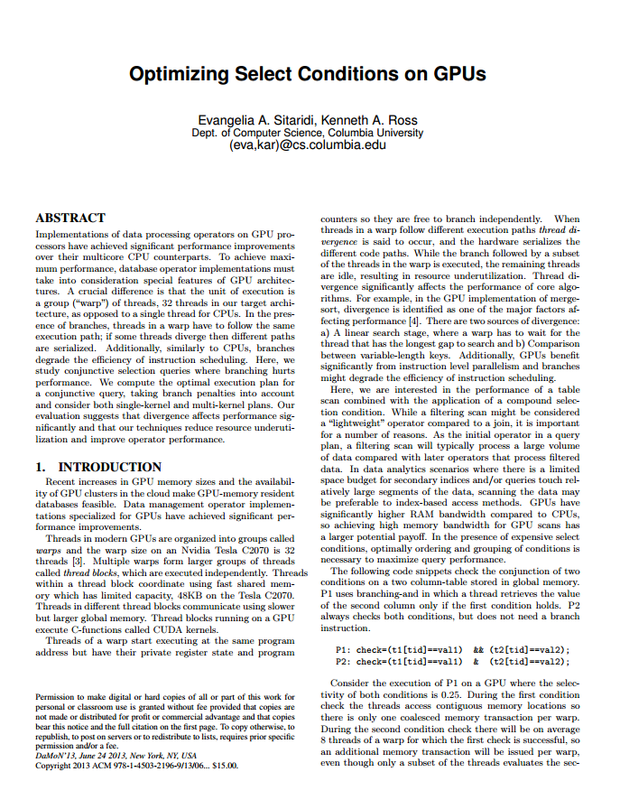
Optimization
Optimal grouping of select predicates in kernels
Chapter 3
Optimizing select conditions on GPUs
DaMoN 2013

Slide 36
Conjunctive Select Conditions (on the GPU)
Scans initial operators in a query plans → Access more data
Space might be limited for indexes → Full scan required
  SELECT CNT(*)
  FROM R
  WHERE col1<v1 AND col2<v2 AND ... AND coln=stringn
Columnar storage, data stored in GPU device memory
Each condition applied on one column
(2) Query Execution
Wide variety of execution strategies
  Single kernel or multiple kernels?
  Remove branches from condition evaluation? [Ross, 2004]

Slide 37
Use Cost Model to Optimize
(3) Cost Model
Choice of the plan matters!
P0:c1&c2&c3&c4 P1: c1&c2&(c3&&c4)
P2: c1&(c2&&(c3&&c4)) P3: c1&&c2&&c3&&c4
Predict device memory performance by calculating:
(a) # mem xcts (b) mem overlap & (c) intermediate results

Slide 38
Thesis Contribution
Rethink for GPU data processing
  Data layout
  Query execution
  Cost models
  Algorithmic evaluation
  Parallelism model
String matching (VLDB Journal & DaMoN 2016) (1), (4), (5)
  Sub-string matching: 3X speed-up & 2X energy savings against parallel state-of-the-art CPU libraries
  Regex matching: 2X speed-up (Haswell) - 5X (Intel Xeon Phi) against scalar code
Massively parallel decompression (ICPP 2016) – In collaboration with IBM Almaden & Watson
  2X speed-ups & 1.2X energy savings against multi-core state-of-the-art CPU libraries (4) , (5)
Conjunctive selection predicate optimization (DaMoN 2013) (2), (3)
  5X speed-ups against multi-core CPU implementations
Grouped aggregation in shared memory (DaMoN 2012) (1)
  10X speed-ups vs baseline layout

Slide 39
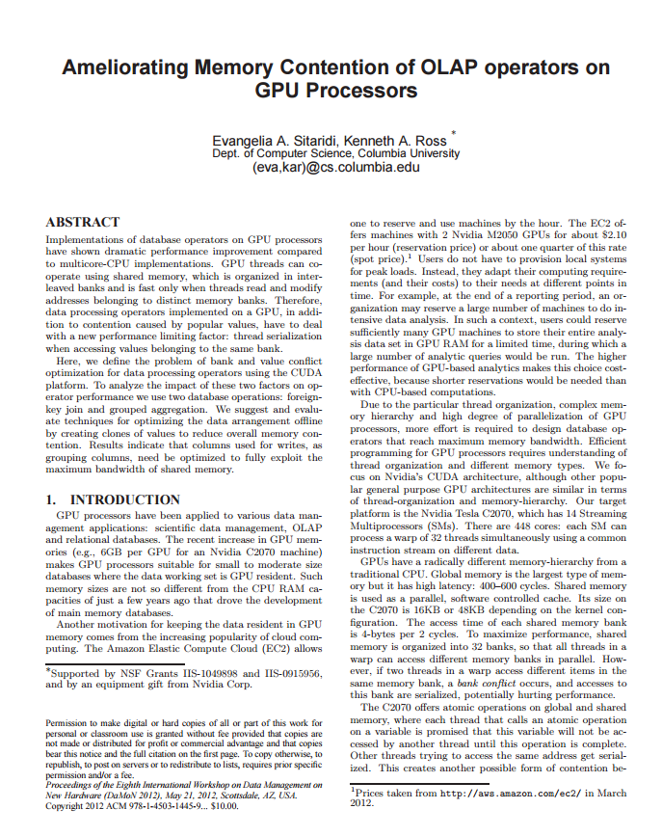
Optimization
Use software controlled cache for aggregation
Chapter 2
Ameliorating memory contention of OLAP operators on GPU processors
DaMoN 2012

Slide 40
Example: Shared memory access
1
2
3
4
5
6
7
8
9
10
11
12
13
14
15
16
17
18
19
20
21
22
23
24
25
26
27
28
29
30
31
32
0
4
8
12
16
20
24
28
32
36
40
44
48
52
56
60
64
68
72
76
80
84
88
92
96
100
104
108
112
116
120
124
128
132
136
…
1
2
3
4
5
6
7
8
9
10
11
12
13
14
15
16
17
18
19
20
21
22
23
24
25
26
27
28
29
30
31
32
Read conflicts: 2 rounds of serialization
Threads
Memory addresses
Write conflicts: 3 rounds of serialization
Banks

Slide 41
How Can We Use Shared Memory?
Aggregate count of customers by city
Full Name | Age | City
“Jason Becker” | 36 | “New York”
“Janet Beck” | 57 | “San Francisco”
“Donna Carreras” | 49 | “Yonkers”
“John Chang” | 29 | “San Jose”
…
Customers Count
“New York”
…
“Chicago”
“San Francisco”
“San Jose”
Running aggregates
Base Table (Billions of rows)
Use shared memory for the aggregate table (<< base table)

Slide 42
How to reduce bank conflicts?
Full Name | Age |  | City
…
“Jason Becker” | 36 | “New York”
“Janet Beck” | 57 | “San Francisco”
“Donna Carreras” | 49 | “Yonkers”
“John Chang” | 29 | “San Jose”
…
Detect and eliminate bank conflicts during preprocessing
“New York”
“San Francisco”
“Yonkers”
“New York”
“San Franscico”
Base Table
Move “New York” to alternative copy. Relocation sequence: 0 → 2
Value | Copy
“New York” | 0,2
“San Francisco” | 0,3
“San Jose” | 3
“Yonkers” | 0
Replica Table

Slide 43
How to reduce bank conflicts?
Full Name | Age |  | City
…
“Jason Becker” | 36 | “New York”
“Janet Beck” | 57 | “San Francisco”
“Donna Carreras” | 49 | “Yonkers”
“John Chang” | 29 | “San Jose”
…
Detect and eliminate bank conflicts during preprocessing
“New York”
“San Francisco”
“Yonkers”
“New York”
“San Franscico”
Base Table
Move “New York” to alternative copy. Relocation sequence: 0 → 2
Value | Copy
“New York” | 0,2
“San Francisco” | 0,3
“San Jose” | 3
“Yonkers” | 0
“Yonkers”
“San Jose”
“New York”
“San Franscico”
,2
Replica Table
Create a new copy for San Jose to bank 2

Slide 44
Conclusions on Bank Optimization
Potential grouping columns should be optimized for writes
Higher skew results in orders-of magnitude significant speed-ups
  1.2X speed-up for uniform data
Achieved maximum perfomance for 2X-4X increase in shared memory footprint
  Shared memory footprint decreasing for higher skew

Slide 45
Open Challenges
Research Challenges
  Cost models
    Analytical (fast to compute/not extensible) vs.
    Learning (compute intensive but extensible) [Bress,2013]
  Compression
    Do alternative coding schemes change the performance skyline?
Technical/Engineering Challenges
  Code maintenance in heterogeneous environments [Heimel,2013]
    How much performance left on the table for single-code paths?

Slide 46
Thesis Contribution
Rethink for GPU data processing
  Data layout
  Query execution
  Cost models
  Algorithmic evaluation
  Parallelism model
String matching (VLDB Journal & DaMoN 2016) (1), (4), (5)
  Sub-string matching: 3X speed-up & 2X energy savings against parallel state-of-the-art CPU libraries
  Regex matching: 2X speed-up (Haswell) - 5X (Intel Xeon Phi) against scalar code
Massively parallel decompression (ICPP 2016) – In collaboration with IBM Almaden & Watson
  2X speed-ups & 1.2X energy savings against multi-core state-of-the-art CPU libraries (4) , (5)
Conjunctive selection predicate optimization (DaMoN 2013) (2), (3)
  5X speed-ups against multi-core CPU implementations
Grouped aggregation in shared memory (DaMoN 2012) (1)
  10X speed-ups vs baseline layout

Slide 47
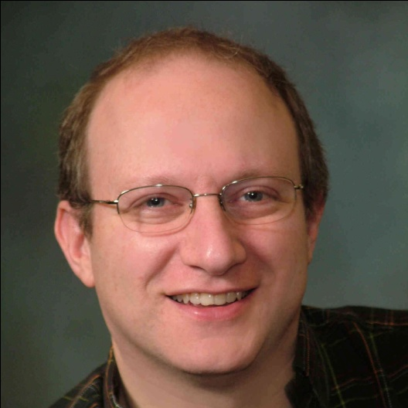
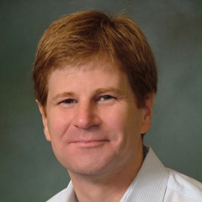
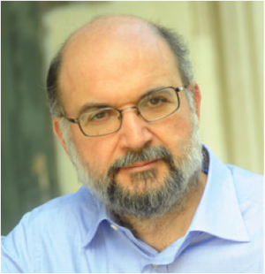

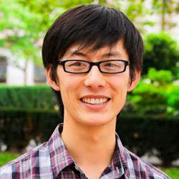
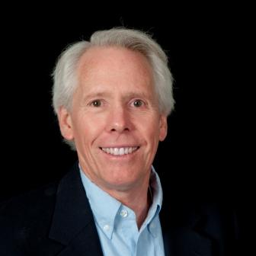


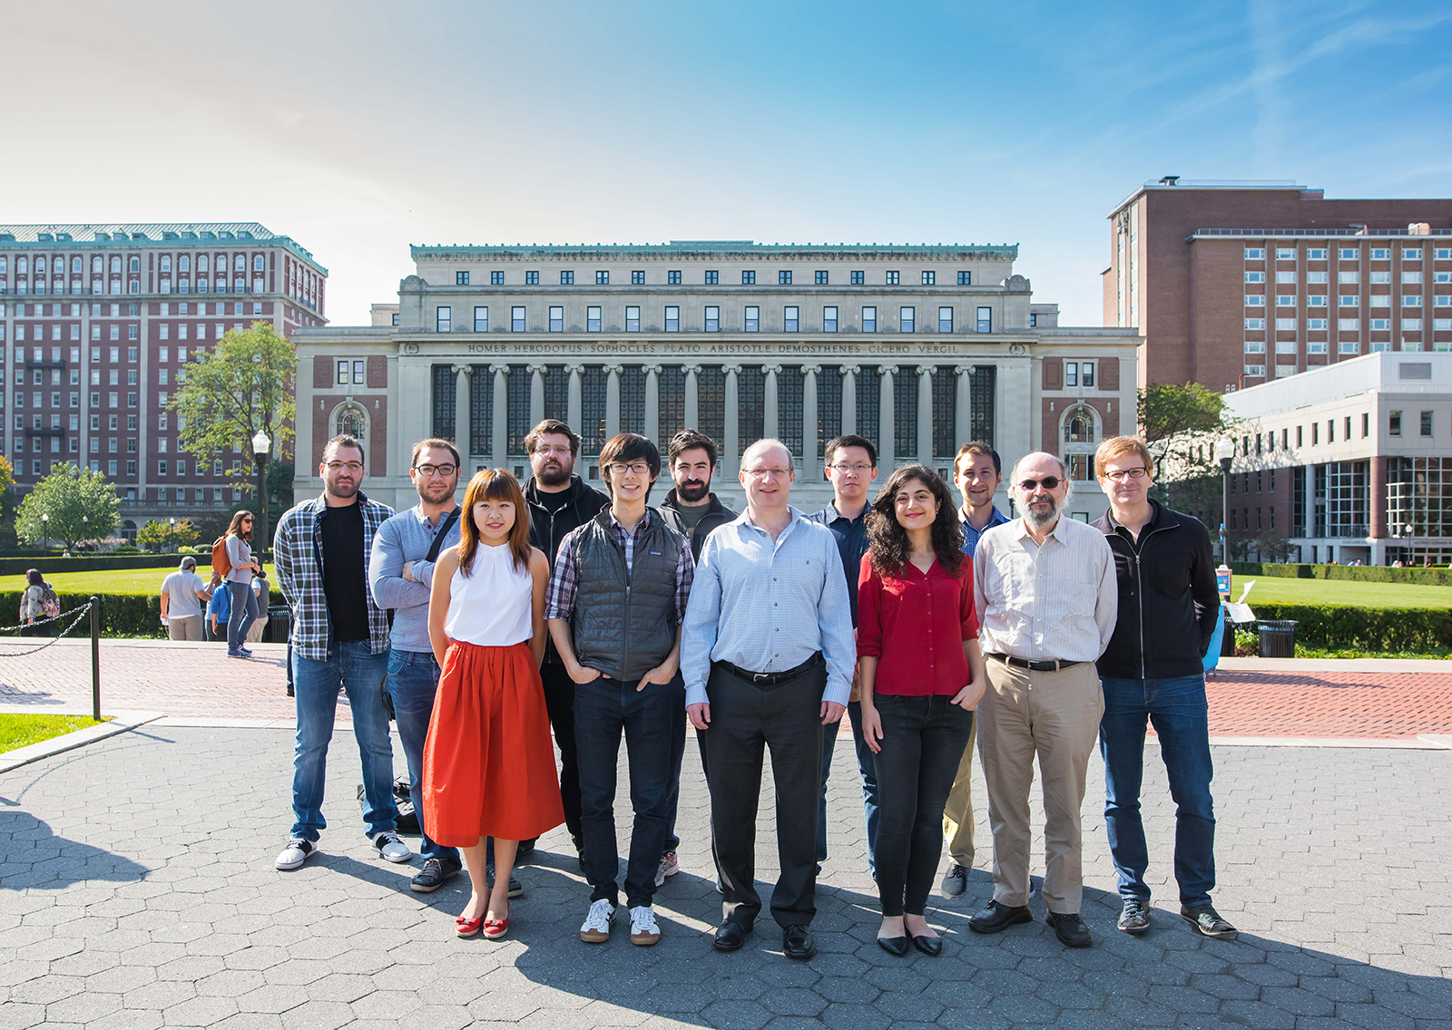



Thank you!

Slide 48
Thesis Contribution
Rethink for GPU data processing
  Data layout
  Query execution
  Cost models
  Algorithmic evaluation
  Parallelism model
String matching (VLDB Journal & DaMoN 2016) (1), (4), (5)
  Sub-string matching: 3X speed-up & 2X energy savings against parallel state-of-the-art CPU libraries
  Regex matching: 2X speed-up (Haswell) - 5X (Intel Xeon Phi) against scalar code
Massively parallel decompression (ICPP 2016) – In collaboration with IBM Almaden & Watson
  2X speed-ups & 1.2X energy savings against multi-core state-of-the-art CPU libraries (4) , (5)
Conjunctive selection predicate optimization (DaMoN 2013) (2), (3)
  5X speed-ups against multi-core CPU implementations
Grouped aggregation in shared memory (DaMoN 2012) (1)
  10X speed-ups vs baseline layout

Slide 49
Back-up Slides

Slide 50
Publications
Evangelia A. Sitaridi, Rene Mueller, Tim Kaldewey, Guy Lohman, Kenneth Ross, Massively-Parallel Lossless Data Decompression, ICPP 2016
Evangelia A. Sitaridi, Orestis Polychroniou, Kenneth Ross, SIMD-Accelerated Regular Expression Matching, DaMoN Workshop 2016
Evangelia Α. Sitaridi, Kenneth Ross, GPU-Accelerated string matching for database applications, VLDB Journal Special Issue on Data Management on Modern Hardware, 2015
Evangelia A. Sitaridi , Rene Mueller, Tim Kaldewey, Parallel Lossless Compression using GPUs, GTC 2014
Evangelia A. Sitaridi , Kenneth A. Ross, Optimizing Select Condition on GPUs, DaMoN Workshop 2013
Evangelia A. Sitaridi, Kenneth A. Ross, Ameliorating Memory Contention of OLAP operators on GPU Processors, DaMoN Workshop 2012 (Best Paper Award winner)

Slide 51
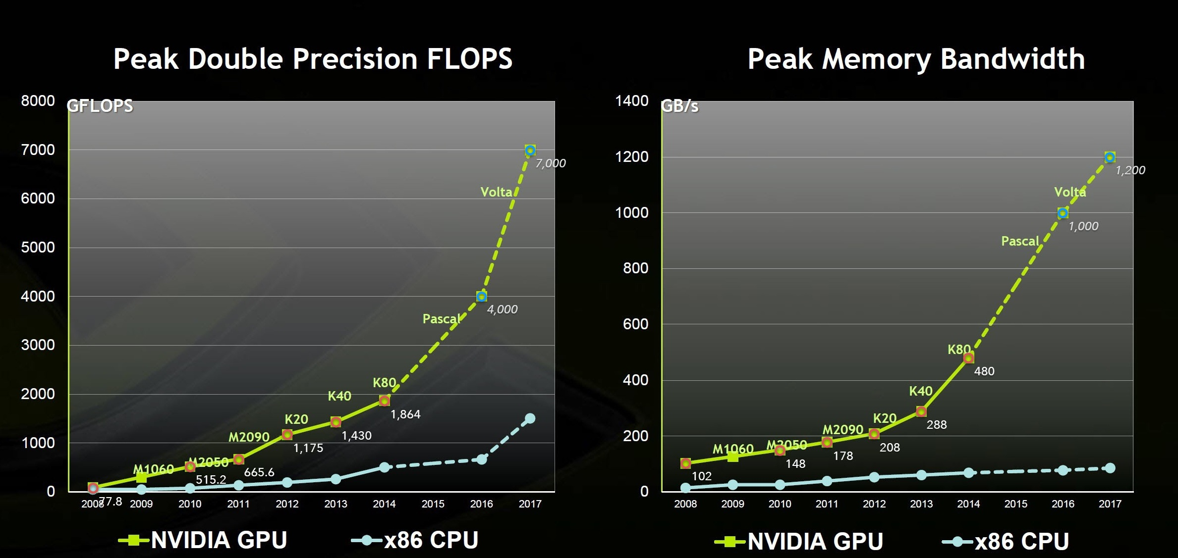
Why GPUs?
Database workloads memory bound
Expected speed-up: 5X
High parallelism & Memory bandwidth

Slide 52
Reduce Memory Divergence (A)
KMP_basic(char *input, char *pattern,
int *next, int m, int n){
…
while (i<n) {
if (pattern[j]==input[i]) {
j++;
i++;
if (j==m)
return true;
} else {
if (j != 0)
j = next[j];
else
i++;
}}
KMP_step(char *input, char *pattern,
int *next, int m, int n){
…
for (int i=0;i<n;i++) {
while (j>=0 && pattern[j]!=input[i])
j=next[j];
j++;
if (j==m)
return true;
}
Thread divergence
Memory divergence
Transform control flow to coordinate memory accesses

Slide 53
CPU String Matching Bandwidth
Intel Haswell processor
CPU sub-string matching memory bound

Slide 54
Example: Abort early regex matches/failures
14
30
16
32
36
37
38
39
vector of rids
40
40
45
45
5
11
14
37
…
5
11
14
37
…
…
…
output
index
6
output
index
6
8
40
30
41
42
36
43
44
39
8
40
30
41
42
36
43
44
39

Slide 55
Matching Performance of URL Regex

Slide 56
Earlier Work
String matching for GPU databases
  Identified as an open problem [Pirk 2014]
Compression
  Emphasis on compression
    High decompression speed for simpler compression schemes
Query execution
  Operator-at-a-time
  Op-code model
  Hybrid model

Slide 57
String Matching: Why not indexes?
Suffix trees drawbacks
  Preprocessing time: Full input strings preprocessing
  Space overhead
  Multiple queries for sequences of patterns
Inverted indexes drawbacks
  Preprocessing time: Full input strings preprocessing
  Space overhead
  Only support predefined query terms
    e.g. Do not support partial word matching

Slide 58
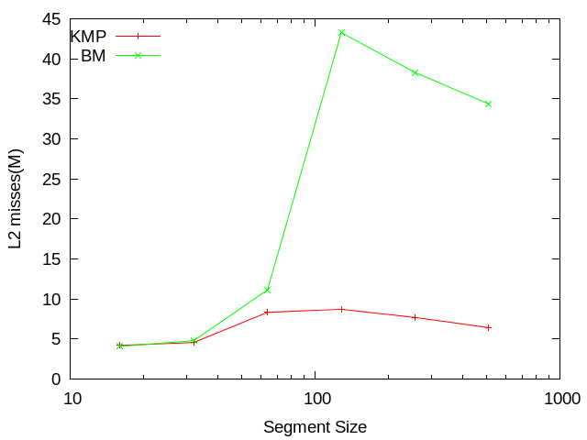
String Matching: L2 Profiling results
KMP: Prefetch multiple character in registers
L2 misses dramatically increase when L2 capacity exceeded

Slide 59
Background: How to Search Text Fast? (A)
Boyer-Moore Algorithm
Input:
ACGTCACCTACTTTACGTACGT
Step 1
i=3
j=3
Pattern:
ACAT
Match from right to left
ACGTCACCTACTTTACGTACGT
ACAT
Mismatch → Skip pattern
Step 2
i=2
j=2
ACGTCACCTACTTTACGTACGT
ACAT
Skip entire pattern
Step 3
i=4
j=4

Slide 60
Background: How to Search Text Fast? (B)
Knuth-Morris-Pratt Algorithm
Shift pattern table
-1
0
0
1
ACAT
ACGTCACCTACTTTACGTACGT
Input:
Step 1
i=0
j=0
Pattern:
ACAT
Match from left to right
ACGTCACCTACTTTACGTACGT
Step 2
i=1
j=1
ACAT
i=2
j=2
ACGTCACCTACTTTACGTACGT
Step 3
ACAT
Character mismatch
i=3
j=0
ACGTCACCTACTTTACGTACGT
Step 4
ACAT
Shift pattern

Slide 61
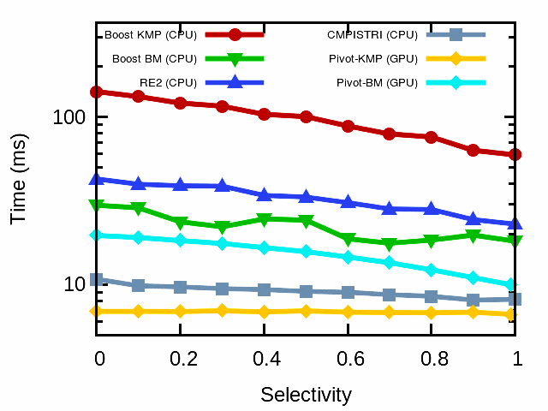
GPU vs CPU Performance
(4) Algorithmic evaluation
GPU faster than the fastest CPU method

Slide 62
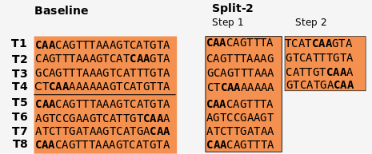
Our approach: Reduce Thread Divergence
Split strings in equal segments
Each step processes a segment
  If match found the remaining string not processed
  If match not found string added to pending set
Threads match early do sit idle for the entire string
Boundary overhead for BM

Slide 63
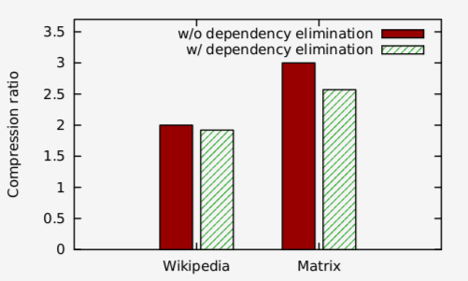
Overhead of Gompresso

Slide 64
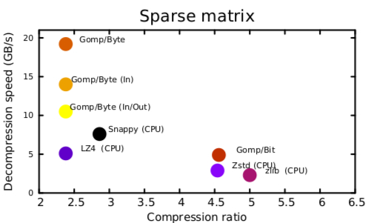
Results of Gompresso for other files

Slide 65







DBMS History
Relational Model
Commercial data
warehouses
HTAP
In-memory analytics
Database as a Service
B.C.
Before Codd
1970’s
1980’s
1990’s
2000’s
2010’s
MPP
Hadoop
NoSQL
Commercial RDBMS
DB2
NOSQL
Notes:
In 1970, Edgar F. Codd, an Oxford-educated mathematician working at the IBM San Jose Research Lab, published a paper showing how information stored in large databases could be accessed without knowing how the information was structured or where it resided in the database.

Slide 66
Reduce memory divergence (B)
KMP_hybrid(char *input, char *pattern,int *next, int m, int n){
…
for(int i=0;i<n;i+=4){
unsigned t=input[i>>2];
for(int k=0;k<4;){
if (pattern[j]==((char)t)) {
t>>=8;
k++;
j++;
if (j==m)
return true;
} else {
if (j != 0)
j = next[j];
else{
t>>=8;
k++;
}}}}
(4) Algorithmic evaluation
Outer Loop: KMP Step, advance by pivoted piece size!
Inner loop: KMP Basic

Slide 67
Compression Trade-offs
Compression ratio
Compression speed
Decompression speed
Input file
Input file
Compression speed vs. Compression ratio
Compression speed vs. Decompression speed
Decompression speed vs. Compression ratio

Slide 68
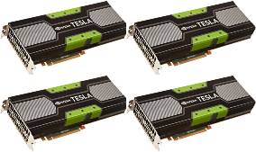

GPU Query Execution
1
Query front-end
parsed query
3
2
Query rewriter &
optimizer
Statistics catalog
compiled plan
4
Query execution engine
ptx code
query-results
GPU-resident data

Slide 69
String Matching Taxonomy
Parallelism
  Single input (segment input)
  Multiple inputs
Early termination vs. complete scan
  Validation
  e.g. REGEXP LIKE @(https?|ftp)://(-\.)?([^\s/?\.#-]+\.?)+(/[^\s]*)?$@iS
  Search string e.g. LIKE ‘%special%orders% (Complete scan)
Architecture implementation
  CPU
  GPUs

