Slide 1
Mobile Platform
Security Models
*Original slides by Prof. John Mitchell

Slide 2
Outline
Introduction: platforms and attacks
Apple iOS security model
Android security model
Windows 7, 8 Mobile security model
Announcement: See web site for second homework, third project

Slide 3
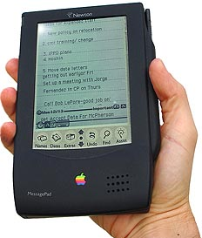
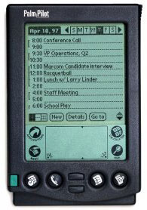
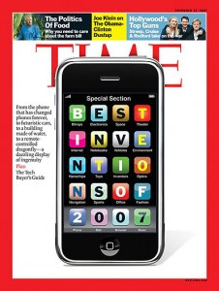
Change takes time
iPhone, 2007
Apple Newton, 1987
Palm Pilot, 1997

Slide 4
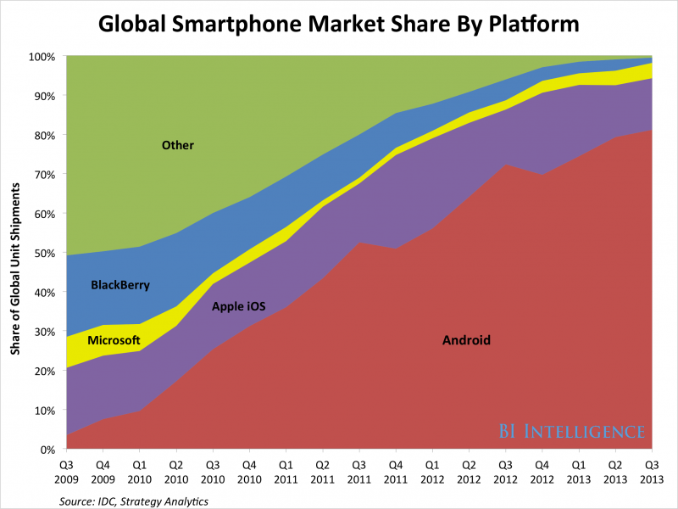
Global smartphone market share

Slide 5

Zillions of apps

Slide 6
Two attack vectors
Web browser
Installed apps
  Both increasing in prevalence and sophistication
source: https://www.mylookout.com/mobile-threat-report

Slide 7
Mobile malware attacks
Unique to phones:
  Premium SMS messages
  Identify location
  Record phone calls
  Log SMS
Similar to desktop/PCs:
  Connects to botmasters
  Steal data
  Phishing
  Malvertising

Slide 8
Kaspersky: Aug 2013 – Mar 2014
3,408,112 malware detections 1,023,202 users.
69,000 attacks in Aug 2013 -> 644,000 in Mar 2014
35,000 users -> 242,000 users
59.06% related to stealing users’ money
Russia, India, Kazakhstan, Vietnam, Ukraine and Germany have largest numbers of reported attacks
Trojans sending SMS were 57.08% of all detections

Slide 9
Typical scenario
Cybercriminals create an affiliate website and invite Internet users to become their accomplices
A unique modification of the malware and a landing page for download is created for each accomplice
Participants of the affiliate program trick Android users into installing malicious application
Infected device sends SMS messages to premium numbers, making money for the cybercriminals
Part of money is paid to the affiliate partners
http://media.kaspersky.com/pdf/Kaspersky-Lab-KSN-Report-mobile-cyberthreats-web.pdf

Slide 10
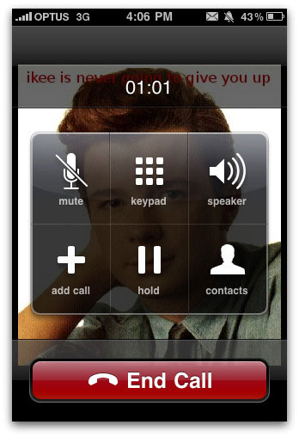

Mobile malware examples
DroidDream (Android)
  Over 58 apps uploaded to Google app market
  Conducts data theft; send credentials to attackers
Ikee (iOS)
  Worm capabilities (targeted default ssh pwd)
  Worked only on jailbroken phones with ssh installed
Zitmo (Symbian,BlackBerry,Windows,Android)
  Propagates via SMS; claims to install a “security certificate”
  Captures info from SMS; aimed at defeating 2-factor auth
  Works with Zeus botnet; timed with user PC infection

Slide 11
Comparison between platforms
Operating system (recall security features from lecture 5)
  Unix
  Windows
Approval process for applications
  Market: Vendor controlled/Open
  App signing: Vendor-issued/self-signed
  User approval of permission
Programming language for applications
  Managed execution: Java, .Net
  Native execution: Objective C

Slide 12
Outline
Introduction: platforms and attacks
Apple iOS security model
Android security model
Windows 7 Mobile security model

Slide 13
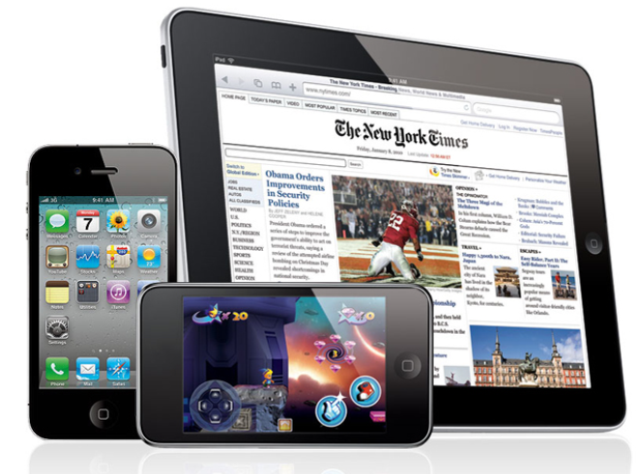
Apple iOS
From: iOS App Programming Guide

Slide 14
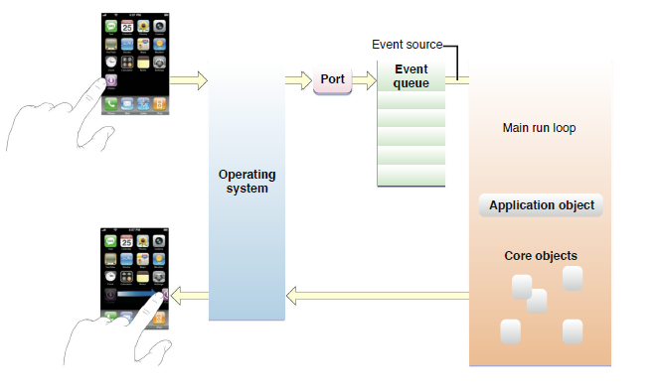
iOS Application Development
Apps developed in Objective-C using Apple SDK
Event-handling model based on touch events
Foundation and UIKit frameworks provide the key services used by all iOS applications

Slide 15
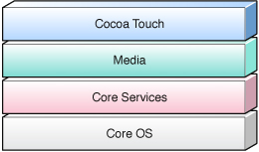
iOS Platform
Cocoa Touch: Foundation framework, OO support for collections, file management, network operations; UIKit
Media layer: supports 2D and 3D drawing, audio, video
Core OS and Core Services: APIs for files, network, … includes SQLite, POSIX threads, UNIX sockets
Kernel: based on Mach kernel like Mac OS X
Implemented in C and Objective-C

Slide 16
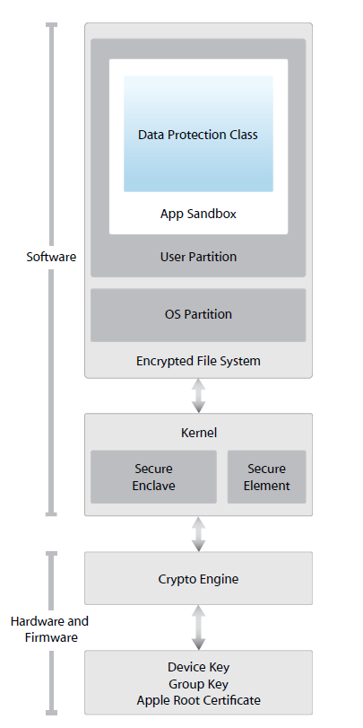
Apple iOS Security
Device security
  Prevent unauthorized use of device
Data security
  Protect data at rest; device may be lost or stolen
Network security
  Networking protocols and encryption of data in transmission
App security
  Secure platform foundation
https://www.apple.com/business/docs/iOS_Security_Guide.pdf

Slide 17
App Security
Runtime protection
  System resources, kernel shielded from user apps
  App “sandbox” prevents access to other app’s data
  Inter-app communication only through iOS APIs
  Code generation prevented
Mandatory code signing
  All apps must be signed using Apple-issued certificate
Application data protection
  Apps can leverage built-in hardware encryption

Slide 18
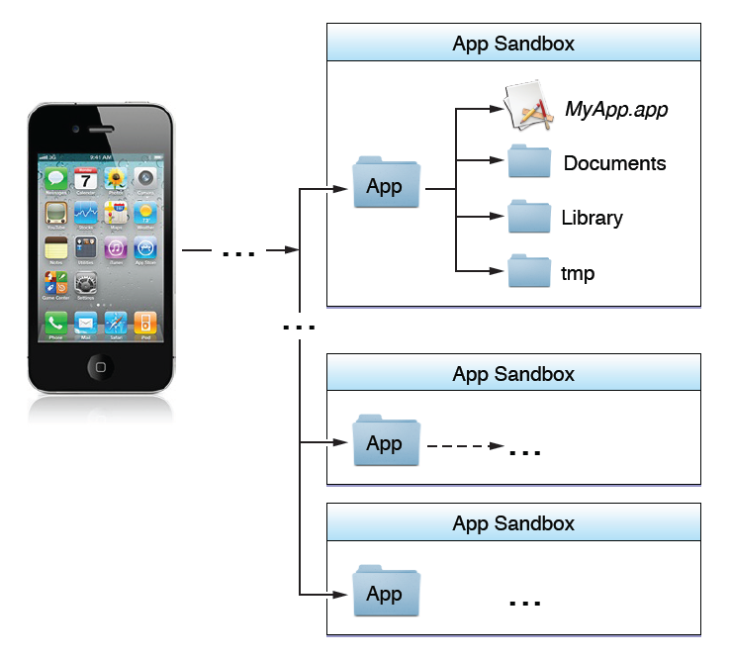
iOS Sandbox
Limit app’s access to files, preferences, network, other resources
Each app has own sandbox directory
Limits consequences of attacks
Same privileges for each app

Slide 19
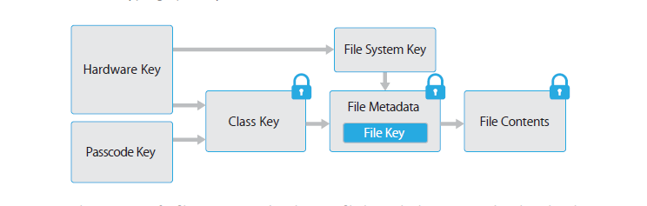
File encryption
The content of a file is encrypted with a per-file key, which is wrapped with a class key and stored in a file’s metadata, which is in turn encrypted with the file system key.
  When a file is opened, its metadata is decrypted with the file system key, revealing the wrapped per-file key and a notation on which class protects it
  The per-file key is unwrapped with the class key, then supplied to the hardware AES engine, decrypting the file as it is read from flash memory
The metadata of all files is encrypted with a random key. Since it’s stored on the device, used only for quick erased on demand.

Slide 20
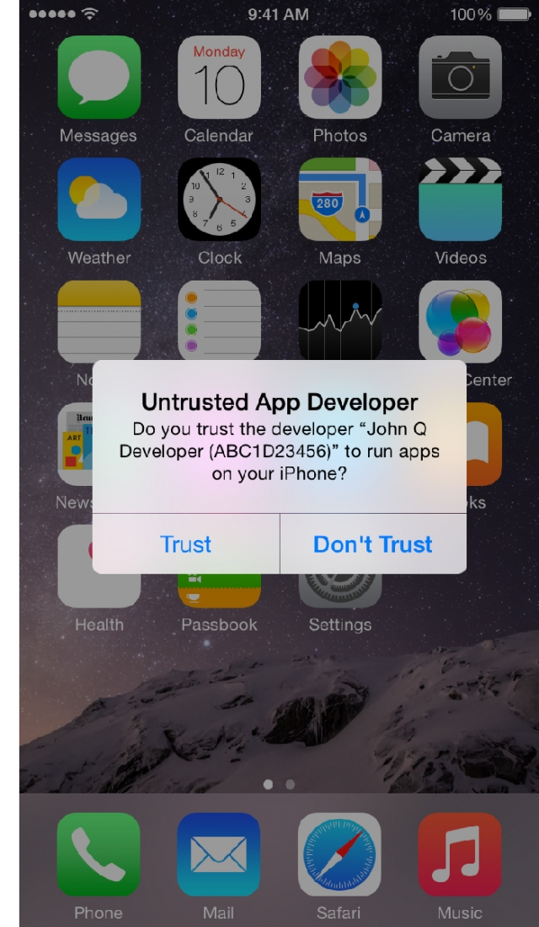
“Masque Attack”
iOS app installed using enterprise/ad-hoc provisioning could replace genuine app installed through the App Store, if both apps have same bundle identifier
This vulnerability existed because iOS didn't enforce matching certificates for apps with the same bundle identifier

Slide 21
Comparison
 | iOS | Android | Windows
Unix | x
Windows
Open market
Closed market | x
Vendor signed | x
Self-signed
User approval of permissions
Managed code
Native code | x

Slide 22
Outline
Introduction: platforms and attacks
Apple iOS security model
Android security model
Windows 7, 8 Mobile security model

Slide 23
Android
Platform outline:
  Linux kernel, browser, SQL-lite database
  Software for secure network communication
    Open SSL, Bouncy Castle crypto API and Java library
  C language infrastructure
  Java platform for running applications
  Also: video stuff, Bluetooth, vibrate phone, etc.

Slide 24
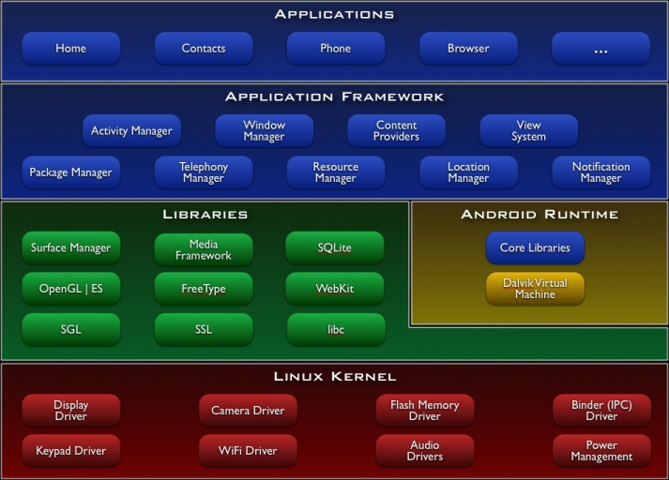

Slide 25
Android market
Self-signed apps
App permissions granted on user installation
Open market
  Bad applications may show up on market
  Shifts focus from remote exploit to privilege escalation

Slide 26
Security Features
Isolation
  Multi-user Linux operating system
  Each application normally runs as a different user
Communication between applications
  May share same Linux user ID
    Access files from each other
    May share same Linux process and Dalvik VM
  Communicate through application framework
    “Intents,” based on Binder, discussed in a few slides
Battery life
  Developers must conserve power
  Applications store state so they can be stopped (to save power) and restarted – helps with DoS

Slide 27
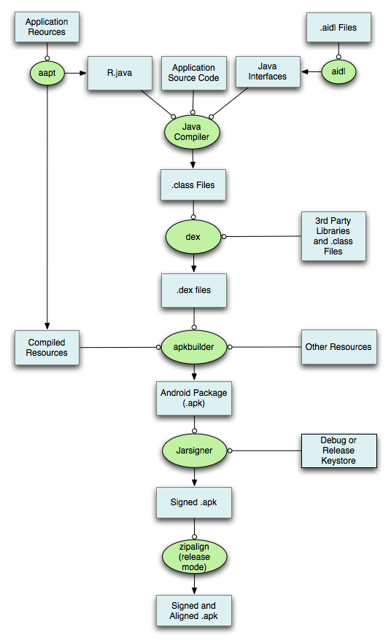
Application development process

Slide 28
Application development concepts
Activity – one-user task
  Example: scroll through your inbox
  Email client comprises many activities
Service – Java daemon that runs in background
  Example: application that streams an mp3 in background
Intents – asynchronous messaging system
  Fire an intent to switch from one activity to another
  Example: email app has inbox, compose activity, viewer activity
    User click on inbox entry fires an intent to the viewer activity, which then allows user to view that email
Content provider
  Store and share data using a relational database interface
Broadcast receiver
  “mailboxes” for messages from other applications

Slide 29
Exploit prevention
100 libraries + 500 million lines new code
  Open source -> public review, no obscurity
Goals
  Prevent remote attacks, privilege escalation
  Secure drivers, media codecs, new and custom features
Overflow prevention
  ProPolice stack protection
    First on the ARM architecture
  Some heap overflow protections
    Chunk consolidation in DL malloc (from OpenBSD)
ASLR
  Avoided in initial release
    Many pre-linked images for performance
  Later developed and contributed by Bojinov, Boneh

Slide 30
Application sandbox
Application sandbox
  Each application runs with its UID in its own Dalvik virtual machine
    Provides CPU protection, memory protection
    Authenticated communication protection using Unix domain sockets
    Only ping, zygote (spawn another process) run as root
  Applications announces permission requirement
    Create a whitelist model – user grants access
      But don’t want to ask user often – all questions asked as install time
    Inter-component communication reference monitor checks permissions

Slide 31
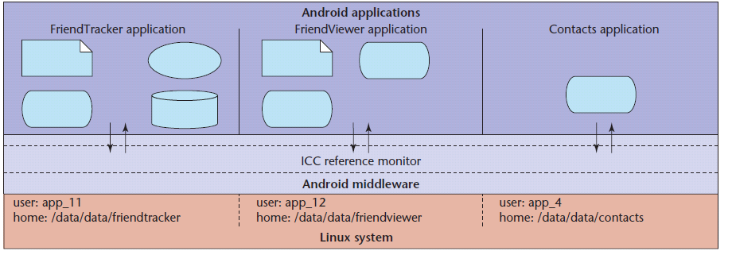
Layers of security
  Each application executes as its own user identity
  Android middleware has reference monitor that mediates the establishment of inter-component communication (ICC)
Source: Penn State group Android security paper

Slide 32
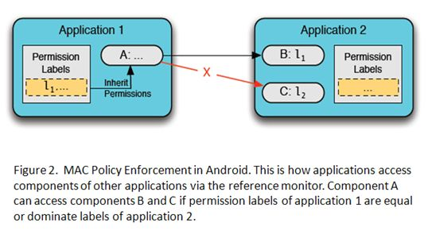
Source: Penn State group, Android security tutorial

Slide 33
dlmalloc (Doug Lea)
Stores meta data in band
Heap consolidation attack
  Heap overflow can overwrite pointers to previous and next unconsolidated chunks
  Overwriting these pointers allows remote code execution
Change to improve security
  Check integrity of forward and backward pointers
    Simply check that back-forward-back = back, f-b-f=f
  Increases the difficulty of heap overflow

Slide 34
Java Sandbox
Four complementary mechanisms
  Class loader
    Separate namespaces for separate class loaders
    Associates protection domain with each class
  Verifier and JVM run-time tests
    NO unchecked casts or other type errors, NO array overflow
    Preserves private, protected visibility levels
  Security Manager
    Called by library functions to decide if request is allowed
    Uses protection domain associated with code, user policy

Slide 35
Comparison: iOS vs Android
App approval process
  Android apps from open app store
  iOS vendor-controlled store of vetted apps
Application permissions
  Android permission based on install-time manifest
  All iOS apps have same set of “sandbox” privileges
App programming language
  Android apps written in Java; no buffer overflow…
  iOS apps written in Objective-C

Slide 36
Comparison
 | iOS | Android | Windows
Unix | x | x
Windows
Open market |  | x
Closed market | x
Vendor signed | x
Self-signed |  | x
User approval of permissions |  | x
Managed code |  | x
Native code | x

Slide 37
Outline
Introduction: platforms and attacks
Apple iOS security model
Android security model
Windows Phone 7, 8 security model

Slide 38
Windows Phone 7, 8 security
Secure boot
All binaries are signed
Device encryption
Security model with isolation, capabilities

Slide 39
Windows Phone OS 7.0 security model
Principles of isolation and least privilege
Each chamber
  Provides a security and isolation boundary
  Is defined and implemented using a policy system
The security policy of a chamber
  Specifies the OS capabilities that processes in that chamber can access

Slide 40
Windows Phone 7 security model
Policy system
  Central repository of rules
  3-tuple {Principal, Right, Resource
Chamber Model
  Chamber boundary is security boundary
  Chambers defined using policy rules
  4 chamber types, 3 fixed size, one can be expanded with capabilities (LPC)
Capabilities
  Expressed in application manifest
  Disclosed on Marketplace
  Defines app’s security boundary on phone
Trusted Computing Base (TCB)
Fixed
Permissions
Chamber
Types
Least Privilege Chamber (LPC)
Elevated Rights
Standard Rights
Dynamic
Permissions
(LPC)

Slide 41
Windows Phone 8 security model
Similar to WP7
Trusted Computing Base (TCB)
WP8 chambers are built on the Windows security infrastructure
Least Privilege Chamber (LPC)
  Services and Application all in chambers
  WP8 has a richer capabilities list
Dynamic
Permissions
(LPC)

Slide 42
Isolation
Every application runs in own isolated chamber
  All apps have basic permissions, incl a storage file
  Cannot access memory or data of other applications, including the keyboard cache.
No communication channels between applications, except through the cloud
Non-MS applications distributed via marketplace stopped in background
  When user switches apps, previous app is shut down
  Reason: application cannot use critical resources or communicate with Internet–based services while the user is not using the application

Slide 43
Four chamber types
Three types have fixed permission sets
Fourth chamber type is capabilities-driven
  Applications that are designated to run in the fourth chamber type have capability requirements that are honored at installation and at run-time

Slide 44
Overview of four chambers
Trusted Computing Base (TCB) chamber
  unrestricted access to most resources
  can modify policy and enforce the security model.
  kernel and kernel-mode drivers run in the TCB
  Minimizing the amount of software that runs in the TCB is essential for minimizing the Windows Phone 7, 8 attack surface

Slide 45
Overview of four chambers
Elevated Rights Chamber (ERC)
  Can access all resources except security policy
  Intended for services and user-mode drivers
Standard Rights Chamber (SRC)
  Default for pre-installed applications that do not provide device-wide services
  Outlook Mobile is an example that runs in the SRC
Least Privileged Chamber (LPC)
  Default chamber for all non-Microsoft applications
  LPCs configured using capabilities (see next slide)

Slide 46
Granting privileges to applications
Goal: Least Privilege
  Application gets capabilities needed to perform all its use cases, but no more
Developers
  Use the capability detection tool to create the capability list
  The capability list is included in the application manifest
Each application discloses its capabilities to the user,
  Listed on Windows Phone Marketplace.
  Explicit prompt upon application purchase
  Disclosure within the application, when the user is about to use the location capability for the first time.

Slide 47
Windows Phone 7 “Capabilities”
W7 Capability: a resource associated with user privacy, security, cost, or business concerns
Examples: geographical location information, camera, microphone, networking, and sensors.

Slide 48
Managed code
Application development model uses of managed code only

Slide 49
.NET Code Access Security
Default Security Policy is part of the .NET Framework
  Default permission for code access to protected resources
Permissions can limit access to system resources.
  Use EnvironmentPermission class for environment variables access permission.
  The constructor defines the level of permission (read, write,…)
Deny and Revert
  The Deny method of the permission class denies access to the associated resource
  The RevertDeny method will cause the effects of any previous Deny to be cancelled

Slide 50
Example: code requires permission
  class NativeMethods
  {
  // This is a call to unmanaged code. Executing this method
  // requires the UnmanagedCode security permission. Without
  // this permission, an attempt to call this method will throw a
  // SecurityException:
  [DllImport("msvcrt.dll")]
  public static extern int puts(string str);
  [DllImport("msvcrt.dll")]
  internal static extern int _flushall();
  }

Slide 51
Example: Code denies permission not needed
  [SecurityPermission(SecurityAction.Deny, Flags =
  SecurityPermissionFlag.UnmanagedCode)]
  private static void MethodToDoSomething()
  { try
  {
  Console.WriteLine(“ … ");
  SomeOtherClass.method();
  }
  catch (SecurityException)
  {
  …
  }
  }

Slide 52
.NET Stackwalk
Demand must be satisfied by all callers
  Ensures all code in causal chain is authorized
  Cannot exploit other code with more privilege
A has P?
Code A
calls
B has P?
Code B
calls
Code C
Demand P

Slide 53
Stackwalk: Assert
The Assert method can be used to limit the scope of the stack walk
  Processing overhead decreased
  May inadvertently result in weakened security

Slide 54
Comparison between platforms
Operating system
  Unix
  Windows
Approval process for applications
  Market: Vendor controlled/Open
  App signing: Vendor-issued/self-signed
  User approval of permissions
Programming language for applications
  Managed execution: Java, .Net
  Native execution: Objective C

Slide 55
Comparison
 | iOS | Android | Windows
Unix | x | x
Windows |  |  | x
Open market |  | x
Closed market | x |  | x
Vendor signed | x
Self-signed |  | x | x
User approval of permissions |  | x | 7-> 8
Managed code |  | x | x
Native code | x

Slide 56
Conclusion
Introduction: platforms and attacks
Apple iOS security model
Android security model
Windows 7, 8 Mobile security model
Announcement: See web site for second homework, third project

