Slide 1
Memento:
Learning Secrets from Process Footprints
Suman Jana and Vitaly Shmatikov
The University of Texas at Austin

Slide 2


Trends in software design
Applications rely on OS abstractions to improve their safety and reliability
  “Process”
  “User”
Case study: Web browsers
Fork a new
process
Fork a new
process
www.xbank.com
www.quickdate.com
OS isolation

Slide 3
Unintended consequences
Good
Better isolation
Better reliability
  Others not affected if one process crashes
Better safety
Bad
Leaks more info to concurrent processes
Topic of this talk

Slide 4


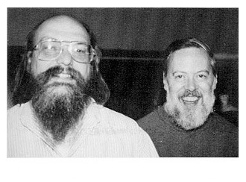

ProcFS:
Process info in multi-user OS
ps
top –p 1
cat /proc/1/status
Tom Killian
"Processes as Files" (1984)
introduced in the 1980s

Slide 5
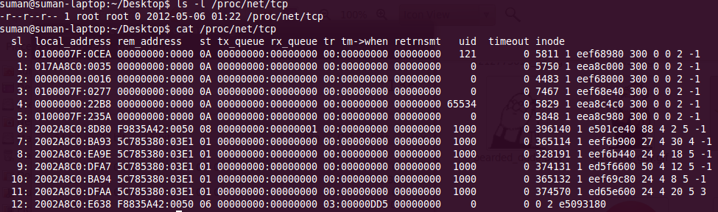
What can one learn from ProcFS?
IP addrs of websites other users are visiting

Slide 6


Side channels through /proc
"Peeping Tom in the Neighborhood: Keystroke Eavesdropping on Multi-User Systems" - Usenix Security 2009
  Keystroke timing leak through ESP/EIP values from /proc/<pid>/stat
Kehuan Zhang
XiaoFeng Wang

Slide 7

The story of "Peeping Tom"
Shout-out to
XiaoFeng ;)
NDSS '09
program committee:
"Nobody uses multi-user computers anymore"

Slide 8
The story of "Peeping Tom"
Shout-out to
XiaoFeng ;)
Oakland '09
program committee:
"Nobody uses multi-user computers anymore"

Slide 9

Nobody uses multi-user computers anymore???

Slide 10
Android sandboxing =
UNIX multi-user isolation
ps
top –p 1
cat /proc/1/status
UNIX multi-users in the 1980s

Slide 11


Android sandboxing =
UNIX multi-user isolation
ps
top –p 1
cat /proc/1/status
Android “multi-users” in 2012

Slide 12
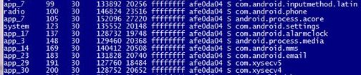

Android sandboxing =
UNIX multi-user isolation
Different apps run as different users
Android uses OS “user” abstraction to isolate applications

Slide 13
Android sandboxing =
UNIX multi-user isolation
ProcFS API is still unchanged!!
ps
top –p 1
cat /proc/1/status
Android “multi-users” in 2012

Slide 14
What can a zero-permission app do?
Can read all world-readable files in /proc
… but “Peeping Tom” attack does not work ☹
  ESP/EIP too unpredictable - JVM, GUI etc.
Introducing “Memento” attacks
  Works on all major OSs (except iOS)

Slide 15
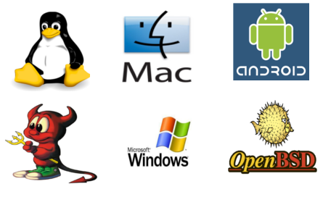
This is not just about Android!

Slide 16
Process resource usage = big-time side channel
Completely
new attack!
Memory usage leaks inputs and user actions
  Reveals webpages visited in Chrome, Firefox, Android browser, any WebKit-based browser
  Reveals state of Web applications
    Membership in dating sites, specific interests on medical sites, etc.
CPU usage leaks keystroke timing
  For bash, ssh, Android on-screen keyboard handler
  Yields a better, much more robust “Peeing Tom”

Slide 17



“Memento” (2000):
putting together “memory streams”

Slide 18

“Memento” (2000):
putting together “memory streams”

Slide 19
Memprint: stream of memory usage
10568 KB
49380 KB
15976 KB
65948 KB
11632 KB
48996 KB
60280 KB
60820 KB
59548 KB

Slide 20



Sniffing memory footprints
browser
process
alloc 1
alloc 2
OS free page pool
OS isolation
2050
memprint
used page count
zero-permission
malicious process
2050

Slide 21

Sniffing memory footprints
browser
process
alloc 1
alloc 2
brk/mmap
OS free page pool
OS isolation
2056
memprint
used page count
zero-permission
malicious process
2050
2056

Slide 22

Sniffing memory footprints
browser
process
alloc 1
alloc 2
brk/mmap
OS free page pool
OS isolation
2080
memprint
used page count
zero-permission
malicious process
2050
2056
2080

Slide 23
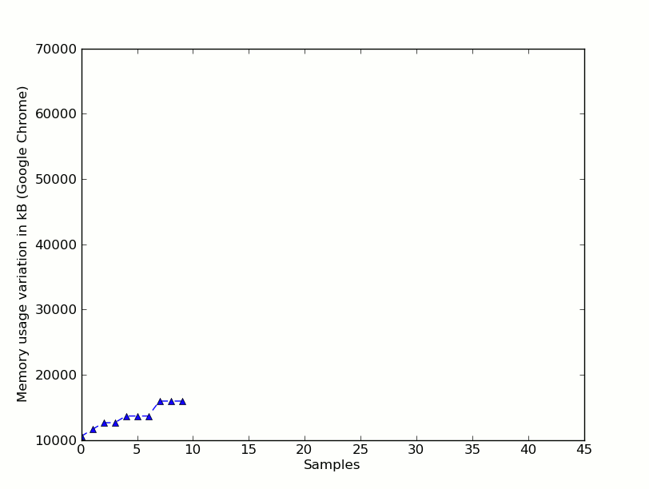
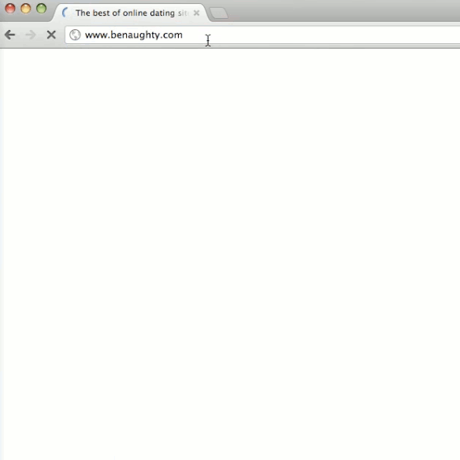
Memprint for Chrome loading benaughty.com

Slide 24
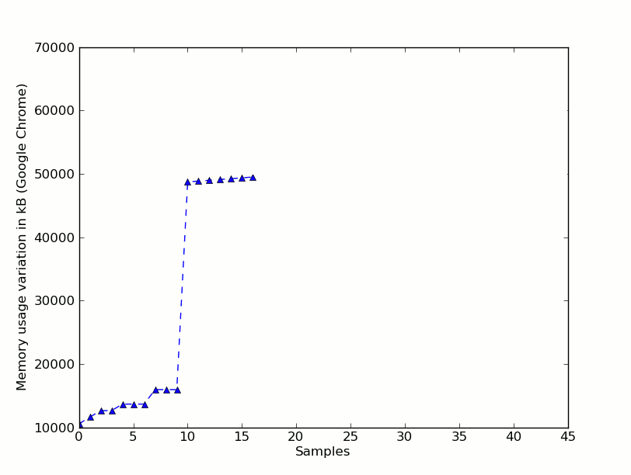
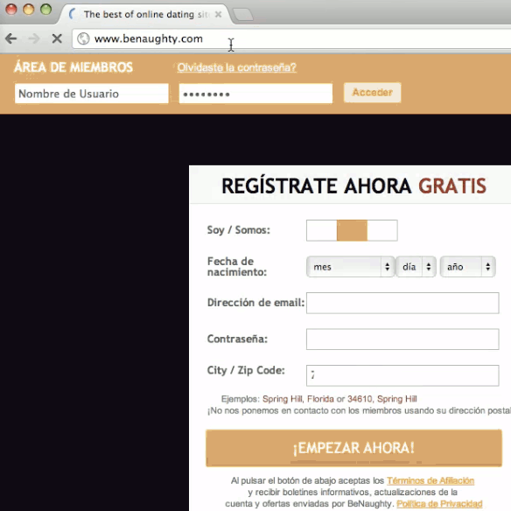
Memprint for Chrome loading benaughty.com

Slide 25
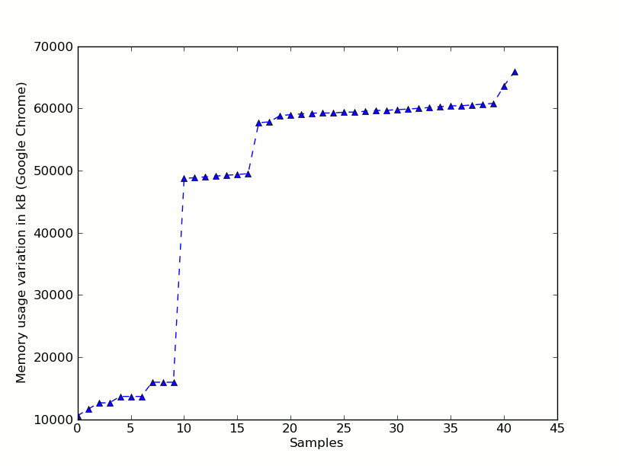
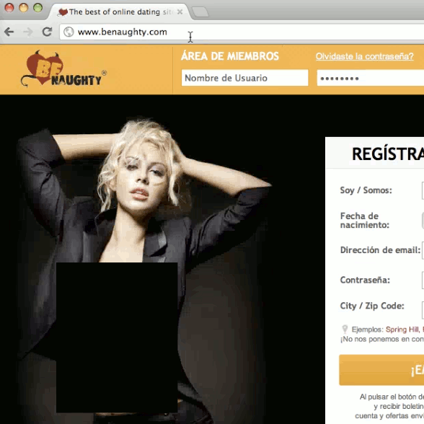
Memprint for Chrome loading benaughty.com

Slide 26
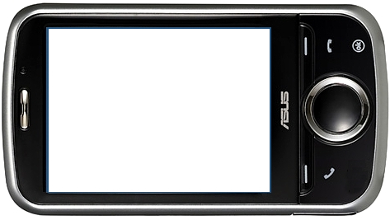
Full attack
zero-permission
app
browser
memprint
/proc/pid/statm
memprint
database
OS isolation

Slide 27
Why the attack works
Memprints are unique (for up to 43% of webpages)
  Can tune recognition to achieve zero false positives
Memprints are stable
  … across repeated visits to the same page
memprints are
OS/browser-dependent but
machine-independent

Slide 28
Cross-page similarity for 100 random pages out of Alexa top 1000
similarity = Jaccard index of memprints
web page ID
Similar to
themselves
web page ID
Different from others

Slide 29
Fine-grained info leak: OkCupid
is login successful?
no
memory usage increases by
1-2 MB
memory usage increases by
27-36 MB
yes
yes
is a paid
customer ?
no
new flash player plugin process to display ads
no new flash player plugin process

Slide 30
Concurrent processes don't hurt, sometimes make it even better!!

Slide 31
Memento attacks: CPU usage info
Monitor /proc/<pid>/status for number of context switches
Infer inter-keystroke timing for bash, ssh, Android on-screen keyboard handler etc.
  Processing each keystroke requires a predictable number of context switches
  Keystroke processing time << keystroke interval
sufficient to
reconstruct typed text
[Zhang and Wang]

Slide 32
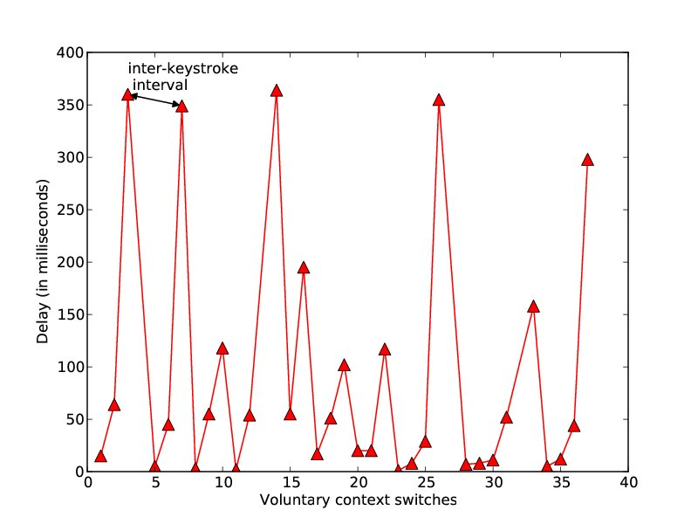
Keystroke timing
(Android MMS app)

Slide 33
Solutions?
Increasing reliance on OS isolation makes these attacks easier
  OS problem, not an application problem
Disable /proc
  FreeBSD: no /proc, but attacker can still measure victim's memory footprint via kvm_getprocs
Stop reporting fine-grained resource usage across “user” boundary
  Only report info for user's own processes
  Breaks tools like ps, top etc.

Slide 34
Summary
Process info API
  A legacy of the 1980s
  Reveals process's resource usage - CPU, mem, netw
  A single measurement is harmless (most of the time)
  Dynamics of processes’ resource usage =
  high-bandwidth side channel
Memento attacks
  OS designers must rethink
  process info API
needed
the API
does NOT need the API

