Slide 1
Enabling Fine-Grained Permissions for Augmented Reality
Applications With Recognizers
Suman Jana^{1*}, David Molnar²,
Alexander Moshchuk², Alan Dunn^{1*}, Benjamin Livshits²,
Helen J. Wang², and Eyal Ofek²
¹University of Texas at Austin
²Microsoft Research
* Work done during internship at Microsoft Research
USENIX Security 2013

Slide 2
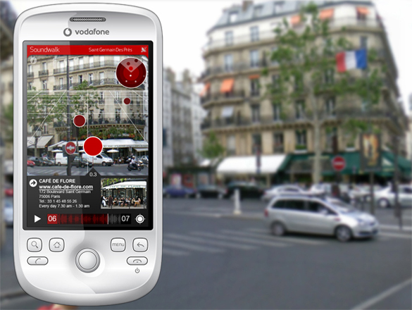
Augmented Reality (AR) : the new frontier!
SoundWalk app on Layar AR browser
http://www.layar.com/layers/clicmobiletestlayar/

Slide 3
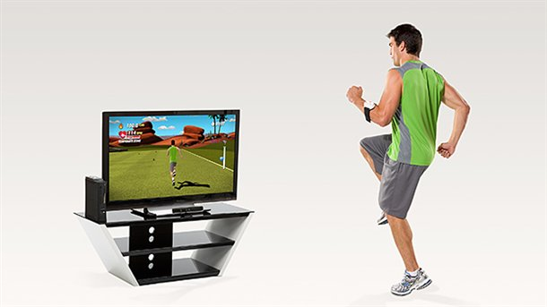
Augmented Reality (AR) : the new frontier!
EA Sports Active 2
http://www.ea.com/ea-sports-active-2

Slide 4
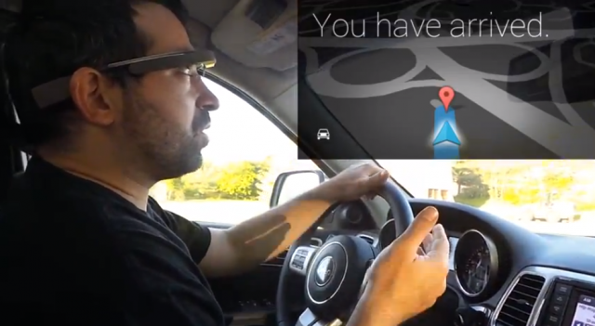
Augmented Reality (AR) : the new frontier!
Google Glass navigation

Slide 5
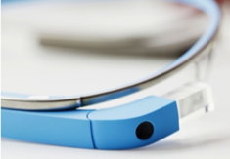
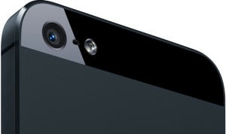
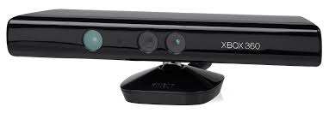


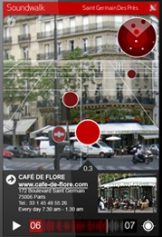
AR application pipeline
recognize
objects
transform
render

Slide 6
AR application pipeline
topic of today’s talk
recognize
objects
current AR applications do it all by themselves!
transform
all these stages
need platform support (HotOS’13)
render

Slide 7

Privacy concern: unrestricted access
all apps see this

Slide 8
Privacy concern: unrestricted access
all apps see this
tons of sensitive information!

Slide 9
Functionality concern: one app at a time
AR tour guide
AR navigator
can’t run concurrently

Slide 10
Scalability concern: must scale to multiple concurrent applications

Slide 11
What can we do with today’s abstraction?
a lot of repetitive work across apps
2x overhead for 2 Kinect Apps
app 1
recognize
objects
transform
render
app 2
recognize
objects
transform
render
hard to maintain
usable frame rate

Slide 12
Recognizers: a new abstraction

Slide 13

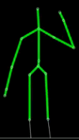
Introducing recognizers
skeleton
recognizer
A new platform abstraction to recognize real-world objects – generates events that apps can subscribe to
Fine-grained control over detected objects
Can enforce least privilege – each app must obtain permissions to access each recognizer

Slide 14
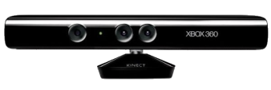
Scalability with multiple recognizers
Explicit data flow
RGB
Depth
Face
3D model
Skeleton
Hand
Foot
sample directed acyclic graph of recognizers

Slide 15

Benefits of explicit dataflow
3D model
offload to cloud
RGB
Depth
Face
3D model
Skeleton
better scheduling
Hand
Foot
lazy invocation

Slide 16
How do recognizers help?
Concerns | Role of recognizers
Privacy concern | Recognizer based permissions allow enforcing least privilege
Scalability concern | Recognizers allow computation sharing across apps
 | Offload individual recognizers

Slide 17
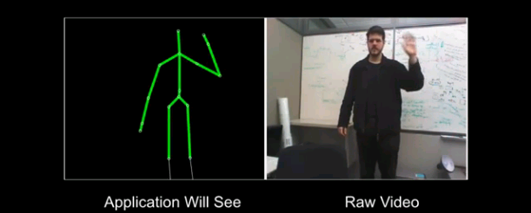
Explaining recognizers: privacy goggles
Visual way to explain information given by each recognizer to an application
Privacy goggles for skeleton recognizer

Slide 18

Recognizer-based AR architecture
App
subscribes to skeleton recognizer
AR platform delivers
recognizer events to app
AR platform
privacy goggles
recognizers

Slide 19
Implementation

Slide 20
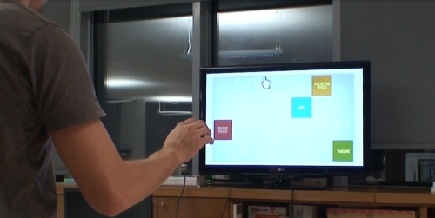
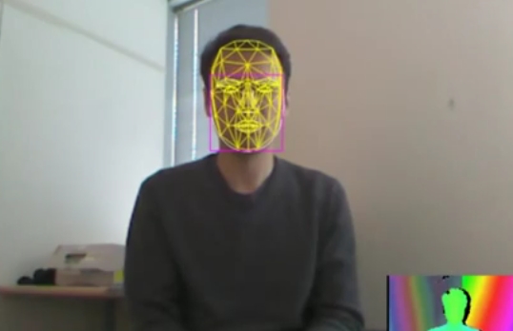
Example applications
Application | What it does | Recognizers
Hand cursor | Control cursor with hand movements | Skeleton
Facial movement detector | Visualize tracked faces | Face detector
Room Scanner | Find flat surfaces | 3D Model, Depth

Slide 21
Evaluation

Slide 22
Evaluation criteria
Privacy: How many applications need access to raw video and sensor data?
Scalability
  Performance of concurrent applications
  Performance of outsourced AR computation
Usability
  Is the information released less sensitive than raw data?
  Do users understand privacy goggles?

Slide 23
Few apps need raw data
Only 4 recognizers cover ~90% of shipping Xbox apps
recognizers used by 87 shipping Xbox Applications

Slide 24
Released information less sensitive
10 surveys with 50 respondents each about recognizer output
Consider the two pictures below. Which picture contains “more sensitive” information?
86% of the users said the left one is more sensitive

Slide 25
Privacy goggles communicate
152 respondents
80% identified that the app could see body position
47% identified that the app could see hand positions

Slide 26
Sharing recognizers works!
> 25 fps for up to 6 apps

Slide 27
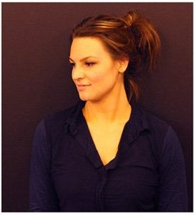
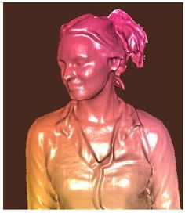

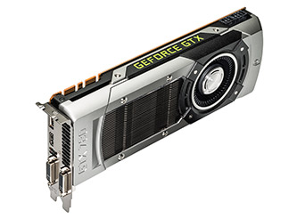

Recognizer offloading
Kinect fusion
recognizer
needs an extremely powerful GPU to run
4.17 fps
doesn’t work
4.46 fps
offloaded recognizer

Slide 28
Minimizing recognizer false positives
Recognizers are not perfect (yet) - false positives can lead to information leakage
AR platforms can apply simple heuristics like combining multiple recognizers to decrease false positives
OpenCV face recognizer
OpenCV face recognizer & Kinect depth filter

Slide 29
Summary
New AR paradigm needs new platform abstractions
Recognizers
  Help in enforcing least privilege
  Allow sharing of computation across apps
  Allow efficient offloading of heavyweight computation
  False positives in recognizers can be dealt using heuristics at the platform level
Privacy goggles - visual permission management

Slide 30
30
Future work
recognize
objects
transform
  tons of exciting new stuff!
  come talk to us if interested
render

Slide 31

Thanks!

