Slide 1
Security architecture & engineering: introduction
Suman Jana
Columbia University
*some slides are borrowed from Vitaly Shmatikov and Ari Juels

Slide 2
Course goals
Understand the fundamental principles of security
  What are the common security mechanisms? Why they often go wrong?
  What are the underlying principles behind building secure systems?
  Why building secure systems is hard?

Slide 3
Logistics
No text book but assigned readings from different sources
Grading
  Six programming assignments (54%)
  Midterm (20%)
  Non-cumulative final (20%)
  Class participation (6%)
Class webpage: http://sumanj.info/security_arch.html

Slide 4
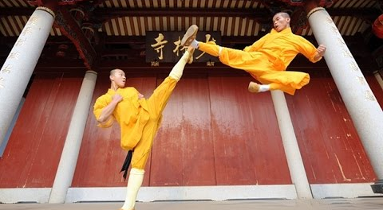
The art of adversarial thinking

Slide 5
What’s adversarial thinking?
“Security requires a particular mindset. Security professionals -- at least the good ones -- see the world differently. They can't walk into a store without noticing how they might shoplift. They can't use a computer without wondering about the security vulnerabilities. They can't vote without trying to figure out how to vote twice. They just can't help it.”
- Bruce Schneier

Slide 6

Adversarial thinking disclaimer
Hopefully, you will learn to think like a criminal mastermind but behave like a gentleman/woman!

Slide 7
Adversarial thinking: key questions
Security goal: what security policy to enforce?
Threat model: who is the adversary? What actions can the adversary perform?
Mechanisms: What security mechanisms can be used to achieve the security goals given the adversarial model

Slide 8
Key security goals
Confidentiality: Data not leaked
Integrity: Data not modified
Availability: Data is accessible when needed
Authenticity: Data origin cannot be spoofed

Slide 9
You can apply adversarial thinking anywhere
Columbia ID cards
  Can you fake an ID card?
ATM machine
  How does the service person gets access to refill it with cash?
MTA metrocard
  Can you increase the card balance without paying?

Slide 10
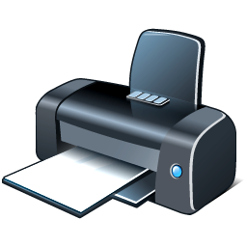
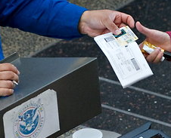
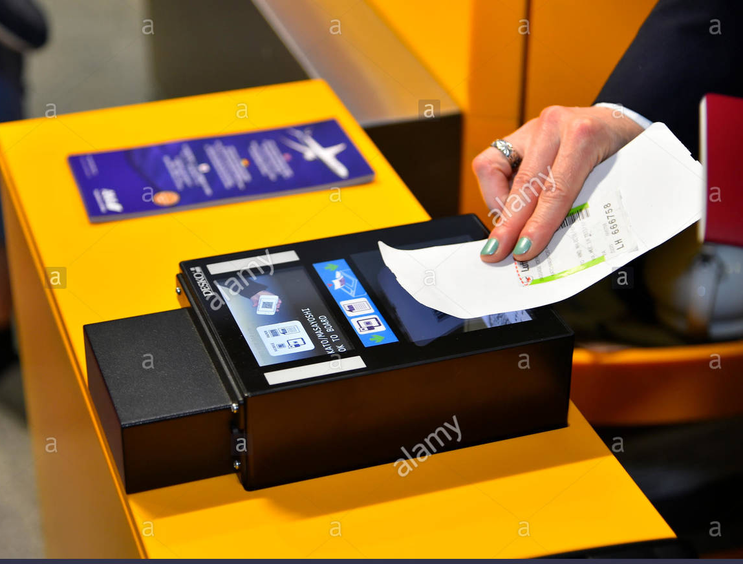
Example: air travel
Print boarding pass at home
ID check by TSA
Boarding pass check at the gate

Slide 11
Adversarial thinking example: air travel
Security goal: Ensure that each person getting inside an airport has a valid boarding pass and is authorized to fly (i.e., not on the no-fly list)
Mechanisms
  TSA checks validity of the ID (e.g., driver’s license) and the boarding pass How?
  TSA matches name in the ID against the name in the boarding pass
  TSA ensures that the name is not on the no-fly list
  Gate agent checks whether the boarding pass is valid and has been checked by TSA How?

Slide 12
Can an attacker who is on the no-fly list fly?

Slide 13
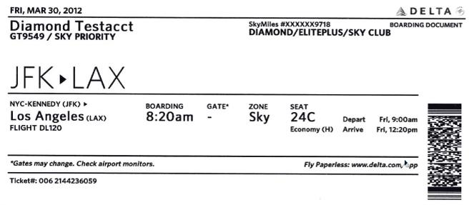
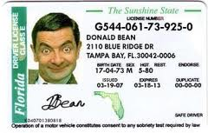
What is the threat model?
Can an attacker create a fake boarding pass?
Can an attacker fake a driver’s license?

Slide 14
Security under different threat models
Security goal: Ensure that each person getting inside an airport has a valid boarding pass and is authorized to fly (i.e., not on the no-fly list)
  What are the minimum requirements for someone to violate this goal in the current TSA system?
  The current TSA system is secure under which threat models?

Slide 15
Not all threat models are equal
Which one is harder and why?
  Creating a fake a boarding pass
  Creating a fake driver’s license

Slide 16
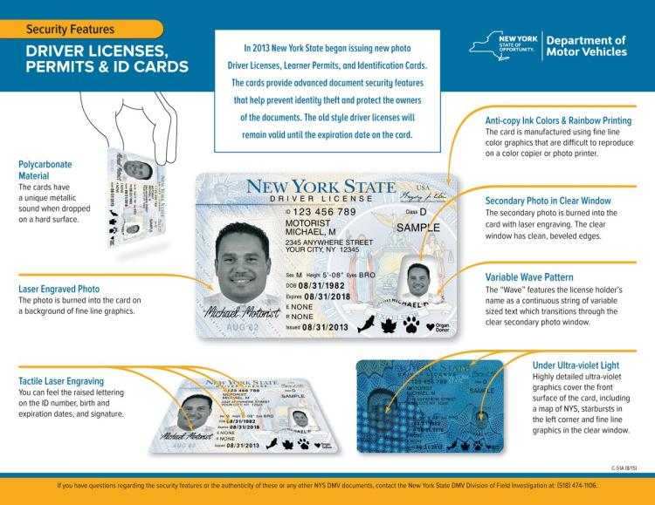
Security measures in a driver’s license?

Slide 17
Security measures in a boarding pass?
Can the barcode be faked?

Slide 18
Air travel revisited: a different security goal
Print boarding pass at home
ID check by TSA
Boarding pass check at the gate
Security goal: everybody boarding an aircraft must pass through TSA security check

Slide 19
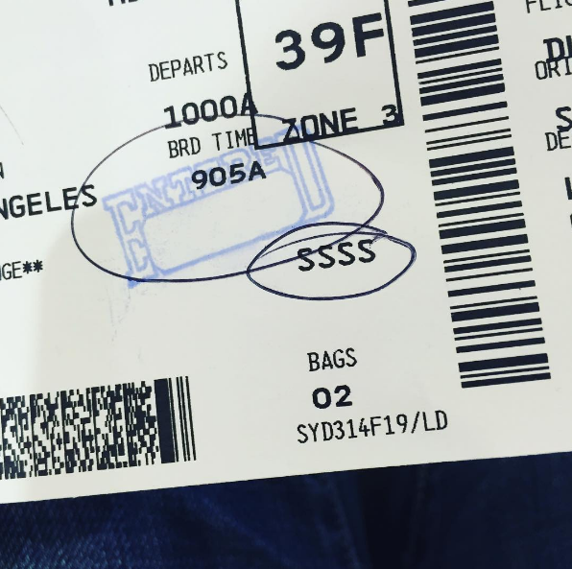
Everybody must go through TSA checks
How does the current TSA system ensure this?
What is an example threat model where this goal can be violated by an attacker?

Slide 20
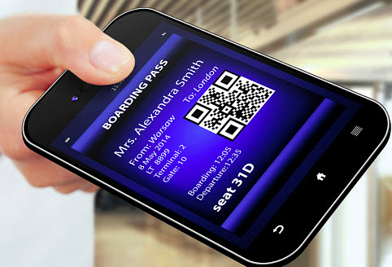
Yet another security goal
Only authorized travelers should be allowed to enter premium lounges
  How will the receptionist at the lounge know who is authorized?

Slide 21
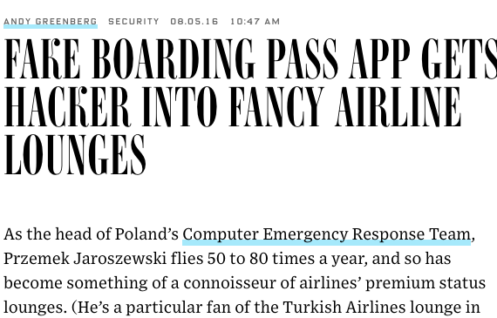
What is the threat model for this attack?
How will you fix it?

Slide 22
What about TSA Pre-Check?
How does TSA Pre-Check work?
  Passengers apply for Pre-Check
  TSA randomly decide whether the passenger is eligible for Pre-Check or not and sends the information back to the Airline.
  The Airline encodes that information in a barcode that is on the issued boarding pass.

Slide 23
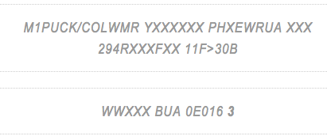
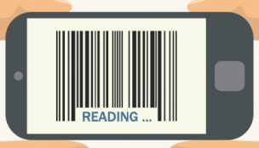
Hacking TSA Pre-Check
1 means no Pre-Check and
3 means Pre-Check
No encryption
Source: https://puckinflight.wordpress.com/2012/10/19/security-flaws-in-the-tsa-pre-check-system-and-the-boarding-pass-check-system/

Slide 24
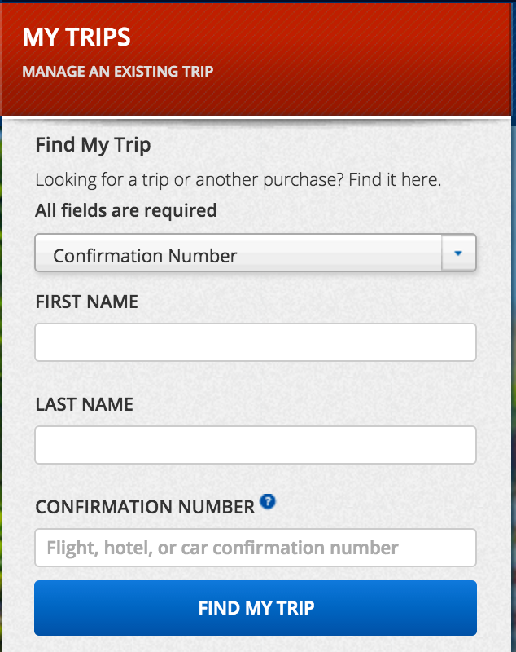
Unintended side-effects of the boarding-pass design
What happens if someone else gets hold of your boarding pass?
All this information is in the boarding pass in cleartext

Slide 25
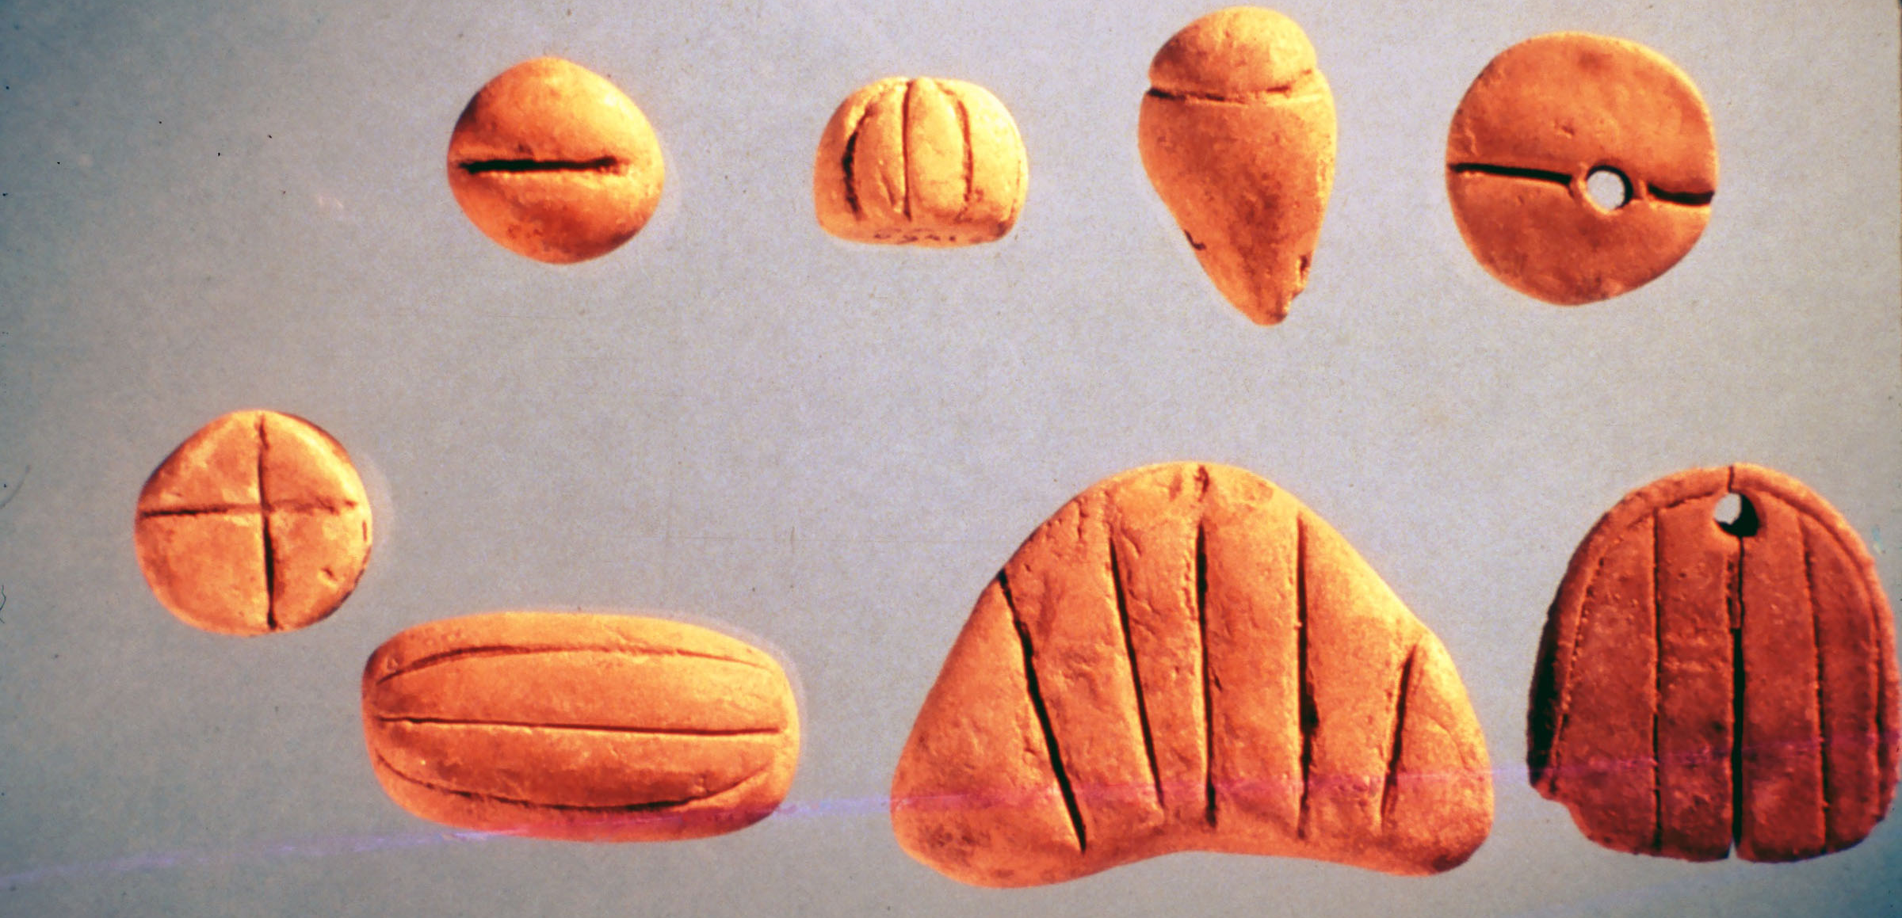
A different setting: money
Counting tokens must be kept in a safe place to prevent tampering
  In a temple or in clay envelopes on shipping routes
How to make counting tokens completely portable for trade?

Slide 26
A different setting: money
Security goals
  Tokens can only be created by a trusted authority
  Authenticity of tokens should be easily verifiable by anyone
Threat model
  Attackers can forge or modify tokens
Clay tokens can be easily forged!

Slide 27
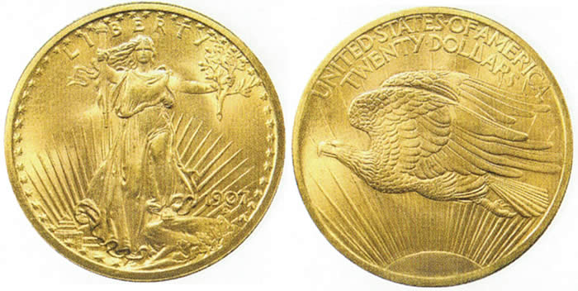
A different setting: money
Coins were introduced around 6/7th century BCE
  Make tokens out of scarce resources(gold and silvers)
  Apply a signature that is hard to copy (depends on the skills of the engravers)
  Harsh penalty for forgers

Slide 28
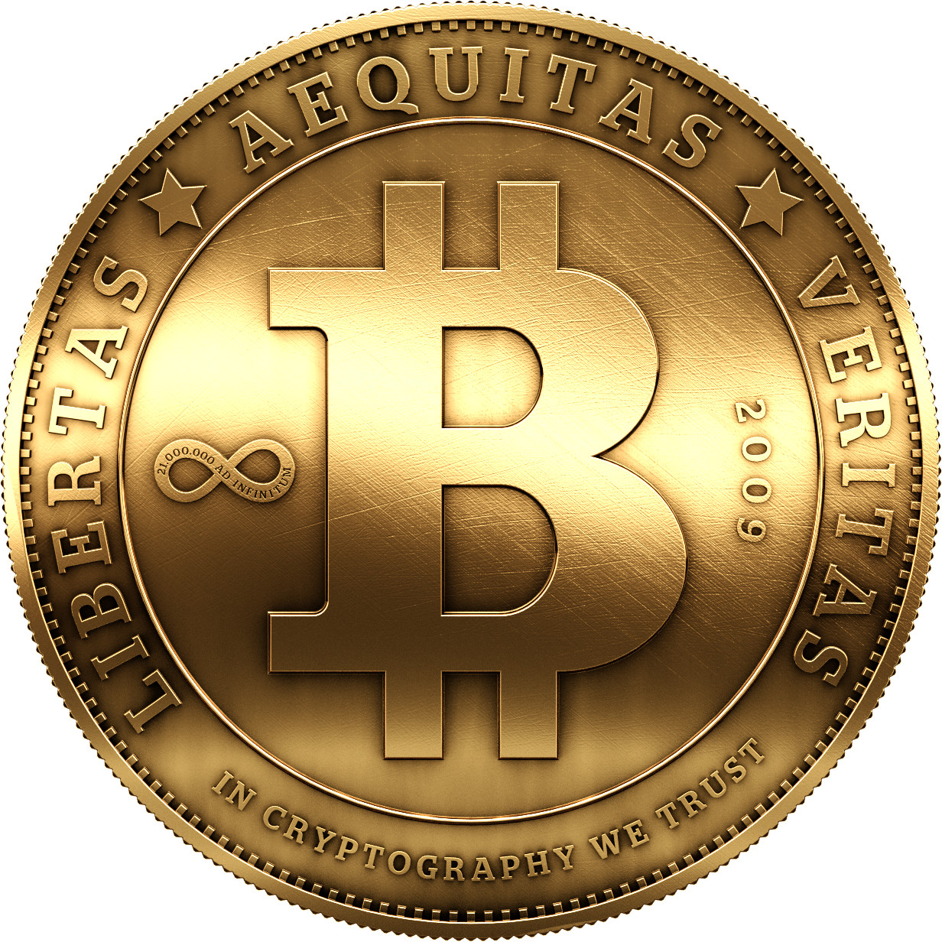
Modern crypto-currencies
Same principles!
  Scarce resource: computation
  Hard-to-forge data: cryptography
  We will talk about bitcoins later in the class

Slide 29
Who is the adversary? depends on who you are

Slide 30
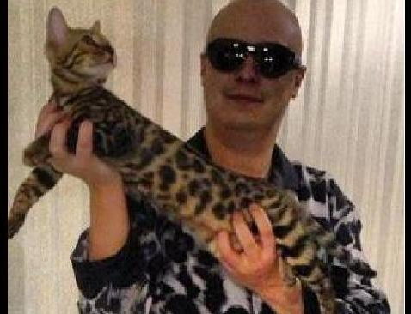
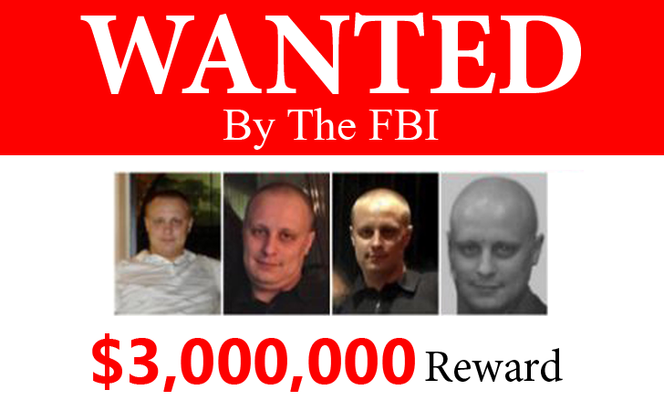
Hackers
Evgeniy Mikhailovich Bogachev
  Gameover Zeus botnet: banking fraud and ransomware distribution

Slide 31
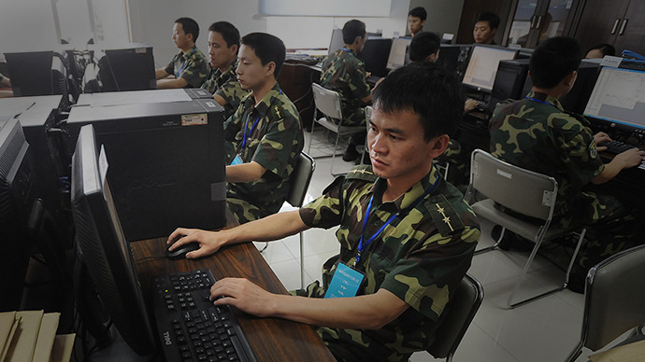
Chinese government
Censorship of materials critical to the current regime
Monitoring dissidents

Slide 32
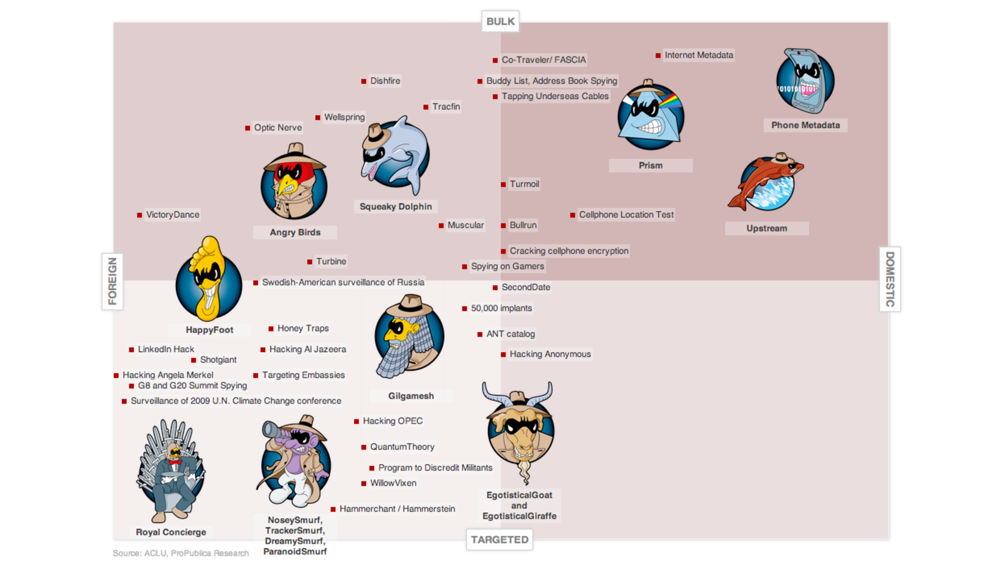
National Security Agency (NSA)

