Slide 1

Formal verification of Neural Networks
Suman Jana*
Assistant Professor
Department of Computer Science, Columbia University
*Joint work with Shiqi Wang, Kexin Pei, Yizheng Chen, Justin Whitehouse, Ahmed Abdou, and Junfeng Yang

Slide 2
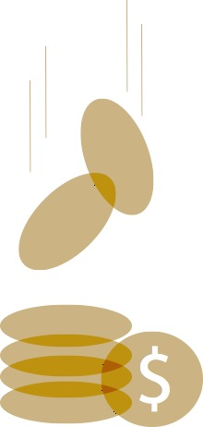
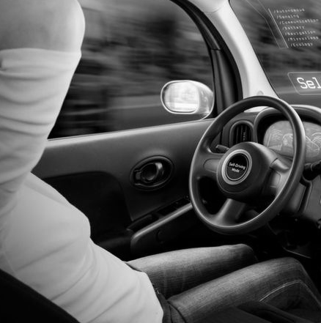

Machine Learning Systems in Security-critical Domains
Huge potential benefits
Autonomous Vehicles
(Tesla, Google, ...)
Unmanned Aircraft Systems
(Navy MQ-4C Triton)

Slide 3
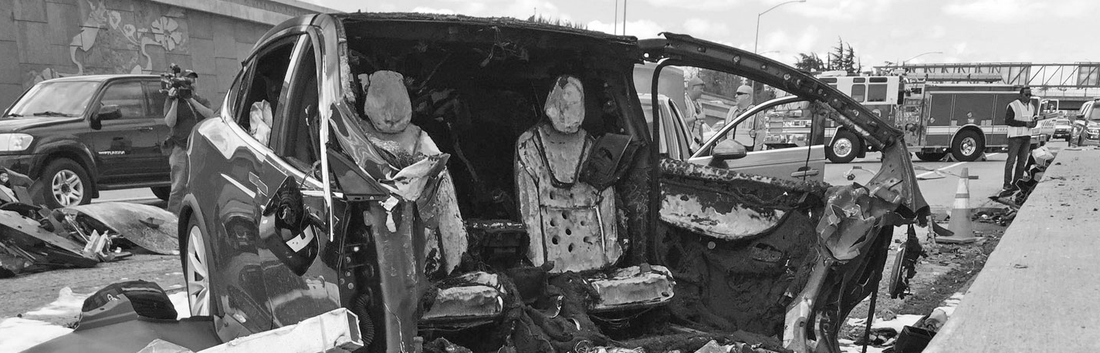
Machine Learning: Safe and Secure?
Tesla Autopilot fatal crash, June 2017
Tesla Autopilot fatal crash, March 2018
Uber fatal crash, June 2018
Not robust or reliable
Danger

Slide 4
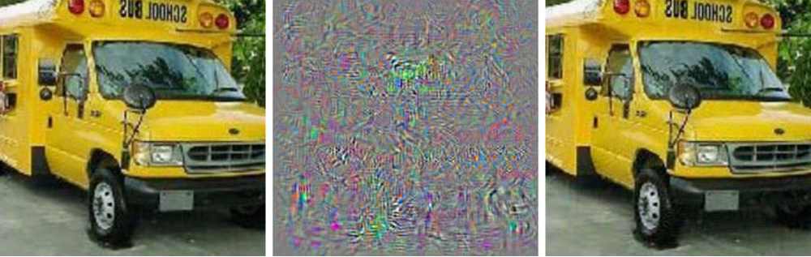
Adversarial Examples
Adversarial examples:
- Minor perturbations will lead to misclassifications with high confidence
An inherent weakness of neural networks
No scalable technique to prove non-existence of adversarial examples
Formal analysis
is urgently needed
Bus
Adversarial Noise
Ostrich

Slide 5


Formal Verification of Neural Networks
Neural Network
Safe
Formal Verification System
Security
Property
Counterexamples

Slide 6
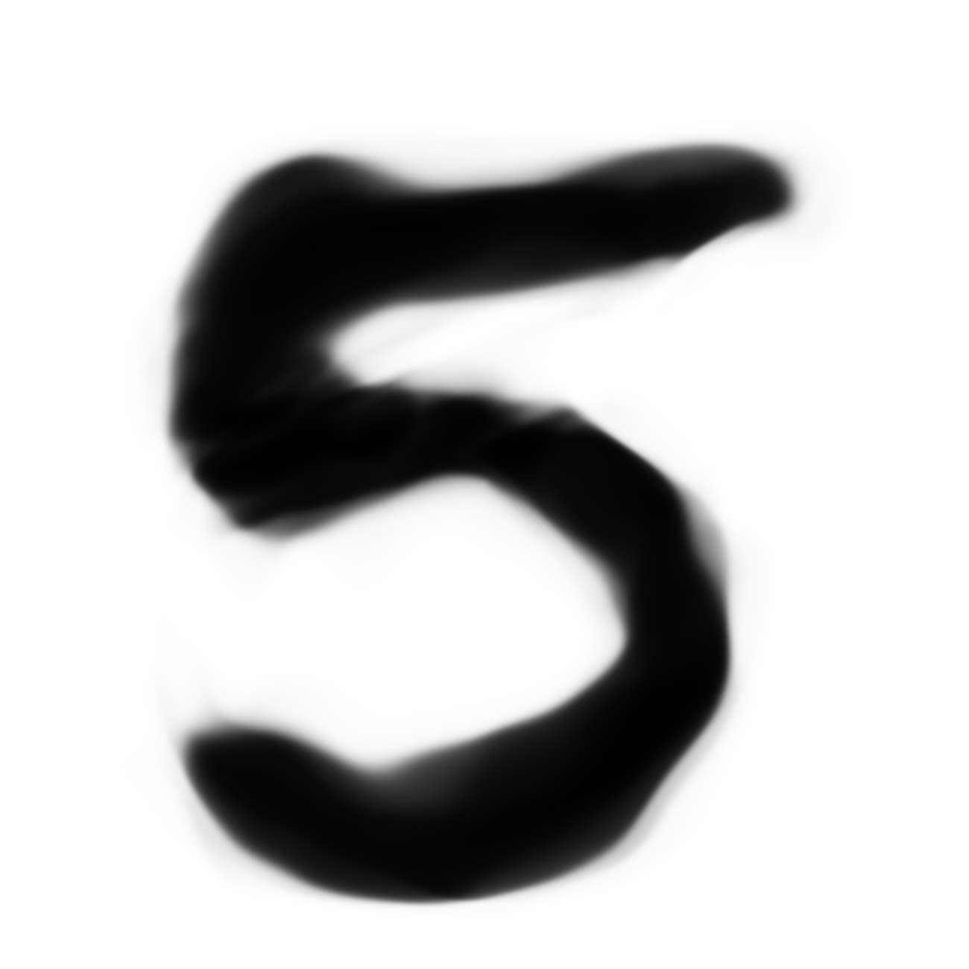
Security Properties
Given a neural network
Given input ranges
- p-norm for images
- Customized ranges
Check output range F
Safe: F satisfies property P
Unsafe: counterexample found
Input layer
Hidden layers
Output layer
X=[x₁, x₂]
x
f
F=[f₁, f₂]
Y=[y₁, y₂]
y
Hard to analyze

Slide 7
Hardness of Formally Bounding Output Ranges
NN without activation functions
- Linear, easy to analyze
- Not very useful in practice
ReLU
- ReLU(x)=max(x,0)
- Two linear pieces
ReLU-based NN
- Outputs are determined by combination of ReLU pieces
- Linear pieces exponentially increase as NN gets larger
x
…
f
…
y
f(x)
d^{n} linear pieces
x
Very expensive to track
all linear pieces

Slide 8
Difference with formal verification of traditional software
Complete specification is not feasible
- Mostly local security properties with respect to an existing dataset (e.g., adversarial perturbations to images in a dataset should not change classifier output)
ML verification can provide verified lower bounds on robustness of a ML model against different attackers
- All perturbations bounded by L_inf norm
- All rotation angles within some bounded range
Generalizability
- Will verified robustness on a test dataset hold for new datasets?
- Machine learning classifiers are already making this assumption for regular accuracy
- Verification is simply leveraging generalizability to provide strong robustness guarantees

Slide 9
Existing Approaches: Customized Solvers
Extend SMT/linear/MILP solvers
- ReluPlex by Katz et al. [CAV’17]
- Sherlock by Dutta et al. [NFMS’18]
Limitations
- High overhead even for simple properties (>hours or days)
- Hard to scale for large networks (<=1000s of ReLU nodes)

Slide 10
Existing Approaches: Relaxation
Over-approximate NN output ranges
- Over-approximate with abstract domain
- Relax to convex optimization problems
Several existing works
- Kolter et al. [ICML’18]
- Gehr et al. [Oakland’18]
- Dvijotham et al. [arXiv:1803:06567]
Drawbacks:
- High false positive rates
- Inefficient at finding concrete violations

Slide 11
We want the best of both worlds!
Efficiently compute sound (i.e., over-approximated) bounds on NN outputs
Iteratively refine the bounds by spending increasingly more computation power
- Ensure that bound soundness is maintained at each step
- Perform cheap, targeted search for counterexamples in each iteration
Support fine-grained trade-off between over-approximation errors and computational effort

Slide 12
Interval Analysis
Sound (always over-approximate output)
Fast bound propagation
- Interval versions of common NN operations (addition and multiplication) are efficient
Easy and efficient refinement through bisection
- Can approximate NN outputs up to any desired precision
- Amenable to highly parallelizable Branch and bound techniques
f(x)
x

Slide 13
Neural network basics (inference)
4.5
1.0
x
y
1
3
4.5*2+1.0*3=12
2
1
Weights
Non-linear
ReLU
If (in>0)
return in
else
return 0
A
B
12
5.5
1
-1
12
f
6.5

Slide 14
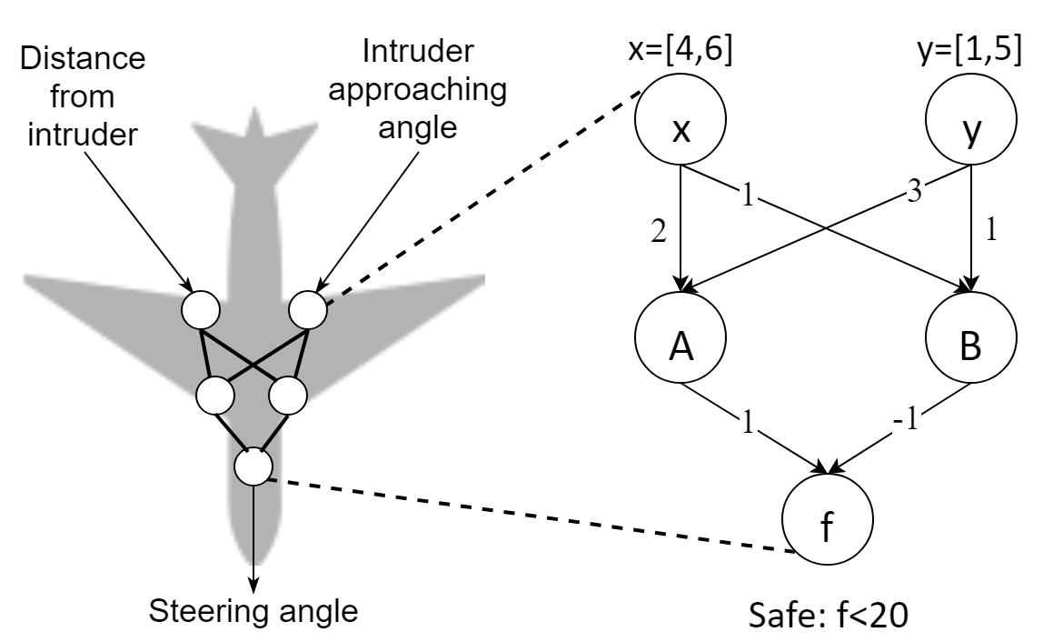
Sample of Naive Interval Analysis
[4,6]
[1,5]
x
y
1
3
2
1
2*[4,6]+3*[1,5]
[5,11]
[11,27]
A
B
[11,27]
[5,11]
1
-1
f
Security property:
input ranges: x=[4,6], y=[1,5]
output: f<20
[0,22]
True security violation?

Slide 15

Ignoring Dependencies Cause Overestimation!
Naive interval:
f = [-1,1] - [-1,1] = [-2,2]
x = [-1,1]
f = x - x = ?
True bound:
f = x – x = [0,0]
Dependency matters

Slide 16
Symbolic Interval Analysis
Symbolic interval [Eq_{low}, Eq_{up}]
- Symbolic linear upper and lower bound equations for each ReLU in terms of inputs
Tighter output approximation
- Track input dependencies
[4,6]
[1,5]
x
x
y
y
1
3
2
1
[11,27]
[5,11]
[2x+3y,2x+3y]
A
B
[x+y,x+y]
[11,27]
[5,11]
-1
1
-
1
1
f
[x+2y,x+2y]
Security property:
input ranges: x=[4,6], y=[1,5]
output: f<20
[6,16]
f is always less than 20
Safe!

Slide 17
Symbolic Interval Analysis is Not Perfect
Concretization
- Only when nonlinearity occurs
- Overestimation
- May have many false positives for large NNs
[4,6]
[1,5]
x
x
y
y
-
1
3
2
5
[11,27]
[-1,16]
A
B
[0,16]
[2x+3y,2x+3y]
[-x+5y,-x+5y]?
[11,27]
[0,16]
-1
1
-
1
1
[2x+3y-16,2x+3y]
f
Security property:
input ranges: x=[4,6], y=[1,5]
output: f<20
[-5,27]
Overestimation

Slide 18
Iterative Interval Refinement with One Bisection
Iterative refinement
- Bisect input ranges
- Compute union of output ranges
- Iteratively refine
Overestimation error decreases as input width becomes smaller
[1,3]
[4,6]
[1,3]U[3,5]
x
y
-
1
3
2
5
[-1,11]
[11,21]
[-1,11]U[9,21]
[11,21]U[17,27]
A
B
[11,21]U[17,27]
[0,11]
[11,21]
[0,11]U[9,21]
-1
1
-
1
1
f
Security property:
input ranges: x=[4,6], y=[1,5]
output: f<20
[0,21]
[0,21]U[-4,18]=[-4,21]
Tighter

Slide 19
Iterative Interval Refinement with Two Bisections
Iterative refinement
- Bisect input ranges
- Compute union of output ranges
- Iteratively refine
Overestimation error decreases as input width becomes smaller
[4,6]
[1,2]U[2,3]U[3,4]U[4,5]
x
y
-
1
3
2
5
…
…
A
B
…
…
-1
1
-
1
1
f
Security property:
input ranges: x=[4,6], y=[1,5]
output: f<20
[5,18]U[3,17]U[1,15]U[0,19]=[3,19]
f is always less than 20
Safe!

Slide 20
Benefits of Iterative Interval Refinement
Highly uneven distribution
- No need to split safe subtrees
- Flexibly refine output based on the property
Iteratively narrow down violating input ranges
- Easily locate counterexamples
Highly parallelizable
- Subtrees are independent
Security property: f<20?
x=[4,6],y=[1,5]
f(x,y)=[5,27]
x=[4,6], y=[3,5]
f(x,y)=[-4,18]
x=[4,6], y=[1,3]
f(x,y)=[0,21]
x=[4,6], y=[3,4]
x=[4,6], y=[1,2]
f(x,y)=[5,18]
x=[4,6], y=[4,5]
x=[4,6], y=[2,3]
f(x,y)=[3,17]

Slide 21
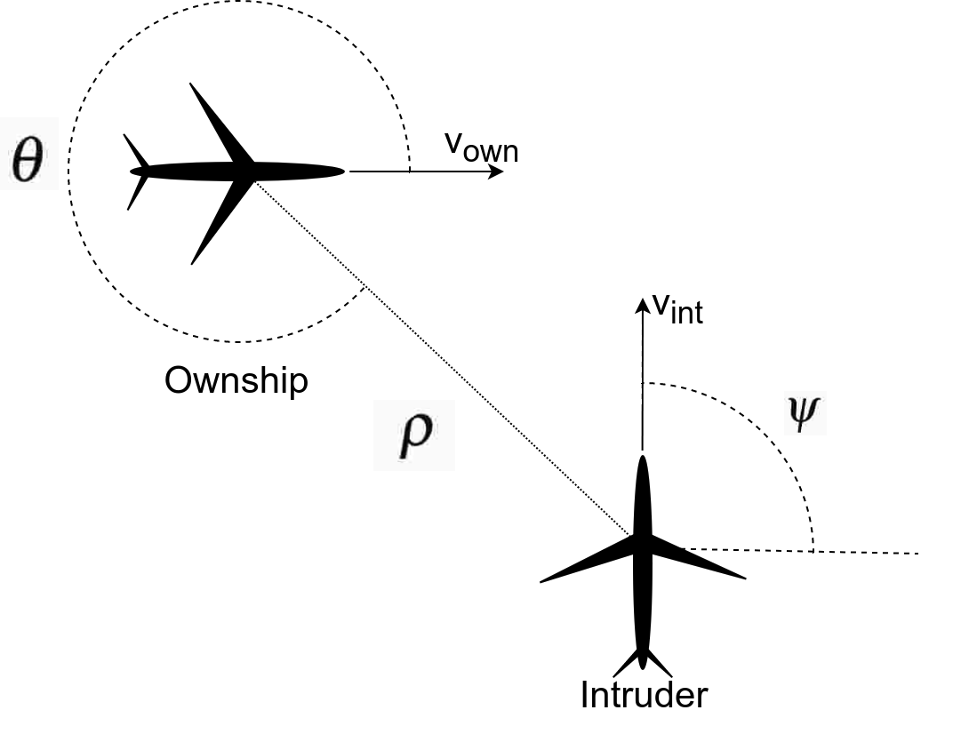
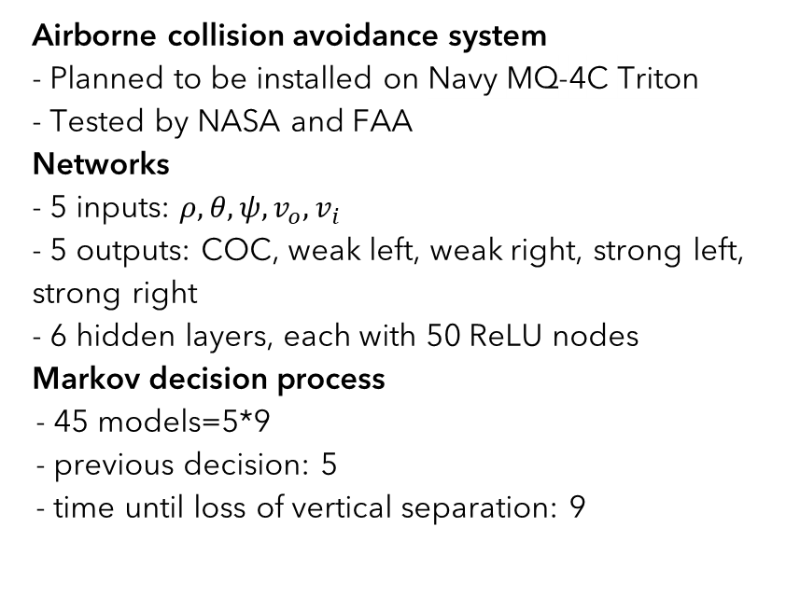
ACAS Xu Models
Airborne collision avoidance system
- Planned to be installed on Navy MQ-4C Triton
- Tested by NASA and FAA
Networks
- 5 inputs: $ρ, θ, ψ, v_{o}, v_{i}$
- 5 outputs: COC, weak left, weak right, strong left, strong right
- 6 hidden layers, each with 50 ReLU nodes
Markov decision process
- 45 models=5*9
- previous decision: 5
- time until loss of vertical separation: 9

Slide 22



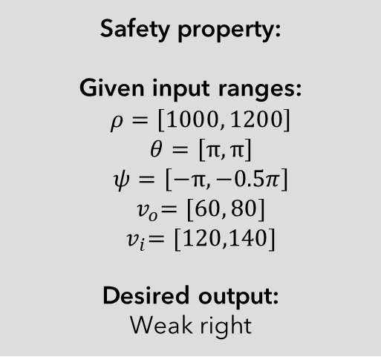






Sample Example of ACAS Xu Safety Properties
Safety property:
Given input ranges:
$$ρ=\left[1000, 1200\right]$$
$$θ=\left[π,π\right]$$
$$ψ=\left[−π,−0.5π\right]$$
$${ v}_{o}=[60, 80]$$
$${ v}_{i}=[120,140]$$
Desired output:
Weak right
$$ρ$$
COC
[4,6]
$$θ$$
Strong Right
[5,7]
$$ψ$$
…
…
…
…
Strong left
[5,8]
$$v_{o}$$
Weak right
[0,3]
$$v_{i}$$
Weak left
[7,9]
Verified safe!

Slide 23
ReluVal vs. Reluplex on ACAS Xu
Source | Networks | Reluplex Time (sec) | ReluVal Time (sec) | Speedup
10 Security Properties Proposed by Guy Katz et al. | 45 | >443,560.73 | 14,603.27 | >30x
 | 34 | 123,420.40 | 117,243.26 | 1x
 | 42 | 35,040.28 | 19,018.90 | 2x
 | 42 | 13,919.51 | 441.97 | 32x
 | 1 | 23,212.52 | 216.88 | 107x
 | 1 | 220,330.82 | 46.59 | 4729x
 | 1 | >86400.0 | 9,240.29 | >9x
 | 1 | 43,200.01 | 40.41 | 1069x
 | 1 | 116,441.97 | 15,639.52 | 7x
 | 1 | 23,683.07 | 10.94 | 2165x
5 Additional Security Properties | 1 | 4,394.91 | 27.89 | 158x
 | 1 | 2,556.28 | 0.104 | 24580x
 | 1 | >172,800.0 | 148.21 | >1166x
 | 2 | >172,800.0 | 288.98 | >598x
 | 2 | 31,328.26 | 876.86 | 36x
Over 200 times faster than Reluplex on average

Slide 24
Neurify [NeuRIPS’18]
Use Linear solver together with symbolic interval analysis
Instead of splitting input features, split inputs to intermediate nodes
- Only relaxed neurons can be overestimated
- Fewer nodes are overestimated
- We can split them instead of inputs
Iteratively split overestimated neurons into two linear cases
- Use linear solver to solve these cases separately

Slide 25
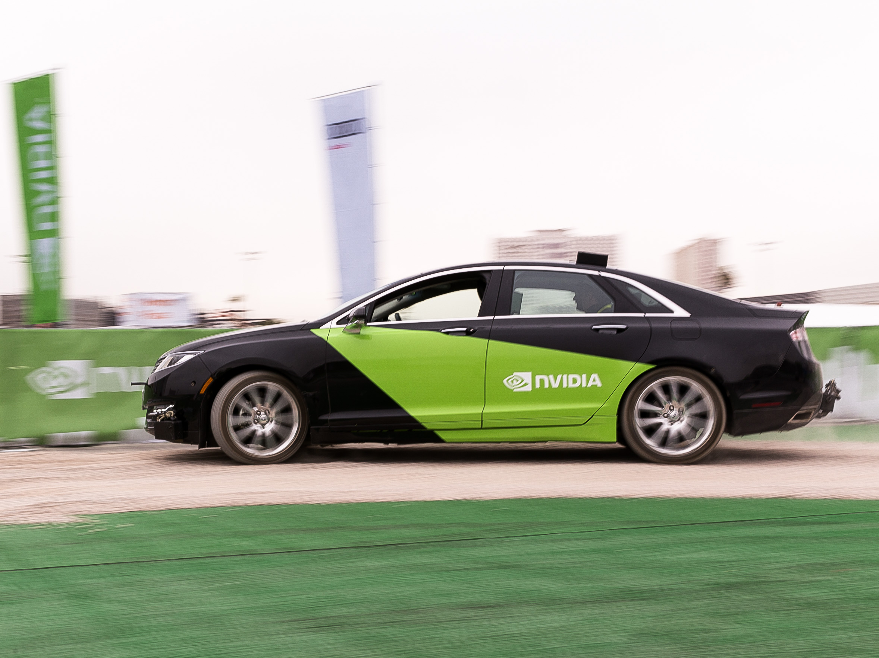
Verification of DAVE Models
DAVE-2 self-driving dataset
- Nvidia end-to-end deep learning for self-driving cars
- Map visual data to steering angles
Convolutional Networks
- 30,000 inputs: raw pixels
- 1 output: steering angle
- Over 10,000 ReLUs
Safety property
- Difference between the predicted steering angle and the ground-truth angle is always less than some threshold

Slide 26
Conclusions and Future Work
Symbolic Interval Analysis is a great tool for verifying NNs
- Efficient and sound over-approximations
- Iterative refinements with bisection
- Can be easily augmented with linear solvers
Exciting new directions
- Use formal verification tools for NNs as part of robust training
- Support verification of complex natural transformations like fog or rain
- Support other activation functions besides ReLUs and other types of networks like RNNs

Slide 27

ReluVal: https://github.com/tcwangshiqi-columbia/ReluVal
Neurify: https://github.com/tcwangshiqi-columbia/Neurify

