Slide 1
Color Tracking

Slide 2
A Quick Overview
Color Representations
Choosing a Color to Track
How to Find the Target

Slide 3
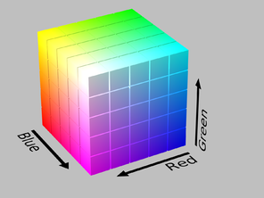
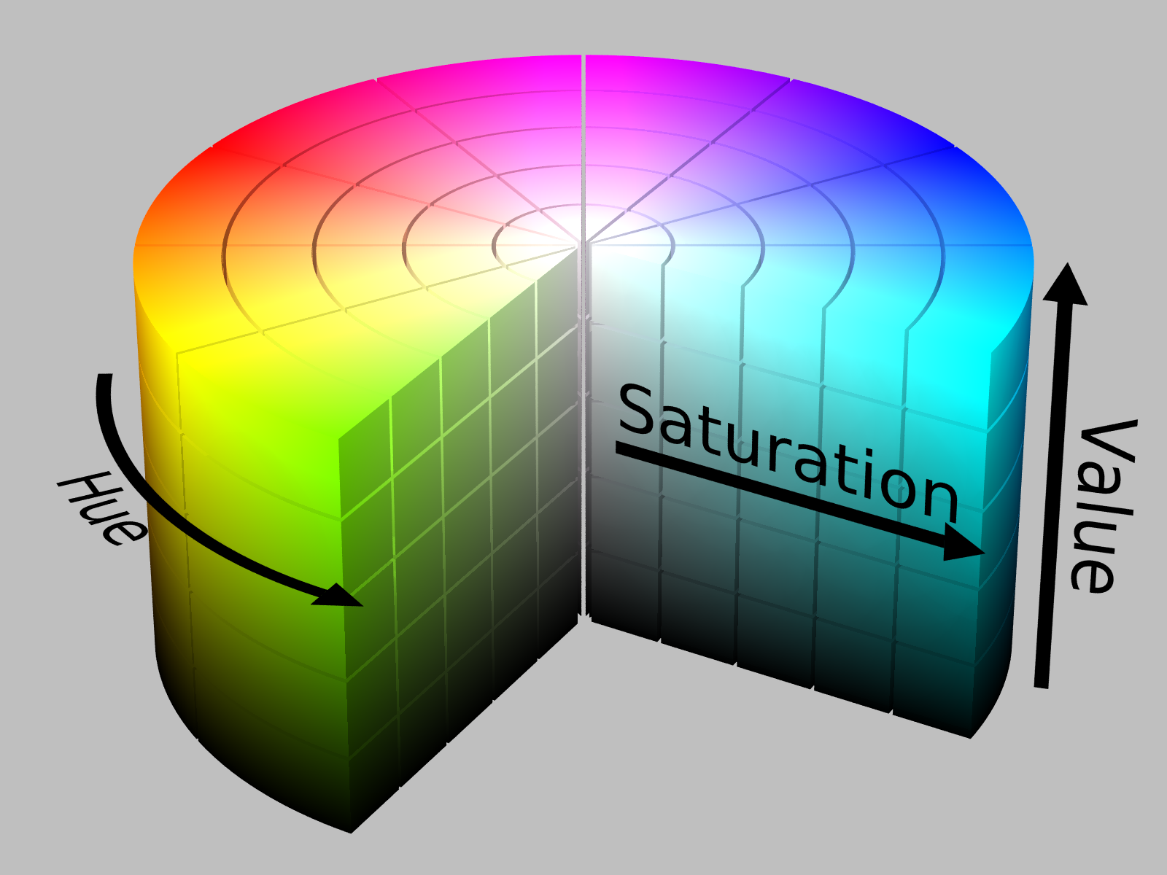
RGB vs HSV
RGB is very sensitive to brightness
HSV (Hue, Saturation, Value) is less sensitive
Color Space Visualizer: http://colorizer.org/

Slide 4
HSV Color Space
Hue: expressed as a number from 0 to 179
Saturation: How "pure" the color is. The closer to 0, the more grey the color looks. Range 0-255
Value: (or Brightness) works in conjunction with saturation and describes the brightness or intensity of the color from 0 to 255.
Color conversion: cv2.cvtColor(input_image, flag)
Where flag determines the type of conversion.
For BGR→Gray, flag is cv2.COLOR_BGR2GRAY
For BGR→HSV, flag is cv2.COLOR_BGR2HSV
Note:
For HSV, Hue range is [0,179], Saturation range is [0,255] and
Value range is [0,255]. You will have to experiment to find the right
settings for your lab.

Slide 5
Convert to HSV, Find HSV values
import cv2
import numpy as np
cap = cv2.VideoCapture(0)
while (1):
# Take each frame
_, frame = cap.read()
# Convert BGR to HSV
hsv = cv2.cvtColor(frame, cv2.COLOR_BGR2HSV)
--------------------------------------------------------------------------------------------
#print out the HSV values for color green
green = np.uint8([[[0,255,0 ]]])
hsv_green = cv2.cvtColor(green,cv2.COLOR_BGR2HSV)
print hsv_green
[[[ 60 255 255]]]

Slide 6
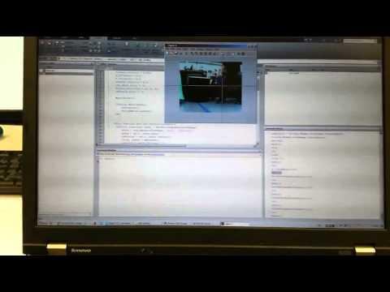
Choosing a Color
Use a patch of pixels to determine target HS values rather than a single pixel.

Slide 7
# Program to use mouse to designate a rectangular
# region on image
import cv2
import numpy as np
def mouseHandler(event,x,y,flags,param):
global im_temp, pts_src
if event == cv2.EVENT_LBUTTONDOWN:
cv2.circle(im_temp,(x,y),3,(0,255,255),5,cv2.LINE_AA)
cv2.imshow("image", im_temp)
if len(pts_src) < 4:
pts_src = np.append(pts_src,[(x,y)],axis=0)
# Open webcam
cap = cv2.VideoCapture(0)
# Capture a frame
ret, frame = cap.read()
# Create a named window
cv2.namedWindow("image",1)
im_temp=frame
pts_src= np.empty((0,2),dtype=np.int32)
cv2.setMouseCallback("image",mouseHandler)
cv2.imshow("image",im_temp)
cv2.waitKey(0)
cv2.destroyAllWindows
print pts_src

Slide 8



Use Morphology to “clean up” image
erode:
The value of the output pixel is the minimum value of all the pixels in the input pixel's neighborhood
dilate:
The value of the output pixel is the
maximum value of all the pixels in the
input pixel's neighborhood
Tutorial: https://docs.opencv.org/3.0-beta/doc/py_tutorials/py_imgproc/py_morphological_ops/py_morphological_ops.html

Slide 9
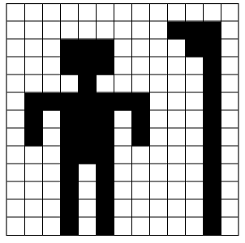
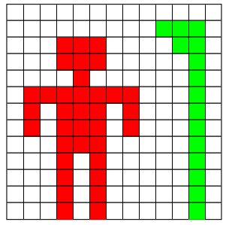

Connected-Component Labeling (a.k.a. Blob Extraction)

Slide 10
Finding the Target-Pseudocode
def get_target(hsv_image):
#get pixels within threshold of target patch
masked_image = mask_image(hsv_image, h_thresh, s_thresh, v_thresh)
#morphologically erode and dilate the image
eroded_image = erosion_filter(masked_image)
cleaned_image = dilate_filter(erodeed_image)
#find the largest connected component (largest blob)
big_blob = get_largest_blob(cleaned_image)
# Compute centroid and area of big_blob to move the robot forward, back, left,, right
centroid = get_centroid(big_blob)
area = get_area(big_blob)
return centroid, area

Slide 11
Center the Target
Move Forward/Backward based on Target Area (i.e. distance to Target)
Turn left/right to center the Target's Centroid. Amount to rotate a function of distance to target
Demo Video
Demo2 Video

