Slide 1
Hough Transform
COMS 4733
Computational Aspect of Robotics
Many slides from James Hays, Kristen Grauman, Derek Hoiem, Lana Lazebnik, Steve Seitz, David Forsyth, David Lowe, Fei-Fei Li

Slide 2
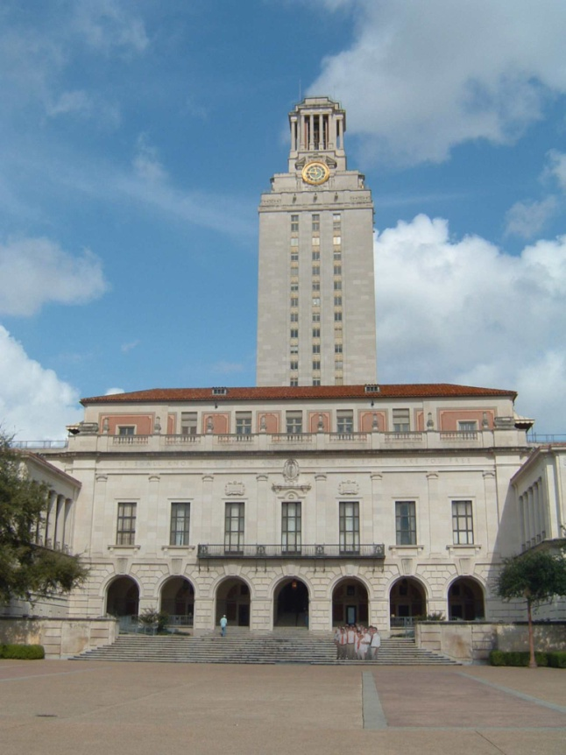
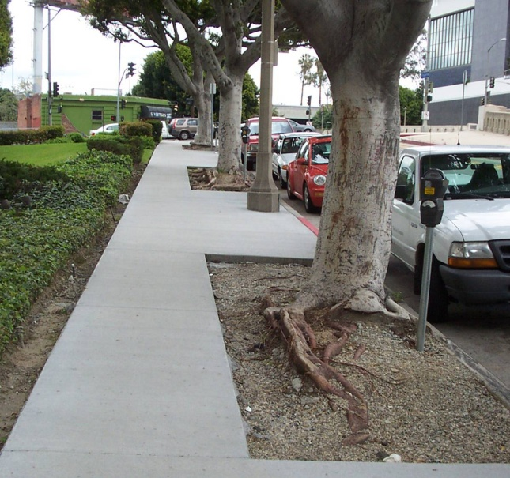
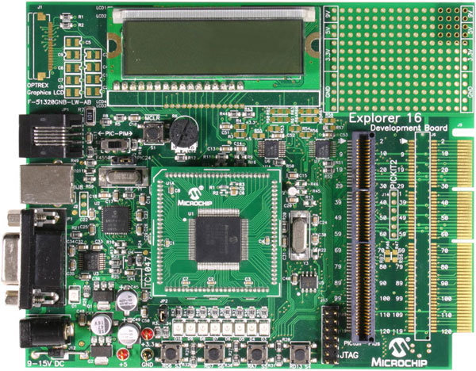
Example: Line fitting
Why fit lines?
Many objects characterized by presence of straight lines
Wait, why aren’t we done just by running edge detection?
Kristen Grauman

Slide 3
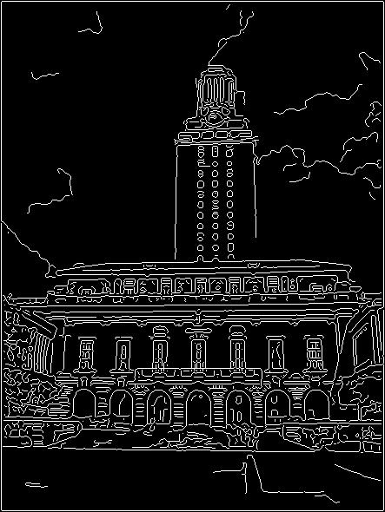
Difficulty of line fitting
Extra edge points (clutter), multiple models:
  which points go with which line, if any?
Only some parts of each line detected, and some parts are missing:
  how to find a line that bridges missing evidence?
Noise in measured edge points, orientations:
  how to detect true underlying parameters?
Kristen Grauman

Slide 4
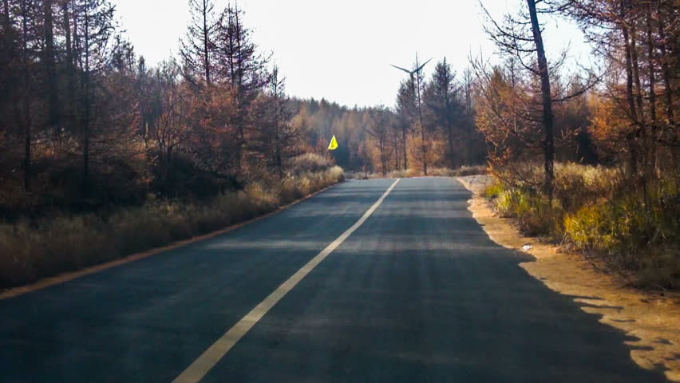
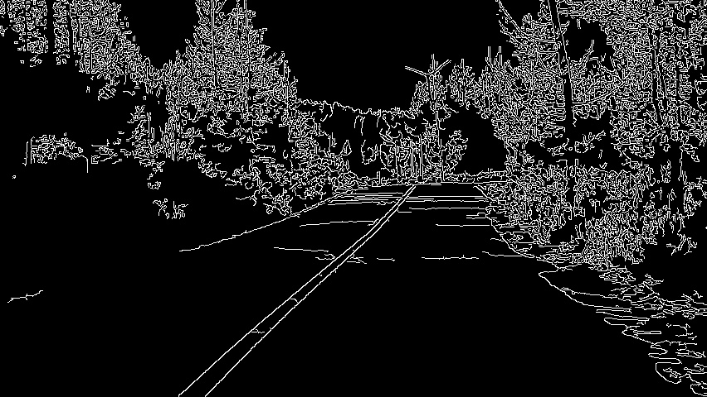
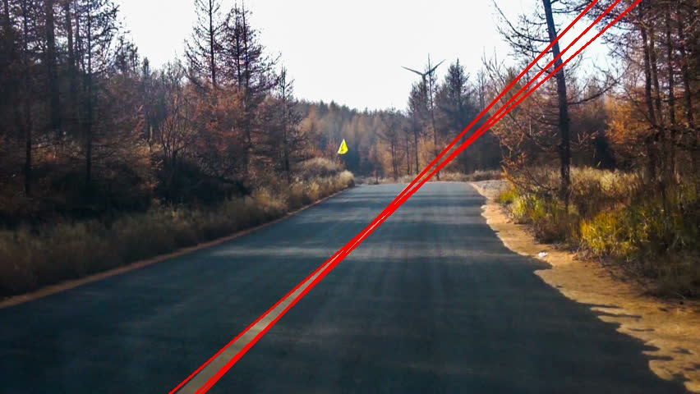
Autonomous
Driving
Want prominent
Lines, not noisy edges

Slide 5
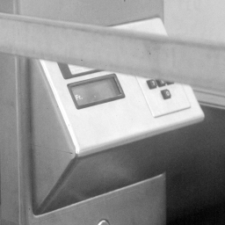
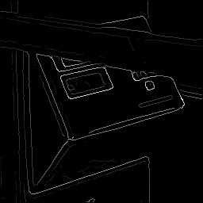
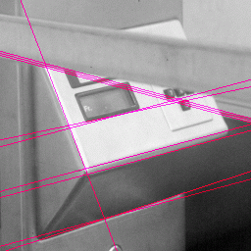
Fitting lines: Hough transform
Given points that belong to a line, what is the line?
How many lines are there?
Which points belong to which lines?
Hough Transform is a voting technique that can be used to answer all of these questions.
  Main idea:
  1. Record vote for each possible line on which each edge point lies.
  2. Look for lines that get many votes.
Kristen Grauman

Slide 6
Voting
It’s not feasible to check all combinations of features by fitting a model to each possible subset.
Voting is a general technique where we let the features vote for all models that are compatible with it.
  Cycle through features, cast votes for model parameters.
  Look for model parameters that receive a lot of votes.
Noise & clutter features will cast votes too, but typically their votes should be inconsistent with the majority of “good” features.
Kristen Grauman

Slide 7
Hough transform
An early type of voting scheme
General outline:
  Discretize parameter space into bins
  For each feature point in the image, put a vote in every bin in the parameter space that could have generated this point
  Find bins that have the most votes
Image space
Hough parameter space
P.V.C. Hough, Machine Analysis of Bubble Chamber Pictures, Proc. Int. Conf. High Energy Accelerators and Instrumentation, 1959

Slide 8

Finding lines in an image: Hough space
y
b
b₀
x
m₀
m
image space
Hough (parameter) space
Connection between image (x,y) and Hough (m,b) spaces
  A line in the image corresponds to a point in Hough space
  To go from image space to Hough space:
    given a set of points (x,y), find all (m,b) such that y = mx + b
Slide credit: Steve Seitz

Slide 9

Finding lines in an image: Hough space
y
b
y₀
x₀
x
m
image space
Hough (parameter) space
Connection between image (x,y) and Hough (m,b) spaces
  A line in the image corresponds to a point in Hough space
  To go from image space to Hough space:
    given a set of points (x,y), find all (m,b) such that y = mx + b
  What does a point (x₀, y₀) in the image space map to?
    Answer: the solutions of b = -x₀m + y₀
    this is a line in Hough space
Slide credit: Steve Seitz

Slide 10
Finding lines in an image: Hough space
y
b
(x₁, y₁)
y₀
(x₀, y₀)
b = –x₁m + y₁
x₀
x
m
image space
Hough (parameter) space
What are the line parameters for the line that contains both (x₀, y₀) and (x₁, y₁)?
  It is the intersection of the lines b = –x₀m + y₀ and
  b = –x₁m + y₁

Slide 11
Finding lines in an image: Hough algorithm
y
b
x
m
image space
Hough (parameter) space
How can we use this to find the most likely parameters (m,b) for the most prominent line in the image space?
Let each edge point in image space vote for a set of possible parameters in Hough space
Accumulate votes in discrete set of bins; parameters with the most votes indicate line in image space.

Slide 12
Polar representation for lines
Issues with usual (m,b) parameter space: can take on infinite values, undefined for vertical lines.
Image columns
[0,0]
: perpendicular distance from line to origin
: angle the perpendicular makes with the x-axis
Image rows
Point in image space → sinusoid segment in Hough space
Kristen Grauman

Slide 13
Hough transform algorithm
Using the polar parameterization:
Basic Hough transform algorithm
  Initialize H[d, θ]=0
  for each edge point I[x,y] in the image
    for θ = [θ_{min} to θ_{max} ] // some quantization
      H[d, θ] += 1
  Find the value(s) of (d, θ) where H[d, θ] is maximum
  The detected line in the image is given by
H: accumulator array (votes)
d
θ
Time complexity (in terms of number of votes per pt)?
Source: Steve Seitz

Slide 14
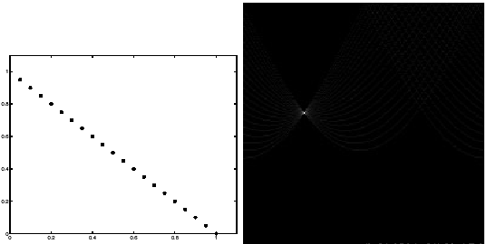
Basic illustration
features
votes
Notes:
Figure 15.1, top half. Note that most points in the vote array are very dark, because they
get only one vote.

Slide 15
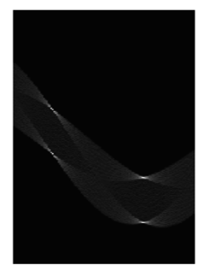
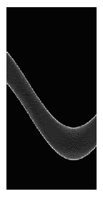
Other shapes
Square
Circle

Slide 16

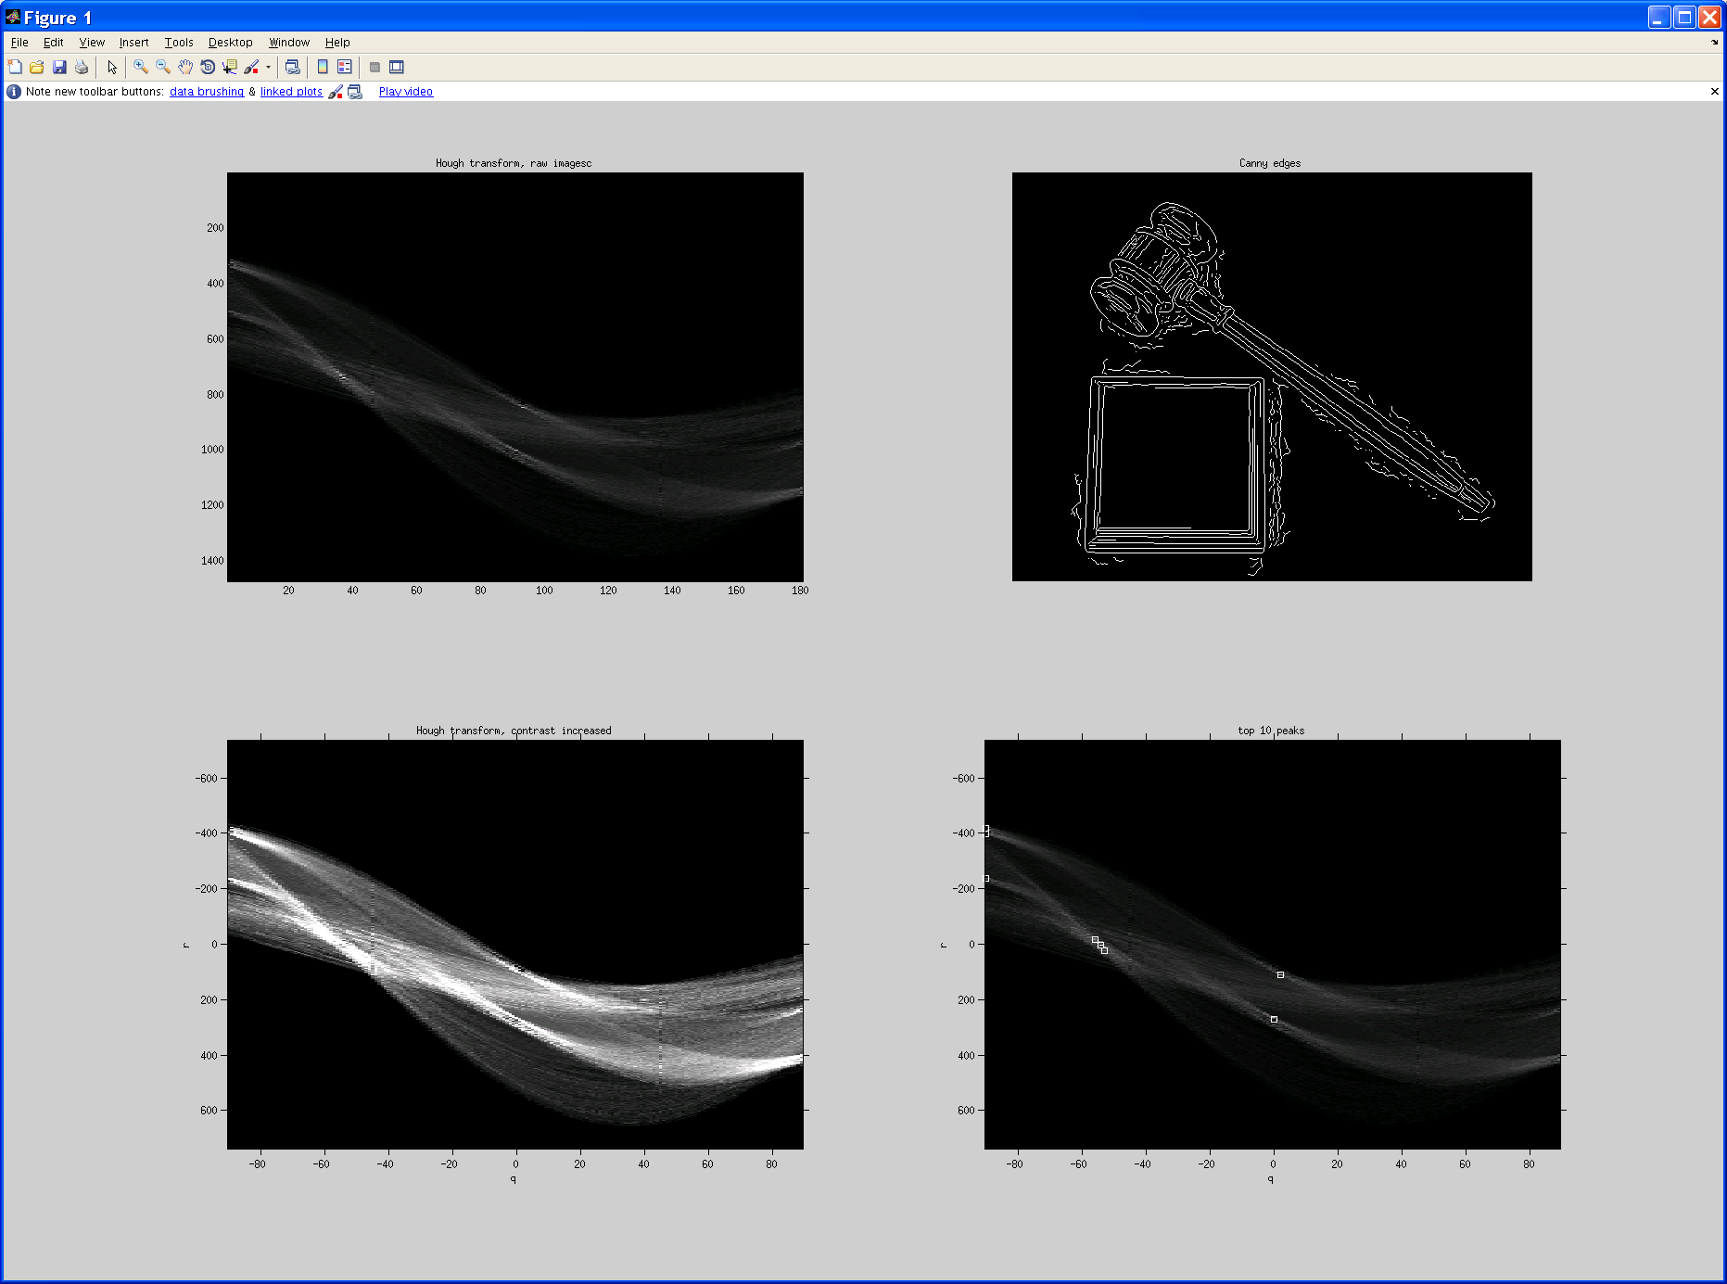
Original image
Canny edges
Vote space and top peaks
Kristen Grauman

Slide 17
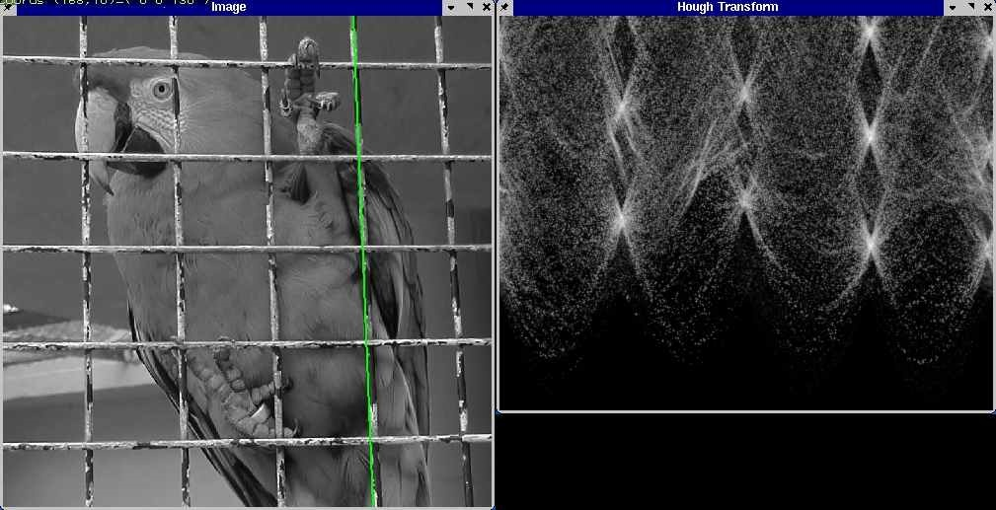
A more complicated image
http://ostatic.com/files/images/ss_hough.jpg

Slide 18
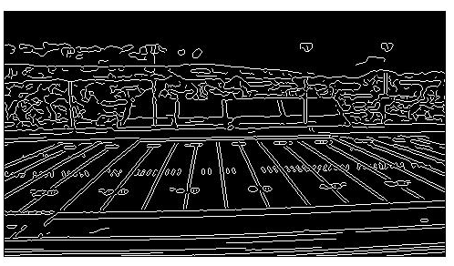
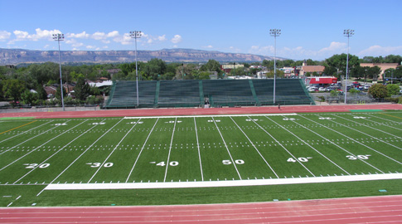
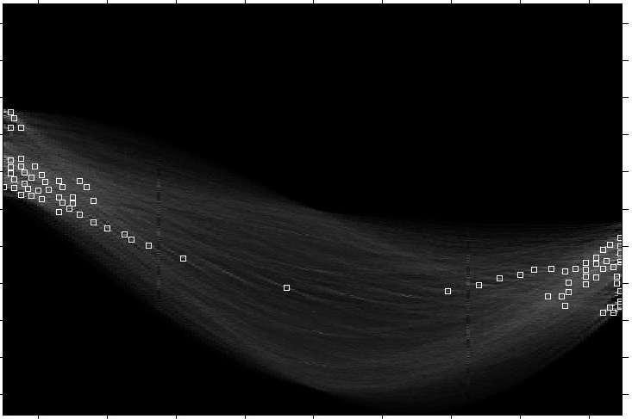
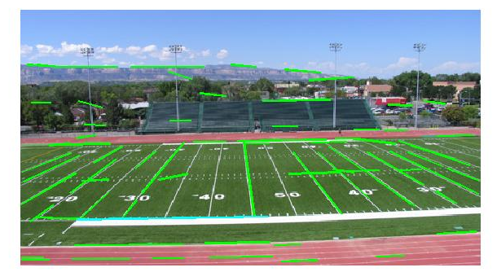
Showing longest segments found
Kristen Grauman

Slide 19
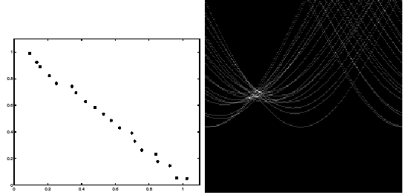
Impact of noise on Hough
y
d
x
θ
Image space
edge coordinates
Votes
What difficulty does this present for an implementation?

Slide 20
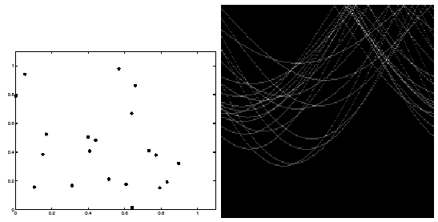
Impact of noise on Hough
Image space
edge coordinates
Votes
Here, everything appears to be “noise”, or random edge points, but we still see peaks in the vote space.

Slide 21
Effect of noise
features
votes
Notes:
This is 15.1 lower half

Slide 22
Effect of noise
features
votes
Peak gets fuzzy and hard to locate
Notes:
This is 15.1 lower half

Slide 23
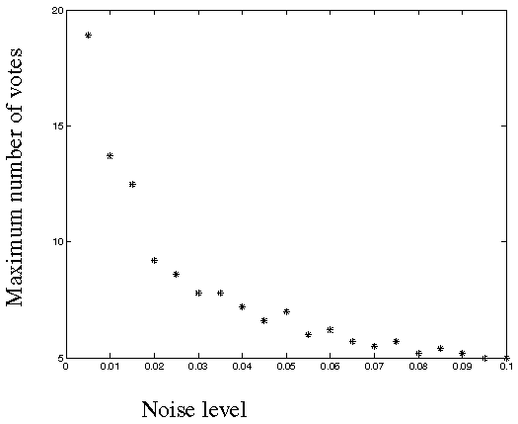
Effect of noise
Number of votes for a line of 20 points with increasing noise:
Notes:
This is the number of votes that the real line of 20 points gets with increasing noise (figure15.3)

Slide 24
Random points
features
votes
Uniform noise can lead to spurious peaks in the array
Notes:
15.2; main point is that lots of noise can lead to large peaks in the array

Slide 25
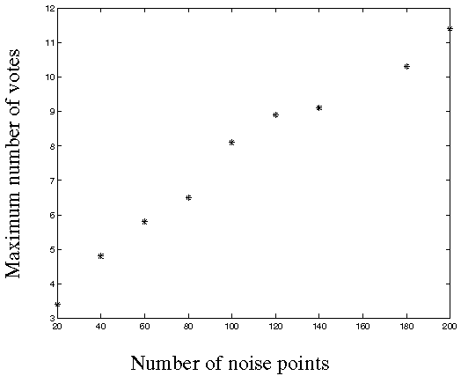
Random points
As the level of uniform noise increases, the maximum number of votes increases too:
Notes:
Figure 15.4; as the noise increases in a picture without a line, the number of points in the max cell goes
up, too

Slide 26
Dealing with noise
Choose a good grid / discretization
  Too coarse: large votes obtained when too many different lines correspond to a single bucket
  Too fine: miss lines because some points that are not exactly collinear cast votes for different buckets
Increment neighboring bins (smoothing in accumulator array)
Try to get rid of irrelevant features
  Take only edge points with significant gradient magnitude

Slide 27
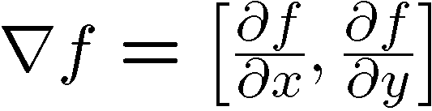
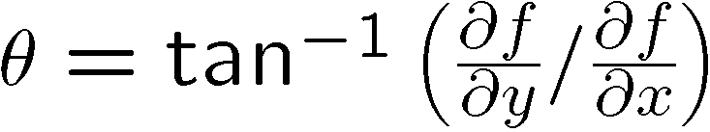
Incorporating image gradients
Recall: when we detect an
edge point, we also know its
gradient direction
But this means that the line
is uniquely determined!
Modified Hough transform:
For each edge point (x,y)
θ = gradient orientation at (x,y)
ρ = x cos θ + y sin θ
H(θ, ρ) = H(θ, ρ) + 1
end

Slide 28
Extensions
Extension 1: Use the image gradient
  same
  for each edge point I[x,y] in the image
    compute unique (d, θ) based on image gradient at (x,y)
      H[d, θ] += 1
  same
  same
(Reduces degrees of freedom)
Extension 2
  give more votes for stronger edges (use magnitude of gradient)
Extension 3
  change the sampling of (d, θ) to give more/less resolution
Extension 4
  The same procedure can be used with circles, squares, or any other shape…
Source: Steve Seitz

Slide 29
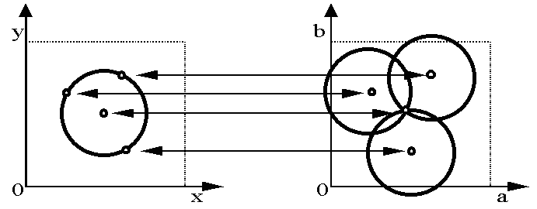
Hough transform for circles
Circle: center (a,b) and radius r
For a fixed radius r, unknown gradient direction
Image space
Hough space
Kristen Grauman

Slide 30
Hough transform for circles
Circle: center (a,b) and radius r
For a fixed radius r, unknown gradient direction
Intersection: most votes for center occur here.
Image space
Hough space
Kristen Grauman

Slide 31
Hough transform for circles
Circle: center (a,b) and radius r
For an unknown radius r, unknown gradient direction
r
?
b
a
Image space
Hough space
Kristen Grauman

Slide 32
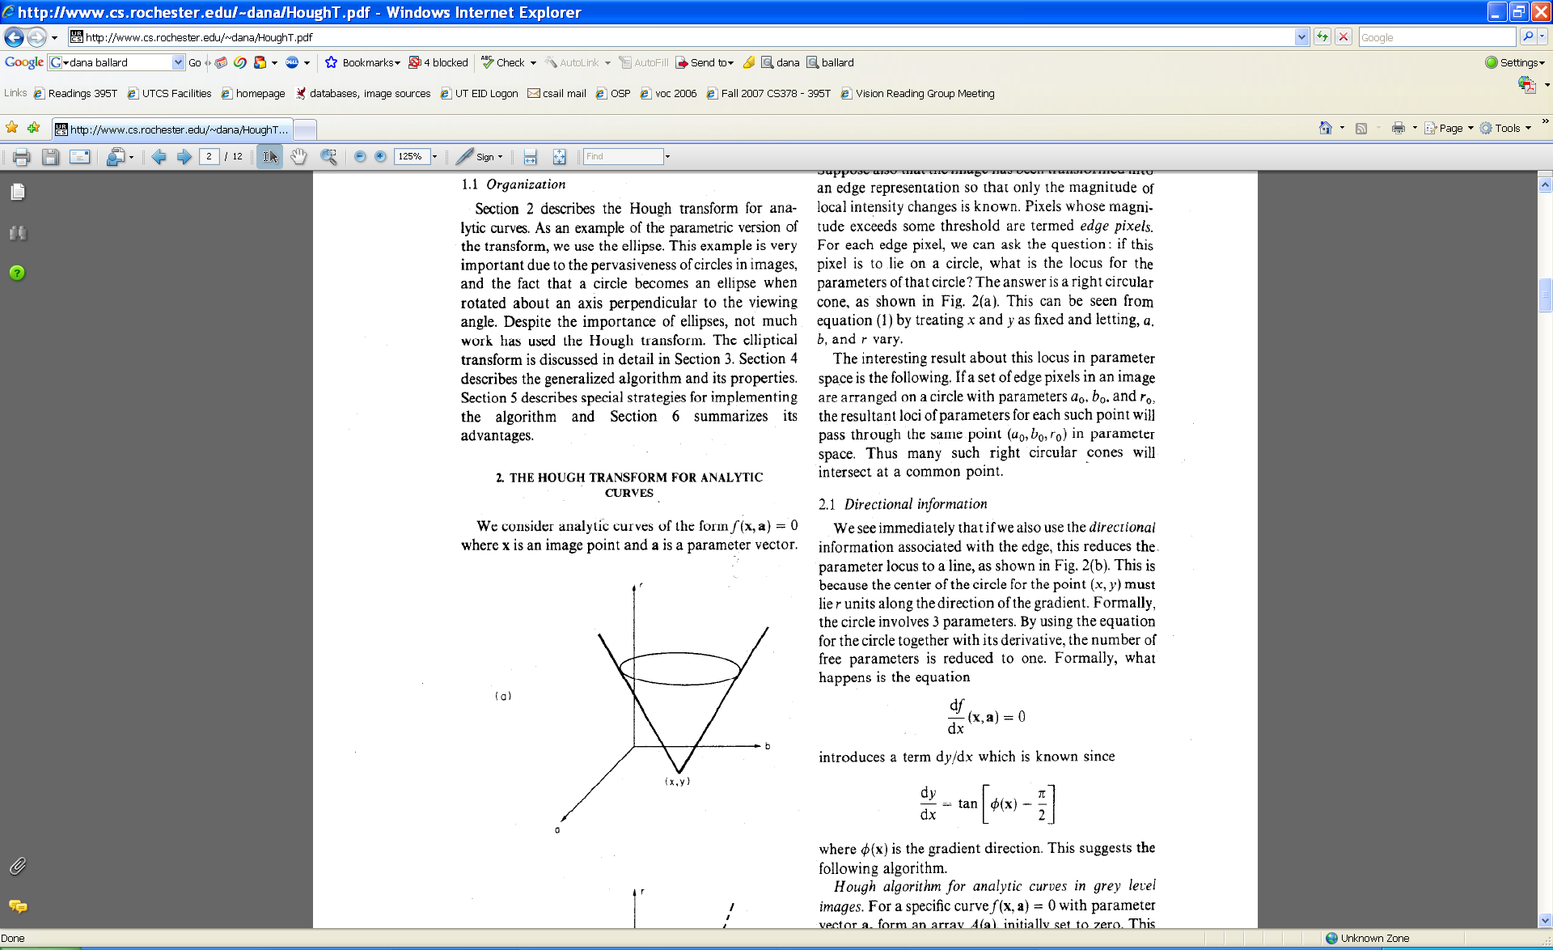
Hough transform for circles
Circle: center (a,b) and radius r
For an unknown radius r, unknown gradient direction
r
b
a
Image space
Hough space
Kristen Grauman

Slide 33
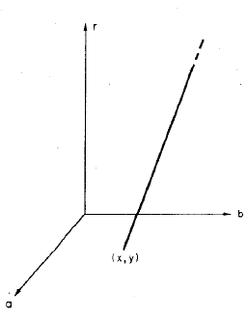
Hough transform for circles
Circle: center (a,b) and radius r
For an unknown radius r, known gradient direction
x
θ
Image space
Hough space
Kristen Grauman

Slide 34
Hough transform for circles
For every edge pixel (x,y) :
For each possible radius value r:
For each possible gradient direction θ:
// or use estimated gradient at (x,y)
a = x – r cos(θ) // column
b = y + r sin(θ) // row
H[a,b,r] += 1
end
end
Time complexity per edgel?
Check out online demo : http://www.markschulze.net/java/hough/
Kristen Grauman

Slide 35
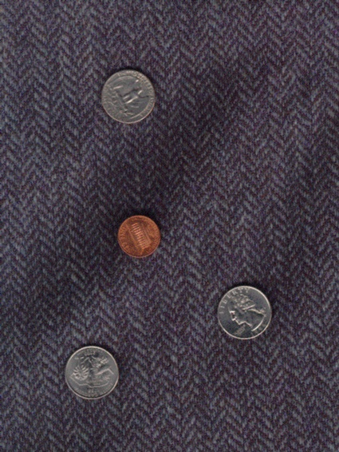
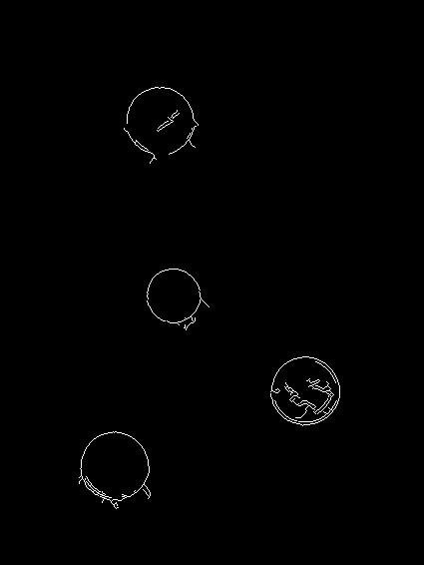
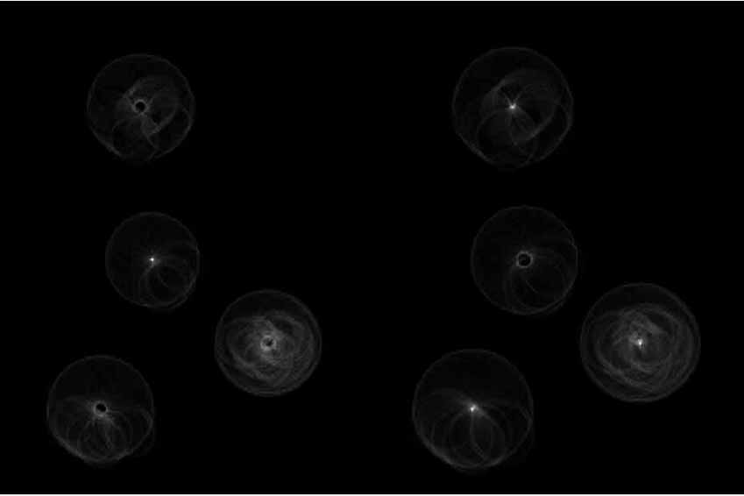
Example: detecting circles with Hough
Original
Edges
Votes: Penny
Note: a different Hough transform (with separate accumulators) was used for each circle radius (quarters vs. penny).

Slide 36
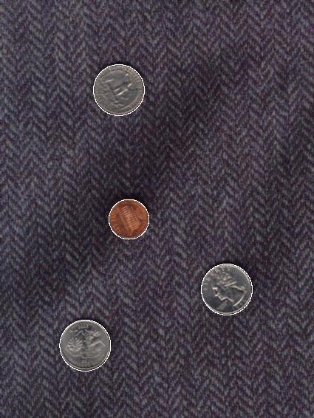
Example: detecting circles with Hough
Original
Combined detections
Edges
Votes: Quarter
Coin finding sample images from: Vivek Kwatra

Slide 37
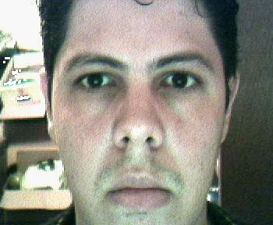
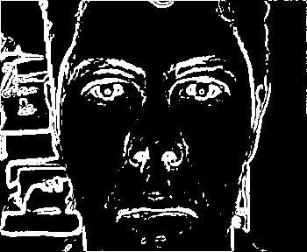
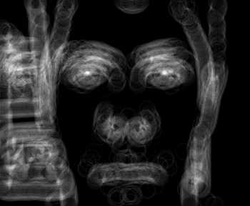

Example: iris detection
Gradient+threshold
Hough space (fixed radius)
Max detections
Hemerson Pistori and Eduardo Rocha Costa http://rsbweb.nih.gov/ij/plugins/hough-circles.html
Kristen Grauman

Slide 38
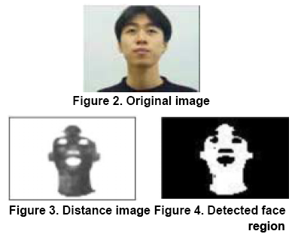
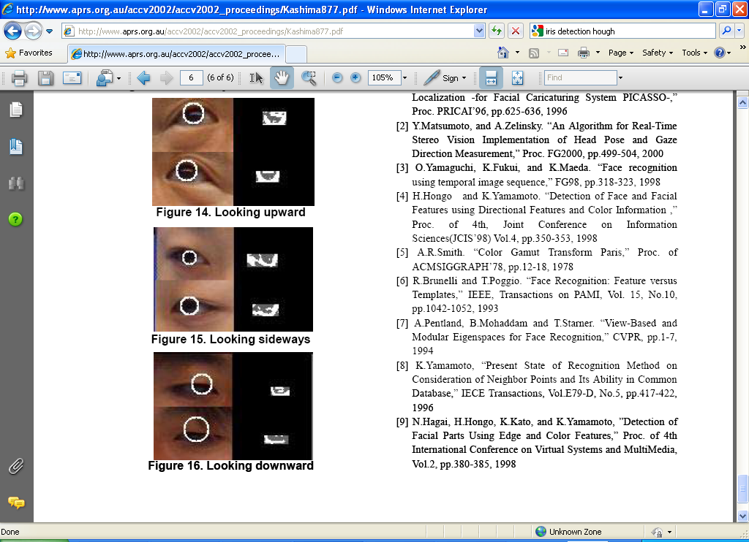
Example: iris detection
An Iris Detection Method Using the Hough Transform and Its Evaluation for Facial and Eye Movement, by Hideki Kashima, Hitoshi Hongo, Kunihito Kato, Kazuhiko Yamamoto, ACCV 2002.
Kristen Grauman

Slide 39
Voting: practical tips
Minimize irrelevant tokens first
Choose a good grid / discretization
Vote for neighbors, also (smoothing in accumulator array)
Use direction of edge to reduce parameters by 1
To read back which points voted for “winning” peaks, keep tags on the votes.
Too fine
?
Too coarse
Kristen Grauman

Slide 40
Hough transform: pros and cons
Pros
All points are processed independently, so can cope with occlusion, gaps
Some robustness to noise: noise points unlikely to contribute consistently to any single bin
Can detect multiple instances of a model in a single pass
Cons
Complexity of search time increases exponentially with the number of model parameters
Non-target shapes can produce spurious peaks in parameter space
Quantization: can be tricky to pick a good grid size
Kristen Grauman

Slide 41
Generalized Hough Transform
What if we want to detect arbitrary shapes?
Intuition:
Displacement vectors
x
x
x
Ref. point
x
x
Model image
Novel image
Vote space
Now suppose those colors encode gradient directions…
Kristen Grauman

Slide 42
Generalized Hough Transform
Define a model shape by its boundary points and a reference point.
Offline procedure:
x
a
At each boundary point, compute displacement vector: r = a – p_{i}.
Store these vectors in a table indexed by gradient orientation θ.
θ
θ
p₁
p₂
Model shape
θ
…
θ
…
…
[Dana H. Ballard, Generalizing the Hough Transform to Detect Arbitrary Shapes, 1980]
Kristen Grauman

Slide 43
Generalized Hough Transform
Detection procedure:
x
For each edge point:
Use its gradient orientation θ to index into stored table
Use retrieved r vectors to vote for reference point
x
θ
x
x
x
θ
θ
p₁
θ
θ
Novel image
θ
…
θ
…
…
Assuming translation is the only transformation here, i.e., orientation and scale are fixed.
Kristen Grauman

Slide 44

Generalized Hough for object detection
Instead of indexing displacements by gradient orientation, index by matched local patterns.
“visual codeword” with
displacement vectors
training image
B. Leibe, A. Leonardis, and B. Schiele, Combined Object Categorization and Segmentation with an Implicit Shape Model, ECCV Workshop on Statistical Learning in Computer Vision 2004
Source: L. Lazebnik

Slide 45
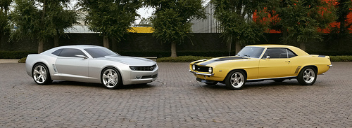
Generalized Hough for object detection
Instead of indexing displacements by gradient orientation, index by “visual codeword”
test image
B. Leibe, A. Leonardis, and B. Schiele, Combined Object Categorization and Segmentation with an Implicit Shape Model, ECCV Workshop on Statistical Learning in Computer Vision 2004
Source: L. Lazebnik

Slide 46
Summary
  Grouping/segmentation useful to make a compact representation and merge similar features
    associate features based on defined similarity measure and clustering objective
Fitting problems require finding any supporting evidence for a model, even within clutter and missing features.
  associate features with an explicit model
Voting approaches, such as the Hough transform, make it possible to find likely model parameters without searching all combinations of features.
  Hough transform approach for lines, circles, …, arbitrary shapes defined by a set of boundary points, recognition from patches.
Kristen Grauman

Slide 47
#Program to find lines using Hough transform
#argv[1] is orig. image, argv[2] is line length to find
import cv2
import numpy as np
import sys
img = cv2.imread(sys.argv[1])
line_length =int(sys.argv[2]) # length of Hough Lines
cv2.imshow("original image",img)
gray = cv2.cvtColor(img,cv2.COLOR_BGR2GRAY)
cv2.imshow("B&W",gray)
edges_unfiltered = cv2.Canny(gray,50,130,apertureSize = 3)
cv2.imshow("Canny Edges #1",edges_unfiltered)
masked_image=gray
eroded_image = cv2.erode(masked_image, np.ones((3,3)), iterations = 1)
dilated_image = cv2.dilate(eroded_image, np.ones((3,3)), iterations = 1)
cv2.imshow("dilated and eroded",dilated_image)
edges = cv2.Canny(dilated_image,100,240,apertureSize = 3)
cv2.imshow("Canny Edges #2",edges)
lines = cv2.HoughLines(edges,1,np.pi/180,line_length)
#draw the found lines on original image
for i in range(len(lines)):
rho,theta = lines[i][0]
a = np.cos(theta)
b = np.sin(theta)
x0 = a*rho
y0 = b*rho
x1 = int(x0 + 1000*(-b))
y1 = int(y0 + 1000*(a))
x2 = int(x0 - 1000*(-b))
y2 = int(y0 - 1000*(a))
cv2.line(img,(x1,y1),(x2,y2),(0,0,255),2)
cv2.imshow("output_lines",img)
cv2.waitKey(0)

Slide 48
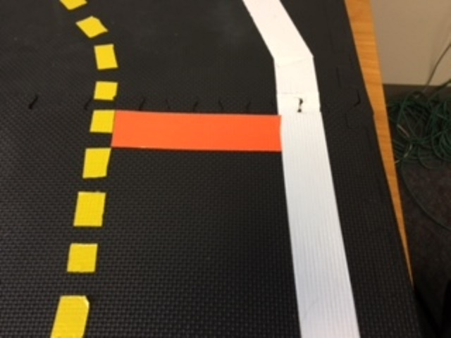
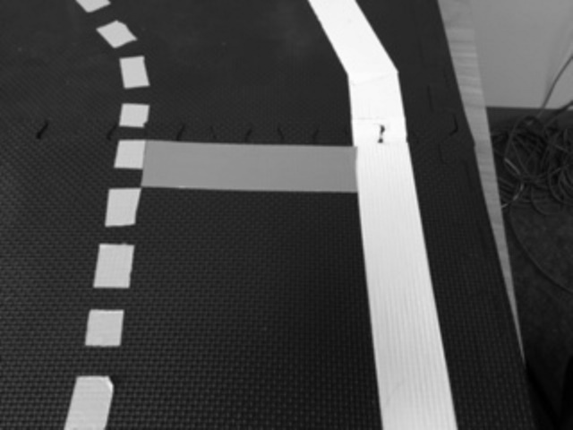
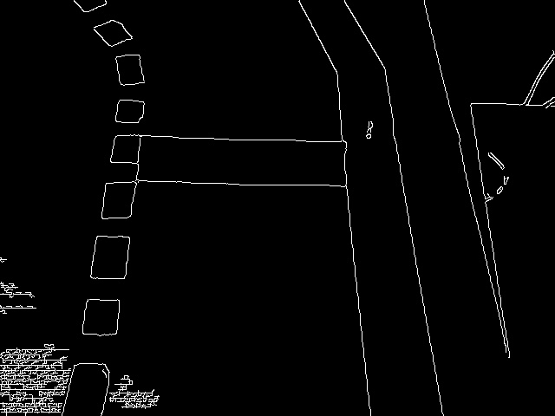
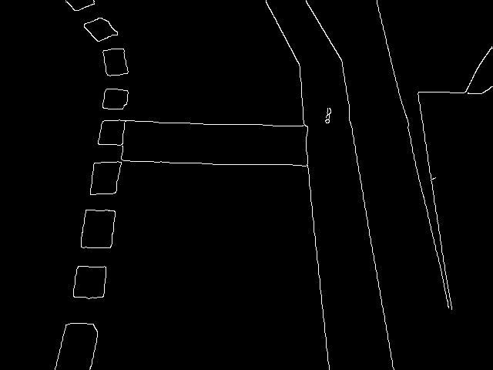
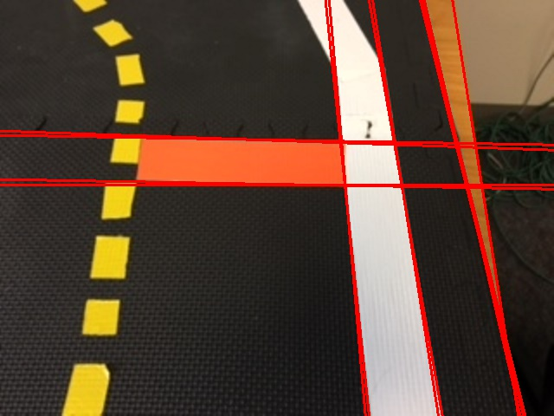
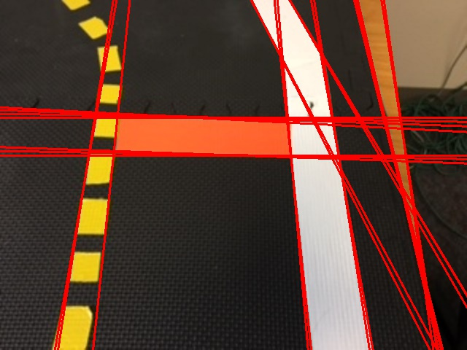
Original image
Grayscale image
Canny Edges
Filtered Canny Edges
After erosion/dilation
Hough Lines, length=99
Hough Lines, length=76
video

