Slide 1
Interactive Data Collection for Deep Learning Object Detectors on Humanoid Robots
2017 IEEE-RAS 17th International Conference on
Humanoid Robotics (Humanoids)
Birmingham, UK, November 15-17, 2017
Elisa Maiettini, Giulia Pasquale, Lorenzo Rosasco and Lorenzo Natale
Presented by: Apurva Ramdham

Slide 2
INTRODUCTION
The ability to localize and recognize objects in the scene is crucial for autonomous robots to act in unconstrained environments.
One of the problems in the adoption of recent remarkable DL methods in robotics, is that they require a large dataset of images carefully annotated.
Image annotation is particularly demanding for training object detection systems, because this process requires not only object labels but also bounding boxes. In addition, it implies an off-line process.
We propose an approach to train DL methods for object detection that overcomes the lack of manual annotations by exploiting the interaction with a human teacher.
The contribution of this work is to assess whether this approach can be adopted to effectively train deep object detectors as the recent Faster Region-CNN.

Slide 3
PAPER ORGANIZATION
.
1
Related work
2
Proposed Pipeline
3
Experimental Results
4
Conclusion

Slide 4
1. RELATED WORK
Architectures for Object Detection and training strategies.
Weakly Supervised Approaches.
Exploiting the Context: Learning Features by Training on a Pretext Task.
Exploiting the Context for Computing Annotations.

Slide 5

2. METHODS
The pipeline proposed in this work is an automatic procedure for extracting and labeling example images for training an object detection network.
STEPS
Data Acquisition Method
Model Training

Slide 6
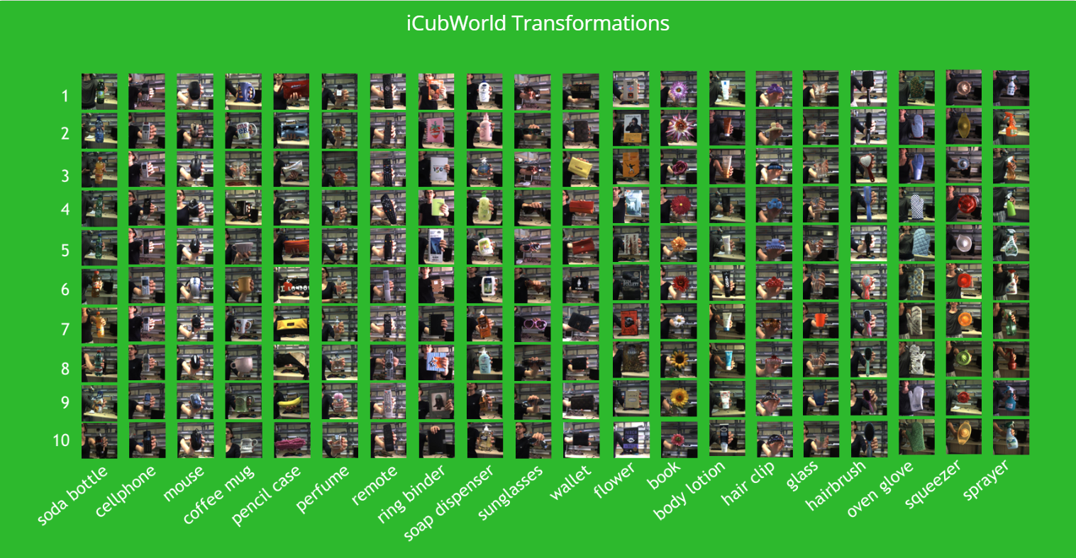
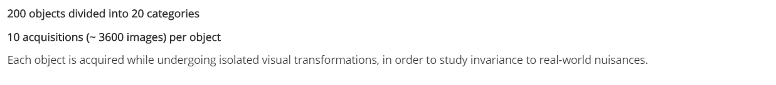

Slide 7
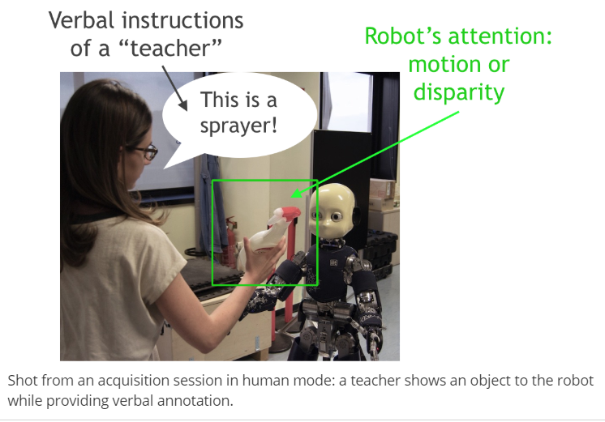
DATA ACQUISITION METHOD
Exploits depth information and human-robot interaction to collect labeled images.
The teacher shows the object in front of the cameras of the iCub.
A tracking routine , uses stereo vision, selecting the pixels from the depth map that are closer to the robot, thus segmenting the object from the background.
A bounding box is estimated to surround it, and it is stored as annotation jointly with the label of the objects which is provided verbally by the teacher.

Slide 8
MODEL TRAINING

Slide 9
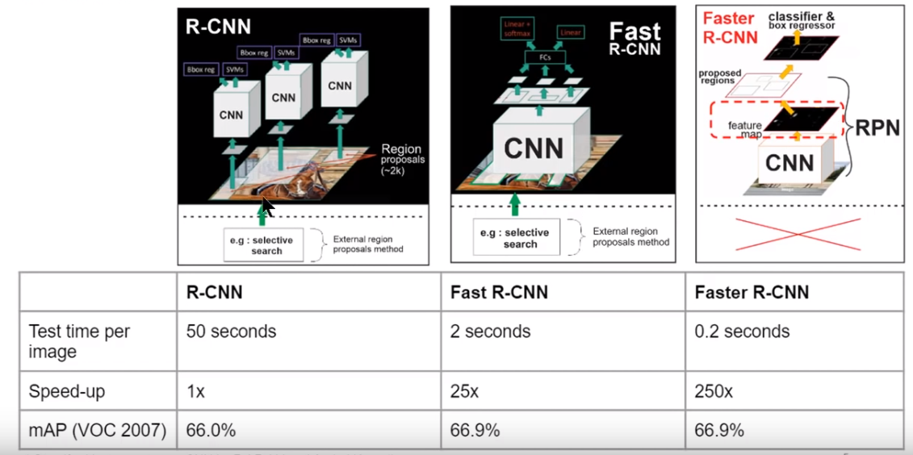

Slide 10
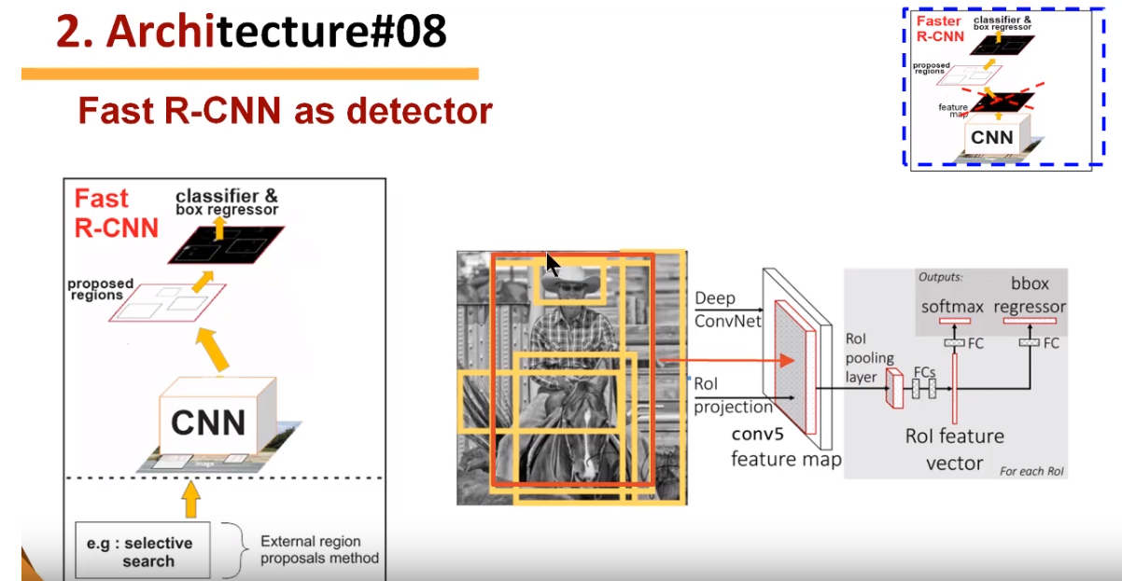

Slide 11
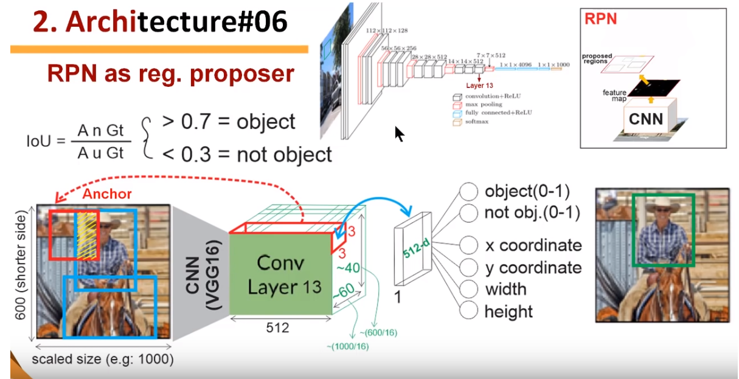
Add a Slide Title – 3

Slide 12
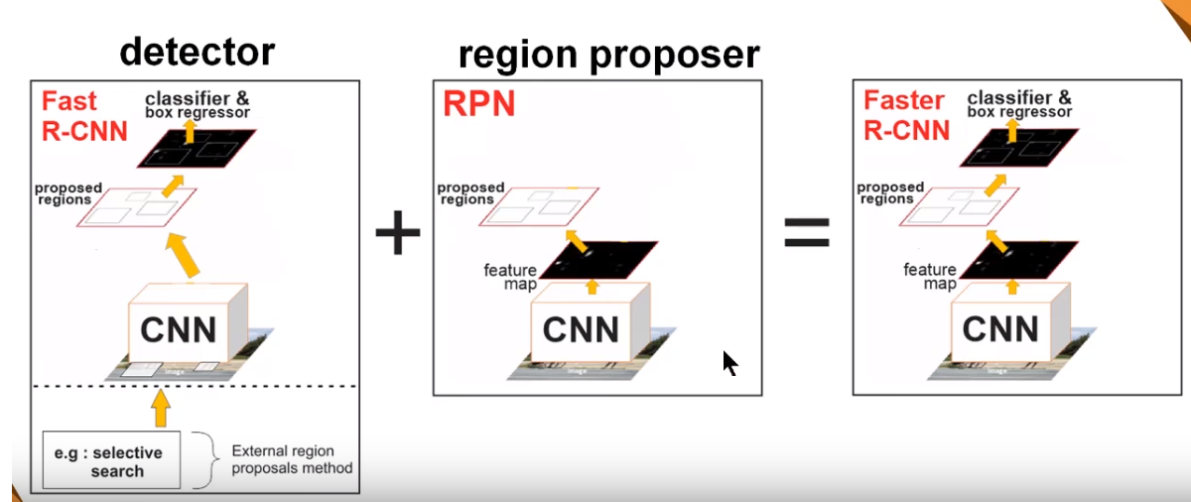
FASTER REGION-CNN ARCHITECTURE
Instead of employing an external method to provide the object detection network with candidate Regions of Interest e.g., Selective Search algorithm, it uses a shallow Convolutional Neural Network called Region Proposal Network (RPN).

Slide 13
Feature Extraction CNN
ZF network (Visualizing and understanding convolution networks. CoRR, abs/1311.2901, 2013)
Initialization
Adopting for the shared convolutional layers the weights trained on the image classification task of the ImageNet Large-Scale Visual Recognition Challenge (ILSVRC) (ImageNet: A Large-Scale Hierarchical Image Database. CVPR09, 2009)
Fine Tuning
4-Steps Alternating Training pipeline
VGG_CNN_M_1024 (Return of the devil in the details: Delving deep into convolutional nets, 2014)

Slide 14
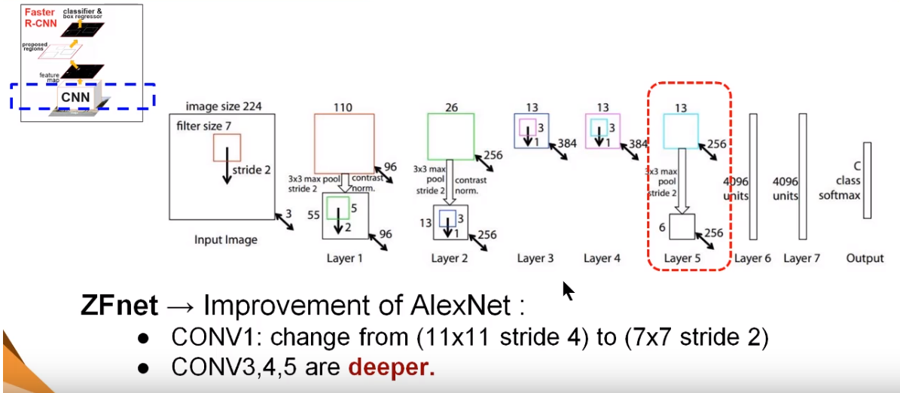
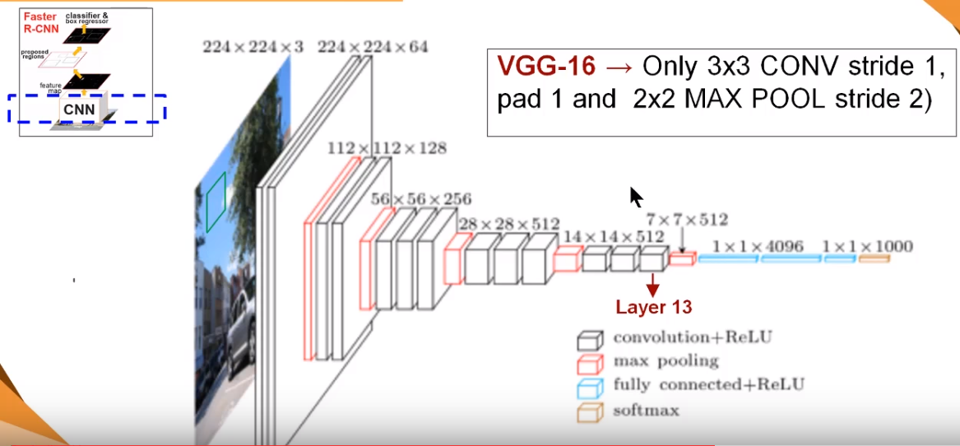

Slide 15
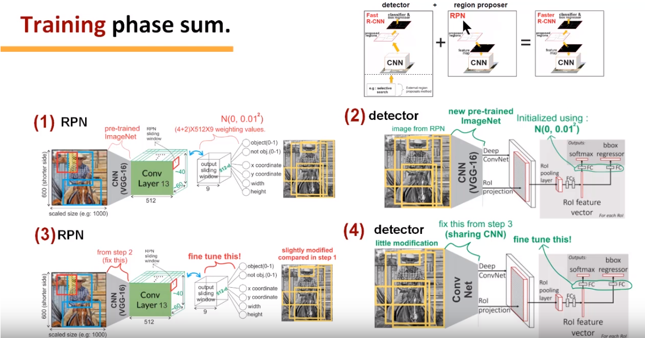

Slide 16
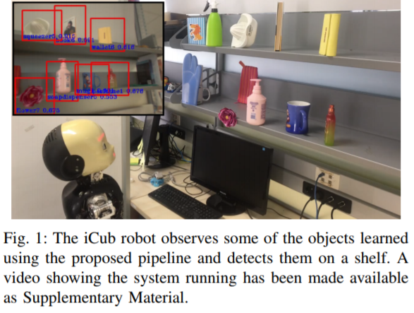
EXPERIMENTS

Slide 17
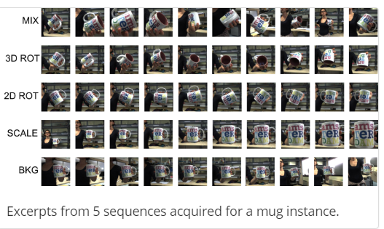
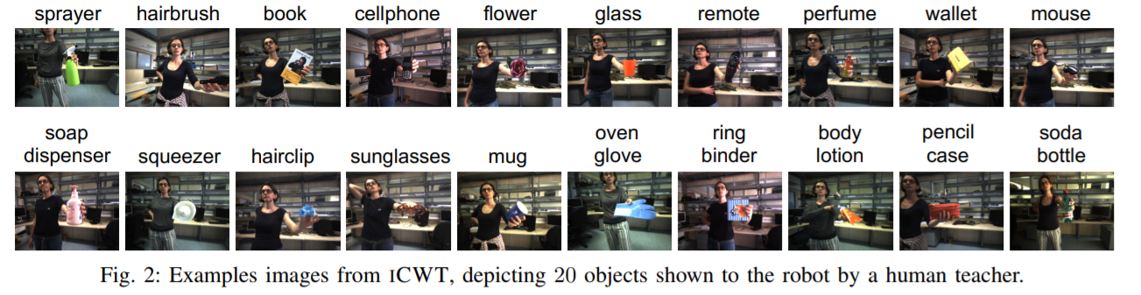
●Training set of ~ 27k images
●Test set of ~13k images

Slide 18
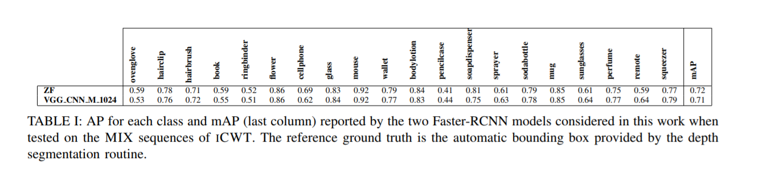
Evaluation I: Object detection in the same setting
Because the training data is segmented and labelled automatically by the robot it inevitably contains errors in the bounding box.
This evaluation is therefore important to determine to what extent the detection network is robust to the noise in the training data.
To this end, we considered the two ZF and VGG_CNN_M_1024 models.

Slide 19
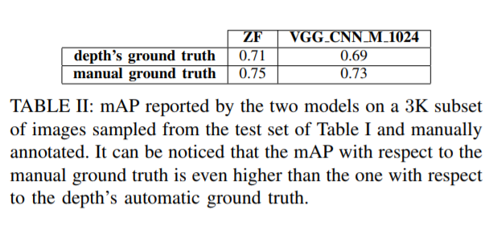
Testing
In this first test we use as ground-truth the bounding boxes computed automatically using depth information.
Further evaluated the system against bounding boxes computed with manual annotation on a subset of the images.
Adopted the labelImg tool5 and fixed an annotating policy such that an object must be annotated if at least a 50-25% of its total shape is visible.
We annotated 150 frames from each MIX sequence, gathering a test set of 3K images for all the 20 objects that we made available at the ICWT website.

Slide 20
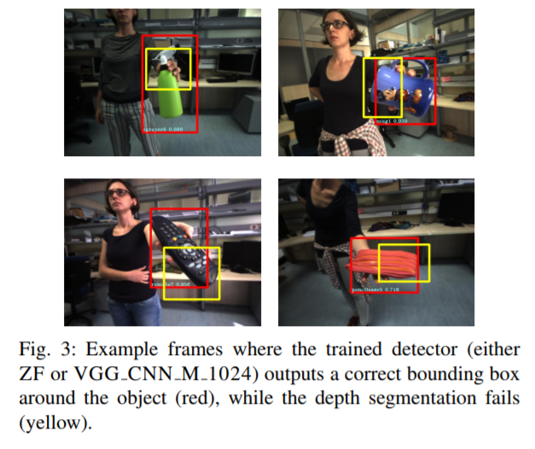
Since the mAP evaluated on the manual ground truth is even higher, it can be inferred that, not only the automatic annotations are sufficient to train good detectors, but these networks also learned to “average out“ possible noise in the ground truth, performing thus better than the depth segmentation procedure.

Slide 21
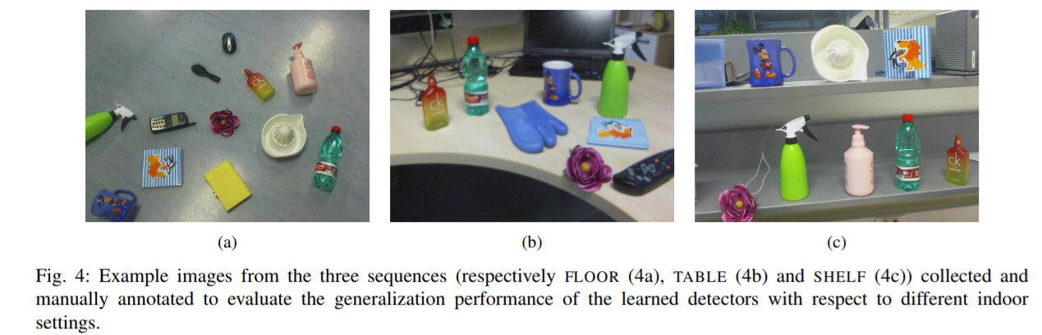
Evaluation II: Detecting objects in other settings
Comprising ∼ 300 frames

Slide 22
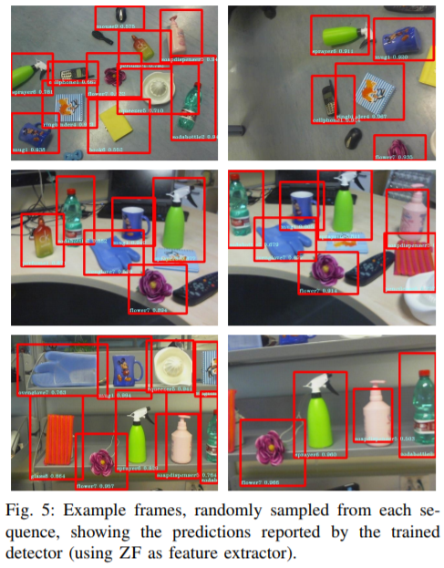
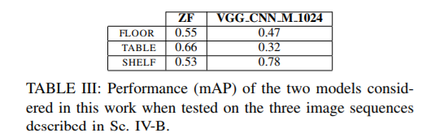
Performance:

Slide 23


Slide 24
DISCUSSION AND CONCLUSION
Propose a procedure to train object detection models in a robotic setting with automatically collected annotated data.
Images collected in this way are sufficient for fine-tuning a deep architecture as to successfully detect the learned objects without using any depth information at inference time.
Noise in the bounding boxes can be averaged out by the training, and that the learned detector generalizes well to different indoor settings.
In future, we plan to expand the proposed acquisition scenario by including information from the motion of the object, human gestures etc.

Slide 25
THANK YOU!

