Slide 1
Efficient Coverage of 3D Environment with Humanoid Robots Using Inverse Reachability Maps
Stefan Oßwald, Philipp Karkowski, Maren Bennewitz
Presentation by Quinn Torres

Slide 2
Introduction
Related Work
Problem Description and Framework
Reachability Map and Pose Evaluation
Efficient Representation of the Inverse Reachability Map
Planning a Tour of Viewing Poses
Experiments
Introduction
  The Problem
  Implementation
  Algorithmic Solutions
  Real-World Example

Slide 3
The Problem
  The Problem
  Implementation
  Algorithmic Solutions
Exhaustively search an environment using a humanoid robot’s camera
Use an inverse reachability map (IRM) to find a pose faster than calculating one
Applications:
  Inspection, surveillance, mapping, object search

Slide 4
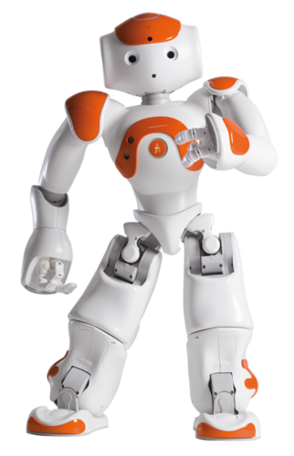
Implementation
  The Problem
  Implementation
  Algorithmic Solutions
SoftBank Robotic’s Nao Robot
Simulation in ROS and real-life tests
Known 3D environment
Consider balance, energy, and time

Slide 5
Algorithmic Solutions
  The Problem
  Implementation
  Algorithmic Solutions
Next-best-view algorithm for 3D coverage
Pre-computed inverse reachability map
Ray casting from object voxels
Utility functions for camera positions
Cost functions for robotic poses
Traveling salesman for connecting poses

Slide 6
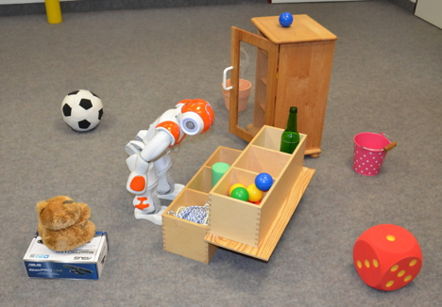
Real-World Example
Nao bends over in order to be able to completely inspect an environment

Slide 7
Introduction
Related Work
Problem Description and Framework
Reachability Map and Pose Evaluation
Efficient Representation of the Inverse Reachability Map
Planning a Tour of Viewing Poses
Experiments
Related Work
Finding Viewpoints
Posture Generation

Slide 8
Finding Viewpoints
  Finding Viewpoints
  Posture Generation
“Art Gallery Problem” is NP-hard and APX-hard
Prior solution: find a view and generate a posture
Research for in-hand objects, cameras on arms, and aerial vehicles
Framework could be expanded to autonomous exploration

Slide 9
Posture Generation
  Finding Viewpoints
  Posture Generation
Previous solutions require pose planning
Planning for humanoid robots needs to consider different factors
Only want viewpoints the robot can reach (small set)
Inverse Reachability Map (IRM) used previously for grasping

Slide 10
Introduction
Related Work
Problem Description and Framework
Reachability Map and Pose Evaluation
Efficient Representation of the Inverse Reachability Map
Planning a Tour of Viewing Poses
Experiments
Problem Description and Framework

Slide 11
Problem Description and Framework
3D model of environment
Determine smallest sequence of camera poses to cover environment
Implement sampling-based next-best-view algorithm
Pre-compute inverse reachability map

Slide 12
Introduction
Related Work
Problem Description and Framework
Reachability Map and Pose Evaluation
Efficient Representation of the Inverse Reachability Map
Planning a Tour of Viewing Poses
Experiments
Reachability Map and Pose Evaluation
Reachability Map I
Reachability Map II
Pose Stability
Cost Function

Slide 13
Reachability Map I
  Reachability Map I
  Reachability Map II
  Pose Stability
  Cost Function
Need posture stability and self-collision avoidance
Save computation using reachability map
  Volumetric representation of poses that an endeffector (arm, head) can reach
  Voxel cell stores joint configurations and cost
  Still need to check collision and optimize cost

Slide 14
Reachability Map II
  Reachability Map I
  Reachability Map II
  Pose Stability
  Cost Function
Original RM created for grasping, so prioritized manipulability
Head-mounted camera cannot cover a large volume

Slide 15
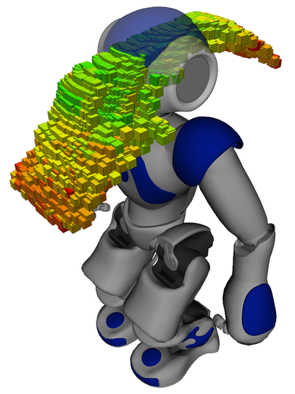
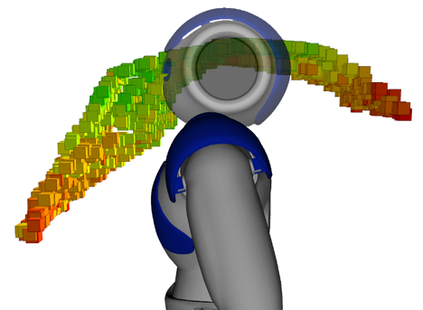
Reachability Map of Nao Robot
Green voxels represent lower total cost

Slide 16
Pose Stability
  Reachability Map I
  Reachability Map II
  Pose Stability
  Cost Function
Measure center of pressure on both feet
  Compare against support polygon (bound of where stability is ensured)
Experiment estimated center of pressure using weight ratio (want to minimize)

Slide 17
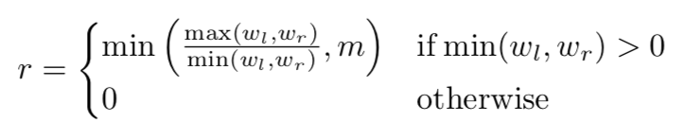
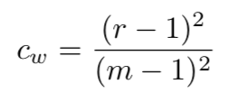
Weight Ratio and Cost
Poses take into account the stability of the robot while posing
w_{l} , w_{r} = weight on each foot
m = experimental limit on weight ratio (3)

Slide 18
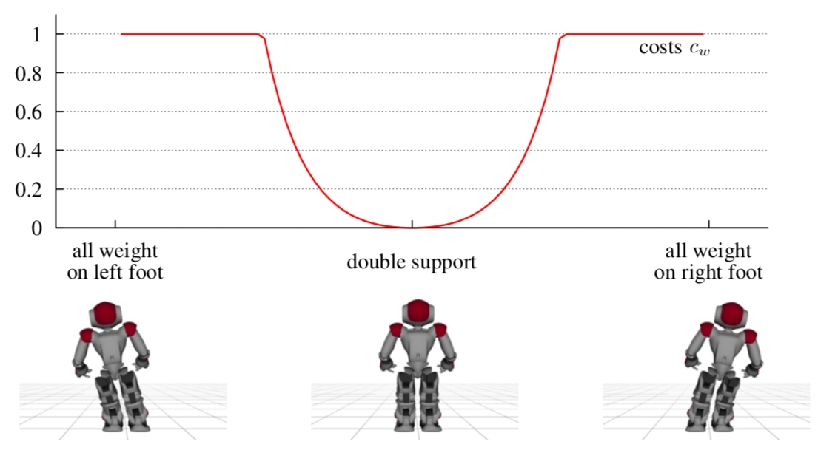
Graphical Representation of Stability Cost
Graph of value for c_{w}

Slide 19
Cost Function
  Reachability Map I
  Reachability Map II
  Pose Stability
  Cost Function
Add a cost for weight (c_{w} ), power, and time
Power (P) computed from electric current for each joint while moving from standard pose to desired pose
Time (Δt) measured experimentally
c = k_{w} · c_{w} + k_{t} · Δt + k_{p} · P

Slide 20
Introduction
Related Work
Problem Description and Framework
Reachability Map and Pose Evaluation
Efficient Representation of the Inverse Reachability Map
Planning a Tour of Viewing Poses
Experiments
Efficient Representation of the Inverse Reachability Map

Slide 21
Efficient Representation of the Inverse Reachability Map
Input is location of endeffector, not the base
More efficient to invert the reachability map
Cells are now locations of base frame instead of endeffector
Store IRM as a database
  Indexed on roll, pitch, and z component of base
Could index with k-d tree or octree for quick search

Slide 22
Introduction
Related Work
Problem Description and Framework
Reachability Map and Pose Evaluation
Efficient Representation of the Inverse Reachability Map
Planning a Tour of Viewing Poses
Experiments
Planning a Tour of Viewing Poses
Sampling Candidate Viewing Poses
Determining Whole-Body Configurations
Formulation as a Traveling Salesman Problem

Slide 23
Sampling Candidate Viewing Poses
  Sampling Candidate Viewing Poses
  Determining Whole-Body Configurations
  Formulation as a Traveling Salesman Problem
Sample the physical space accessible by the robot’s camera
Cast rays from each object voxel across the space
Free-space voxel utility increases for each object voxel that collides
For each voxel, sample random 3D orientations

Slide 24
Determining Whole-Body Configurations
  Sampling Candidate Viewing Poses
  Determining Whole-Body Configurations
  Formulation as a Traveling Salesman Problem
Sequence of checks
  Location is reachable, using 2D occupancy grid map
  Feet do not collide with environment
  Full body does not collide with environment
    Flexible Collision Library

Slide 25
Formulation as a Traveling Salesman Problem
  Sampling Candidate Viewing Poses
  Determining Whole-Body Configurations
  Formulation as a Traveling Salesman Problem
Find smallest set of viewing poses to cover all object voxels
Object search: start with panoramic, high utility views and use a greedy approach
Inspection: use Lin-Kernighan heuristic solver to save time and energy (of the robot)
  Node distance is physical travel distance

Slide 26
Introduction
Related Work
Problem Description and Framework
Reachability Map and Pose Evaluation
Efficient Representation of the Inverse Reachability Map
Planning a Tour of Viewing Poses
Experiments
Experiments
Generating the Inverse Reachability Map
Coverage of Simulated Environments
Coverage of a Real Scene

Slide 27
Generating the Inverse Reachability Map
  Generating the Inverse Reachability Map
  Coverage of Simulated Environments
Used default controller to create join configurations
  Already handles joint limit constraints and stability
Sample head orientations and varying torso heights, controller calculates poses
Map contains 1514 configurations

Slide 28
Coverage of Simulated Environments
  Generating the Inverse Reachability Map
  Coverage of Simulated Environments
Generate footstep plans with a planner
Use models of rooms from Blender and render as an OctoMap
First consider high utility voxels (light blue)
Some surfaces unobservable due to robot’s height
Set threshold for view utility: trade off between completeness and runtime

Slide 29
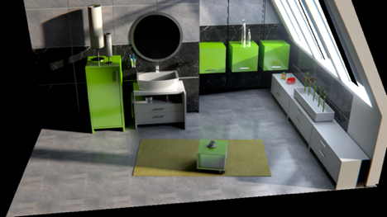
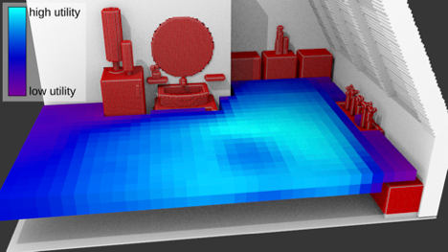
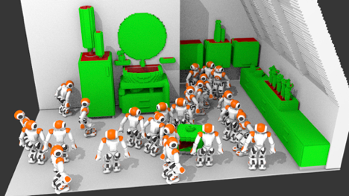
Simulation Results I
Top: Simulated environment.
Middle: Objects to inspect highlighted in red. 2D utility map generated.
Bottom: Poses necessary to cover all possible voxels.

Slide 30
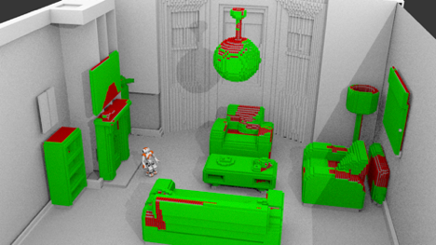
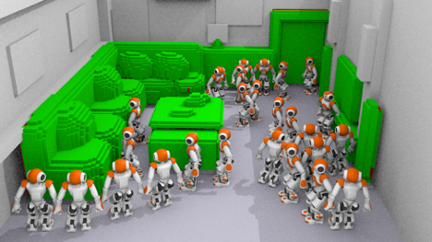
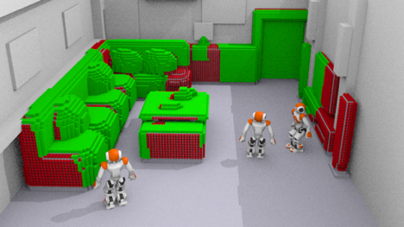
Simulation Results II
Top: Coverage from a single viewpoint.
Middle: Full coverage from 26 viewpoints.
Bottom: Efficient coverage from 3 viewpoints.

Slide 31
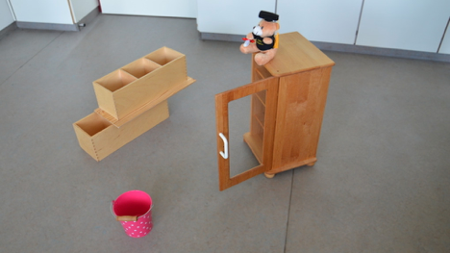
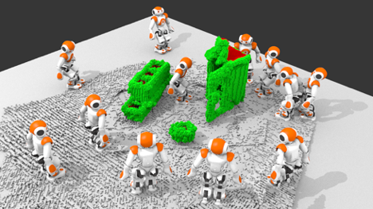
Real Scene Results
Top: Real scene setup.
Bottom: Pose estimates.
Outcome of simulation vs real scene is in practicality the same.

Slide 32
Thank You!

