Slide 1
A Low-Cost EEG System-Based Hybrid Brain-Computer Interface for Humanoid Robot Navigation and Recognition
Bongjae Choi, Sungho Jo
Presented by Megan Fillion

Slide 2

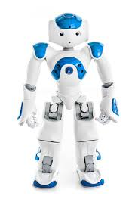
Introduction
Robot controlled remotely from user wearing an EEG
Enables a subject to control the navigation and exploration of a humanoid robot and recognize a desired object among candidates
Employs a hybrid BCI technique that combines P300 potential, SSVEP, and ERD.

Slide 3
Related Work
“A Hybrid Brain-Computer Interface Based on the Fusion of Electroencephalographic and Electromyographic Activities” Leeb, Sagha, Chavarriaga, Millán
“Combining Eye Gaze Input with Brain-Computer Interface for Touchless Human-Computer Interaction” Zander, Haertner, Kothe, Vilimek
“An Adaptive Brain-Computer Interface for Humanoid Robot Control” Bryan, Green, Chung, CHanh, Scherert
“fMRI Robotic Embodiment: A Pilot Study” Cohen, Druon, Lengagne, Mendelsohn, Malach

Slide 4
Goal
“This work aims to overcome the limitations of relatively low-quality data from a low-cost system by suggesting algorithmic solutions. The objective of this work is to demonstrate that it is possible to use a low-cost hybrid BCI system to perform multiple tasks with a humanoid robot while giving the user the illusion of embodying the robot.”

Slide 5
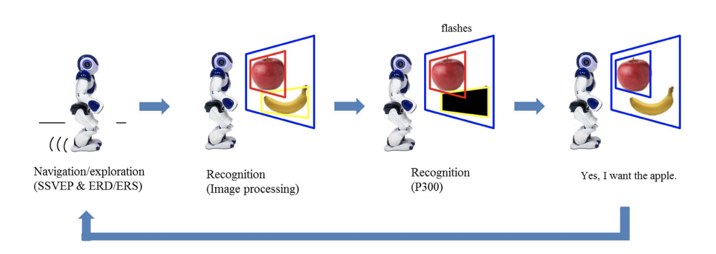
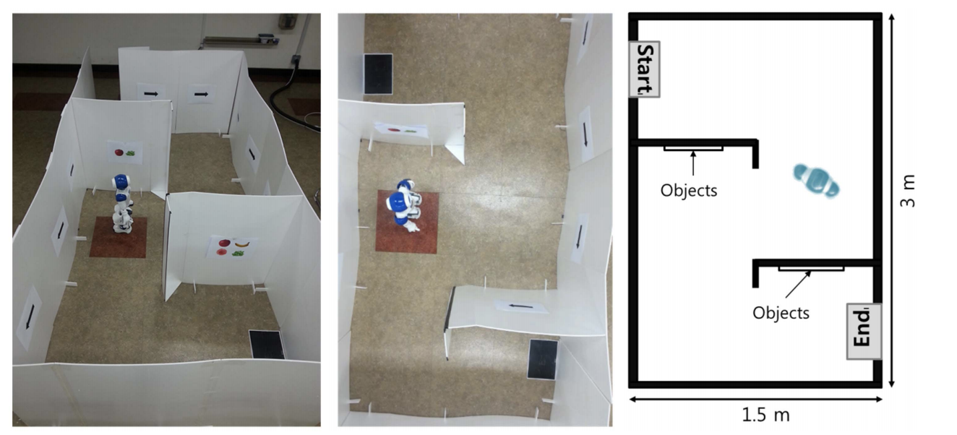
Scenario

Slide 6
Reactive BCI
Enables users to control an application by detecting indirectly modulated brain signals related to specific external stimuli
P300 potential
  P300 wave is an event related potential evoked in the process of decision making
  300ms delayed response to stimulus
Steady State Visually Evoked Potential (SSVEP)
  Signals that represent natural responses to visual stimulation at specific frequencies

Slide 7
Active BCI
Enabled users to control an application though consciously intended brain activity without external events.
Event Related Desynchronization/Synchronization (ERD/ERS)
  A short-lasting and localized amplitude decrease/increase of rhythmic activity
Motor Imagery
  Process by which a user simulates a given action. In doing so, the EEG can pick up on the unconscious signals emitted before the execution of the action.

Slide 8
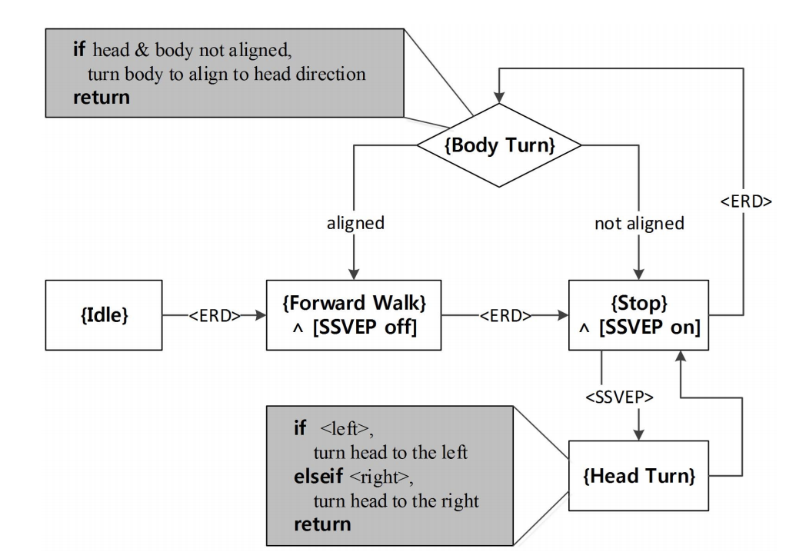
Navigation and Exploration Mode
Navigation (ERD): Forward walk and and body turn (left-right).
Exploration (SSVEP): Turning head left or right.
Algorithm intended to achieve desired performance with the least amount of effort possible.

Slide 9
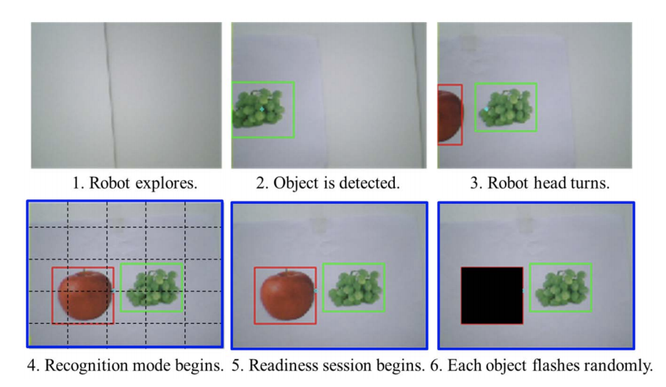
Recognition Mode
Uses color filtering to detect objects
Once detected, each object is bordered by a rectangular box
When the rectangular box border turn blue, recognition mode is turned on
Each box flash in a random order at specific frequencies
Check to see if P300 signal matches one of the object’s displayed frequencies

Slide 10
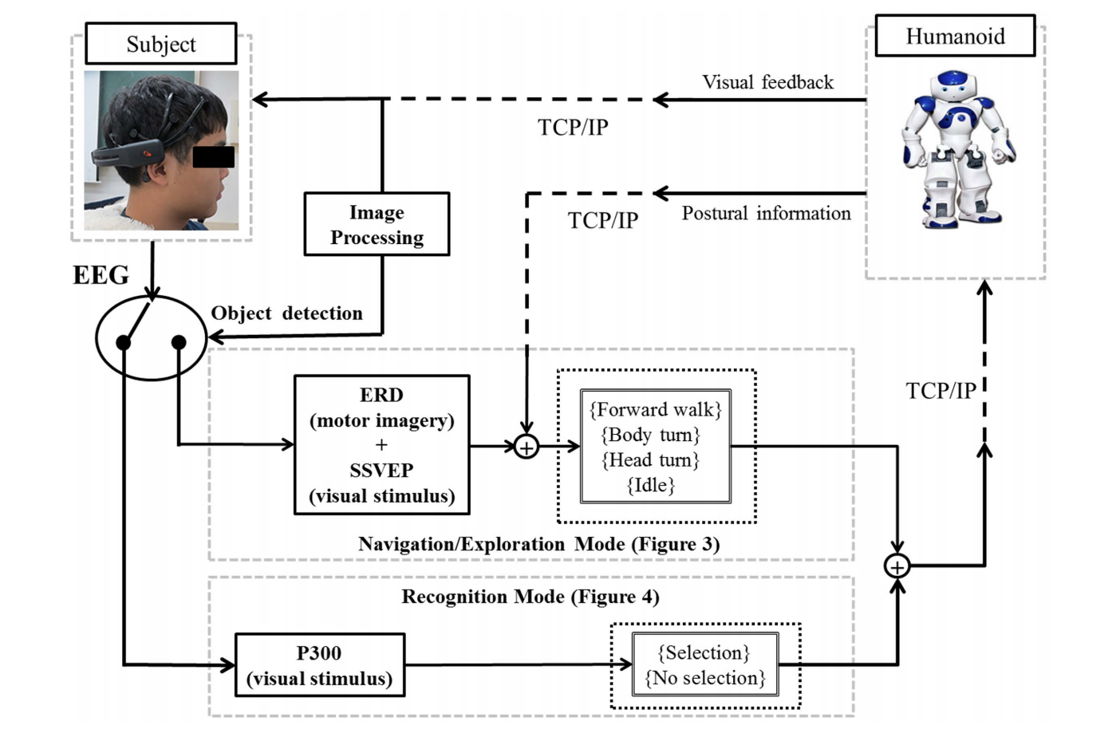
System Architecture

Slide 11


ERD-based BCI protocol
S: sampling rate, T: number of samples, X: EEG signals
X1: set of EEG signals corresponding to the motor signals
X2: remaining EEG signals
Ci: spatial covariance matrix of an associated class
Then uses Support Vector Machines algorithm with a linear kernel to map the output to a desired feature (left or right).

Slide 12
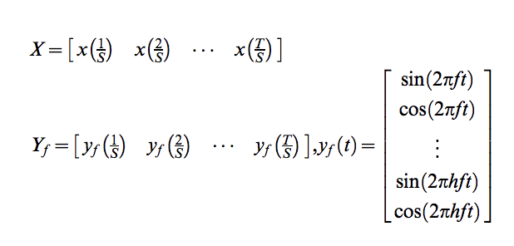
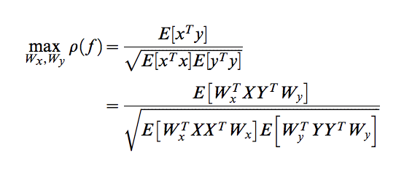
SSVEP-based BCI protocol
Two-class classification was designed based on Canonical Correlation Analysis
x(t) EEG signals, yf(t) stimulus signals set at frequency f
Canonical Variants x = X^{T}W_{x} and y = X^{T}W_{y} used to maximize correlation between x and y
f1 and f2 indicate left and right turns respectively
State selected by checking correlation values p(f1) and p(f2)
EEG signals were filtered between 4 and 50 Hz

Slide 13
P300-based BCI
P300-based BCI protocol using xDAWN spatial feature where EEG channels are concatenated and rescaled to create feature vectors.
Improves quality of response by taking into account both signal and noise (lots of noise in low-cost EEG)
Collected data projected into a three-dimensional signal subspace constructed by the filter.
Bayesian linear discriminant analysis classifier applied to identify p300 signal.
Frequencies between 1 and 20 hz

Slide 14
Video
https://plos.figshare.com/articles/_A_Low_Cost_EEG_System_Based_Hybrid_Brain_Computer_Interface_for_Humanoid_Robot_Navigation_and_Recognition_/787978

Slide 15
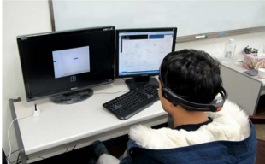
Testing
Very specific criteria for test subjects:
20-30 year old
Same gender (all male)
All right handed
No history of central nervous system abnormalities
Cannot be on psychiatric medication
Have epilepsy, dyslexia or experience hallucinations

Slide 16
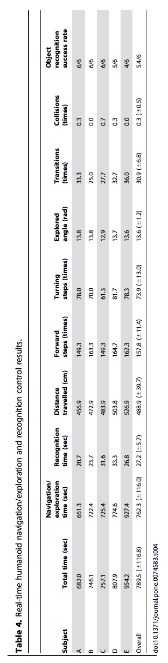
Results

Slide 17
Conclusion
Effective implementation of simple hybrid BCI protocols
Stable implementation of complex tasks resulting in high success rates
Was able to implement a low cost, non-invasive BCI while still being able to collect enough viable data to execute tasks
But the EEG did not fully cover the sensorimotor cortex
Also it proved difficult to correctly place the plastic electrodes
Used color filtering to detect objects

