Slide 1
Autonomous navigation of a humanoid robot over unknown rough terrain using a laser range sensor
-Koichi Nishiwaki, Joel Chestnutt and Satoshi Kagami
-The International Journal of Robotics Research (2012)
Presented by: Abhijeet Arunkumar Mishra (aam2285)

Slide 2
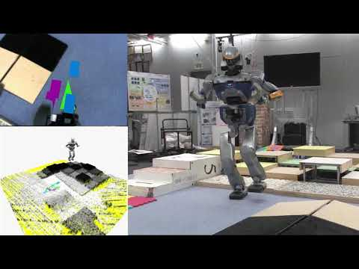
Autonomous navigation over unknown terrain

Slide 3
Key Concepts
Enable a bipedal robot, which is inherently unstable, to walk.
Employ a laser range finder to sense terrain shape.
Allow the system to work no previous knowledge of the surrounding.
Allow for errors in measurement of slope and height of terrain.
This was enabled by:
A robust walking control system, which allows for perception errors
A footstep planning method that can evaluate quality of foot placement from grid height map, which may contain measurement errors.
Basically, increased processing power allowed for smaller time intervals for each step.

Slide 4
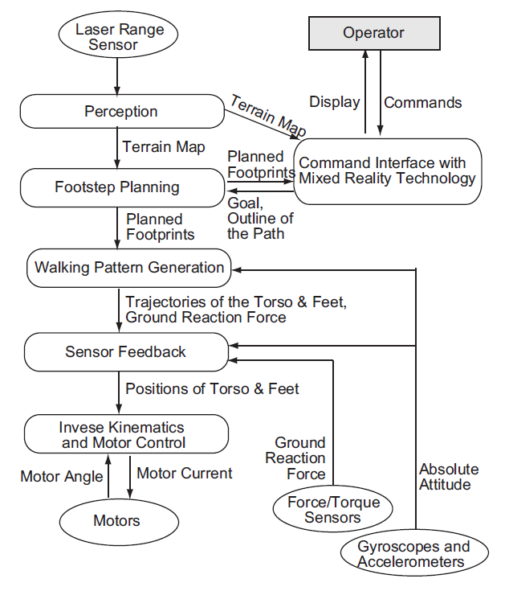
Overview of System

Slide 5
Laser Based Perception System
Walking Control
Experiments & Conclusion
Footstep Planning
Operational Interface

Slide 6
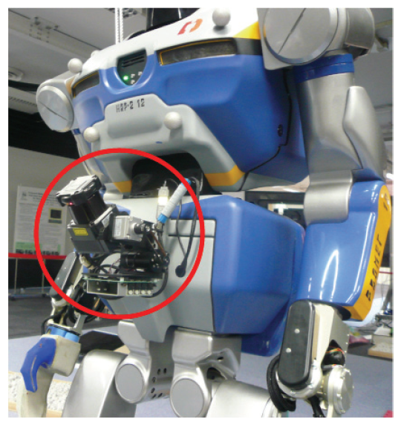
Laser Based Perception System
Terrain shape map generated using laser sensor (UTM-X002S)
Sensor has scanning frequency of 100 Hz and angular resolution of 0.625 degrees
Map divided into cells of 2cm*2cm.
Each cell has height associated with it, which is average of all values detected in a cell.
Flat surfaces detected with an accuracy of 0.01 m

Slide 7
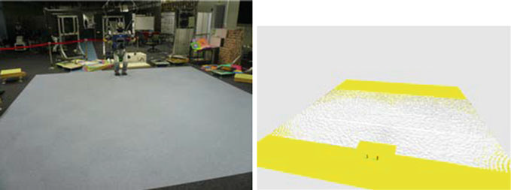
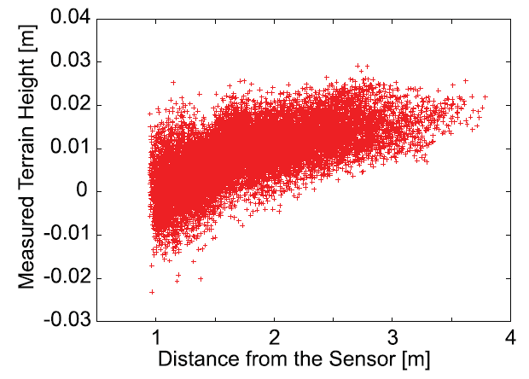
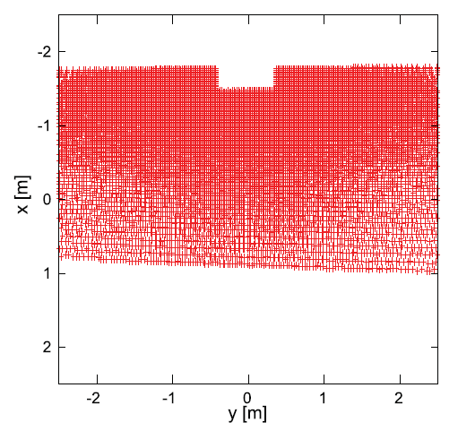
Perception of Robot of a flat mat (generated from laser scan). Each white dot is a cell and has a height associated with it.
Height measured vs distance from robot for flat mat
Cell visualization of robot perception

Slide 8
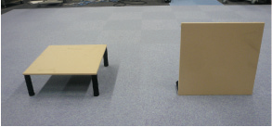
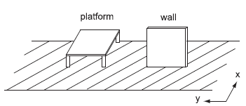
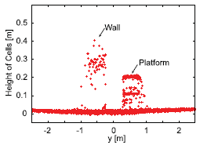
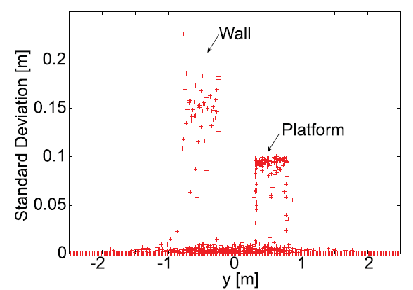
Managing Walls ( cells with multiple heights )
Table of height 0.2m and wall of height 0.5m
Representation of the obstacles
Perceived height of the objects
Standard Deviation of Measured points

Slide 9
Solution
Wrong measurements due to averaging of all values in cells.
But averaging is necessary to avoid errors.
We know, standard deviation of data of a cell must be < 0.01m
Thus, Std Dev of all data in a cell < 0.01, then the avg(data) = height
If Std Dev > 0.01, algorithm is as follows:
Sort data from largest to smallest
Calculate Std Dev of top n high values, from n=1
Keep repeating and increasing while Std Dev < 0.01
Stop when Std Dev > 0.01, and Avg(data upto [n-1]) = height of cell

Slide 10
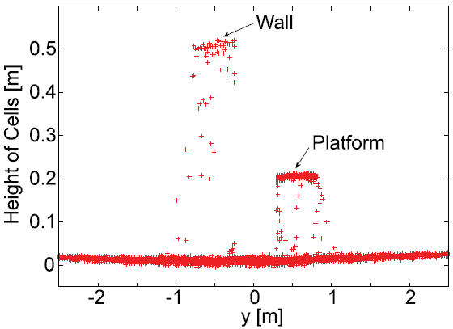
Result of Algorithm
Table of height 0.2m and wall of height 0.5m
Heights perceived by the robot, once the algorithm is implemented

Slide 11
Odometry errors of height
Calculating position of laser range sensor accurately critical.
Drifts along translational axis and rotational angle about gravitational axis.
Drifts accounted for using multiple measurements of various sensors.
For better localization, another low cost method adopted.
Difference in heights of known cells in two different scans measured.
Average of difference of multiple cells is chosen as the drift.

Slide 12
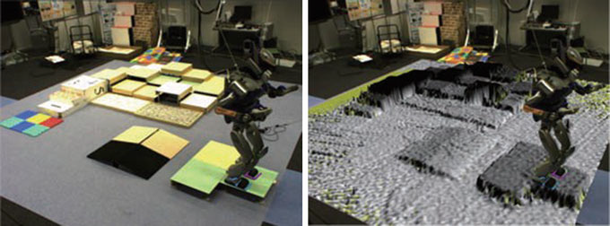
Perception of a complex environment after applying all filters.

Slide 13
Laser Based Perception System
Walking Control
Experiments & Conclusion
Footstep Planning
Operational Interface

Slide 14
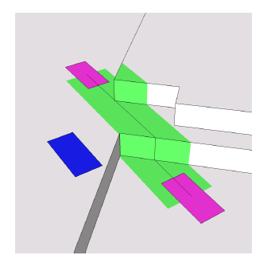
Footstep Planning
The path can be predefined or only the goal can be specified.
The robot will plan footsteps along the path.
It uses A* algorithm to carry out a heuristic search.
It then plans footsteps along the path.
The quality of footsteps is judged based on the location, height, slope, stability, largest bump etc.
Footsteps updated as robot moves.
Judgement of footstep quality

Slide 15
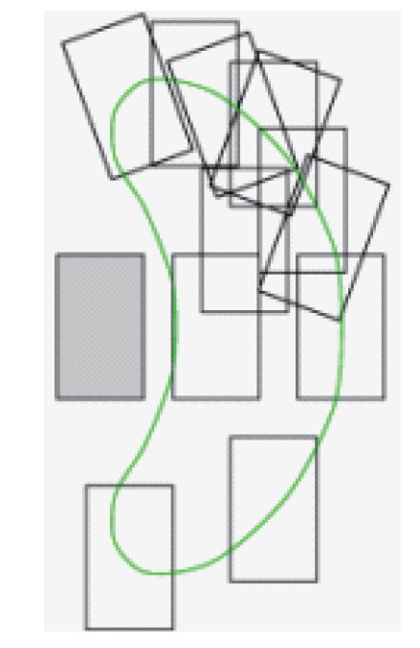
Number of Footsteps
Large number of possible footsteps around a point require larger processing power.
However, reducing number of possible footsteps, would make it difficult to find path around rough terrains.
Thus, it was decided to use an adoptive model.
The number of possible footsteps over any area is kept constant.
If a footstep (transition) is not acceptable, a position around it is evaluated and selected.
Figure showing number of possible footsteps (transitions) about a point

Slide 16
Laser Based Perception System
Walking Control
Experiments & Conclusion
Footstep Planning
Operational Interface

Slide 17
Walking Control
Robots required to autonomously realize footprints, leg trajectory and manage any error in terrain shape generated by perception system.
Walking for bipedal robots is extremely dynamic.
The robot must constantly react to the changing loads and any non-uniformity in the terrain.
Thus, walking patterns are generated at a very high frequency (40 ms)
The robot reads sensor data and calculates the trajectory of the body, every 40 ms.
This allows for errors in terrain upto a few centimeters and of inclination upto 10 degrees

Slide 18
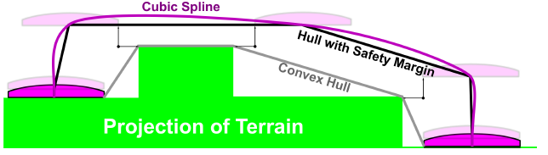
Trajectory Example
Example of the trajectory of a foot. It will keep updating this trajectory every 40 ms.

Slide 19
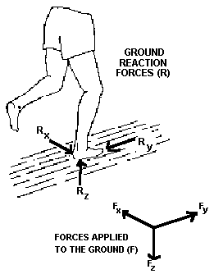
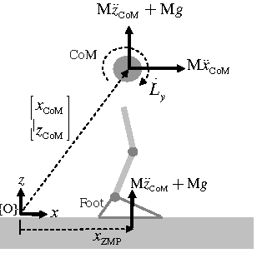
Zero Moment Position & Ground Reaction Force
https://www.semanticscholar.org/topic/Zero-moment-point/252013
https://ouhsc.edu/bserdac/dthompso/web/gait/kinetics/GRFBKGND.HTM

Slide 20
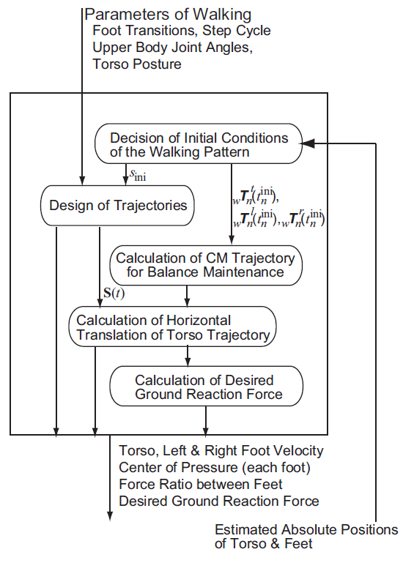
Dynamically Stable Pattern Generation
Starts Generating a 40 ms trajectory path 36 ms before the actual trajectory begins.
Thus initial position of several parameters have to be estimated. (i.e. Torso, feet position)
Desired trajectory of Centre of Mass of system is calculated from the reference Zero Moment Point (ZMP) trajectory.
Centre of Mass Trajectory is then utilized to calculate torso and feet trajectory.
Next, forces are calculated and motors are actuated to achieve desired ground reaction force.

Slide 21
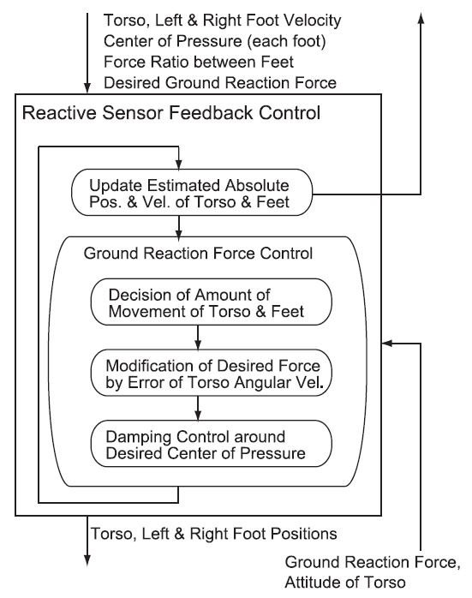
Sensor Feedback Modification
Aim to realize the specified torso path even if terrain shape not as predicted.
Feedback in the form of Ground Reaction Force and control of position of torso.
Estimation of position and posture every 1 ms.
Used to calculate GRF and velocities for feedback.
GRF is then modified to achieve updated velocity to realise trajectory.
Following this, all other parameters such as ZMP, feet positions, torques of motor are calculated.
Overview of Sensor feedback Mechanism

Slide 22
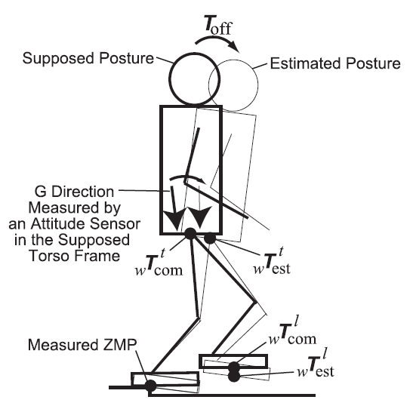
Estimating Position
Torso postures and positions measured in cycles of 1 ms.
Inertial measurement Unit used to estimate any unexpected rotation or translation.
In case of rotation about ZMP, offset between actual and commanded position is measured.
Robot rotated about ZMP in order to nullify the offset.
In case of high torso rotation velocity, feet velocities are updated too.
Estimating absolute posture

Slide 23
Laser Based Perception System
Walking Control
Experiments & Conclusion
Footstep Planning
Operational Interface

Slide 24
Operational Interface
Three Types of User Interfaces utilized:
Graphical User Interface: User specifies goal or path on GUI. Earliest Interface.
MR Interactive Interface: This is a mixed reality interface. User wears head-mounted display to track live movements and can give commands with hand directly.
Joystick Interface: Camera view is displayed on a monitor and joystick is used to control movement. Remote control is possible but operator is more involved

Slide 25
Laser Based Perception System
Walking Control
Experiments & Conclusion
Footstep Planning
Operational Interface

Slide 26
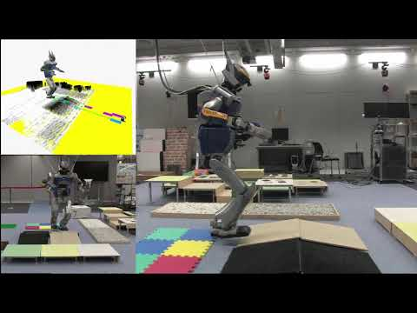
Experimentation
GUI based Interface

Slide 27
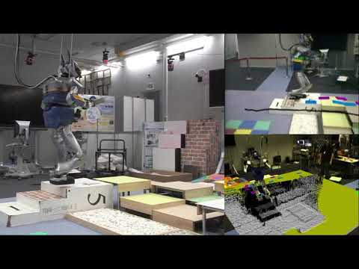
HMD DISPLAY

Slide 28
Joystick based Interface

Slide 29
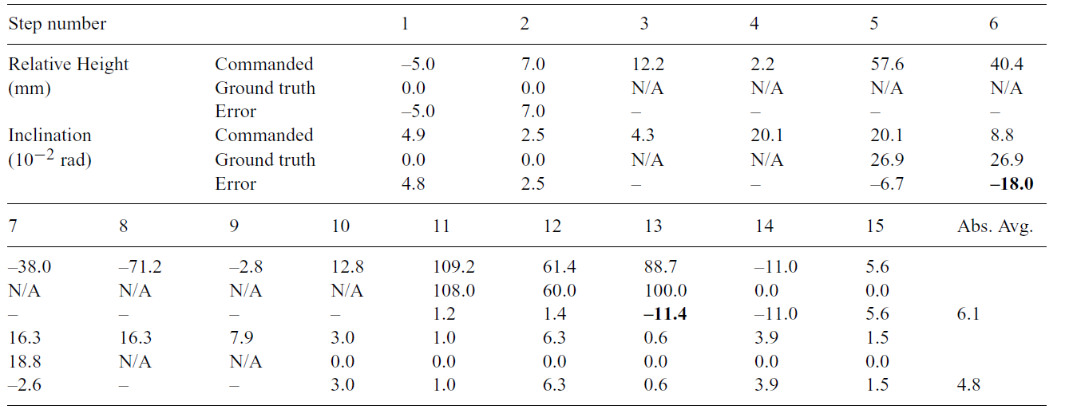
ACCURACY

Slide 30
Conclusion
Robust walking system developed.
Can be used with multiple interfaces.
Achieved navigation on unknown rough terrains without any previous knowledge of environment.
Assumption: Stepping positions do not deform.
Assumption: Environment not complicated enough to cause collisions.
Future : Robot Localization and development of a larger map.
Future : Robot locomotion on deformable objects.
Future : Completely online processing
Future : Implementing reinforcement learning to learn to walk.

Slide 31
Thank You
All data has been taken from the following references:
Zero Moment Point Walking Controller for Humanoid Walking Using Darwin-op, A Thesis, Joseph Rudy, 2014
Planning and Control of a Humanoid Robot for Navigation on Uneven Multi scale Terrain, Satoshi Kagami et all.
Torso height Optimization for Bipedal Locomotion, Thomas Buschmann et all.
Autonomous navigation of a humanoid robot over unknown rough terrain using a laser range sensor, Satoshi Kagami et all

