Slide 1
Synergy-Based, Data-Driven Generation
of
Object-Specific Grasps for Anthropomorphic Hands
Julia Starke, Christian Eichmann, Simon Ottenhaus and Tamim Asfour
Notes:
We are going to explore methods in dimensionality reduction as a control strategy for operating robotic hands, in particular those that look like the ones we humans work with everyday.

Slide 2
Shape and Grasp Manipulation
artificial hands have traditionally faced control difficulties when looking to mimic the capabilities of the human hand
the challenge is a consequence of
  differing hand kinematics
  physiological constraints
Starke directs her focus on anthropomorphic hands–hands that resemble anatomical structure of the human hand

Slide 3
Underactuated Robotic Hands
full actuation implies an actuator for each degree of freedom
a fully actuated anthropomorphic hand would have at least 20 DOF
an underactuated hand simplifies control complexity by controlling the same number of joints with fewer actuators, but faces drawbacks in dexterity
provides the passive compliance required to grasp objects with a variety of geometries
let’s see a few examples:

Slide 4
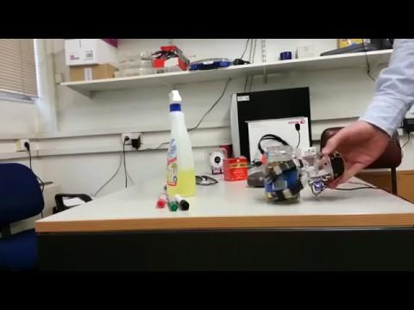

Slide 5
Hand Synergies
hand synergies represent the intrinsic mechanism by which a hand operates
the apparent control is moving the angle of each finger joint–this mechanism lives in a high-dimensional space
experiments in neurophysiology validate that each joint is not exactly independent of the rest in the context of grasping
the lower dimensional space X that can approximate the original joint state space Y as f(X) is the space of hand synergies

Slide 6
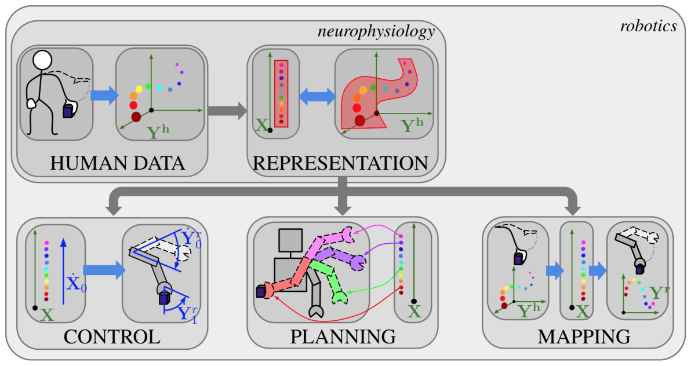

Slide 7
Discovering Synergies with PCA
Principal Component Analysis (PCA) is a conventional unsupervised learning technique used to discover synergies in a dataset of grasps on various objects
PCA finds the lower dimensional space that maximizes the variance of the original dataset when projected into this space
The first two principal components capture about 80% of human grasps

Slide 8
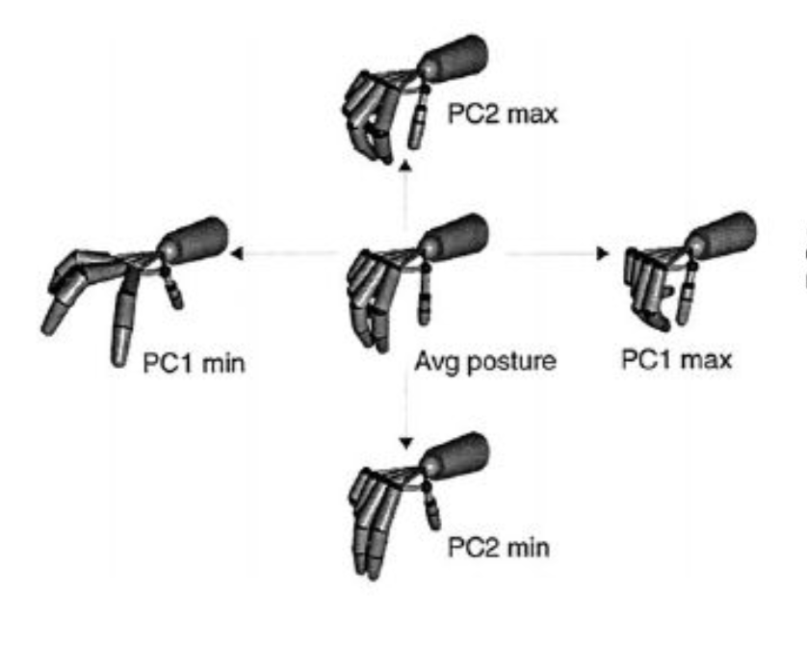

Slide 9
Non-Linear Dimensionality Reduction
Starke suggests that the correlation between finger motions are highly non-linear
one such non-linear method is known as Gaussian Process Latent Variable Models (GPLVM)
GPLVM outperforms the reconstruction and generation of grasps
non-linear methods introduce further complexity into the selection of control parameters to achieve a desired grasp

Slide 10
Starke’s Main Contribution
clusters representing grasp types and/or object geometries can be found in the original high dimensional space
projecting these grasps into a lower dimensional space does not preserve these clusters
sampling the latent space for a specific grasp type with a specific object size is therefore nearly impossible
successfully discovers a subspace of synergies that cluster together with respect to the above parameters, allowing for object-specific grasp generation

Slide 11
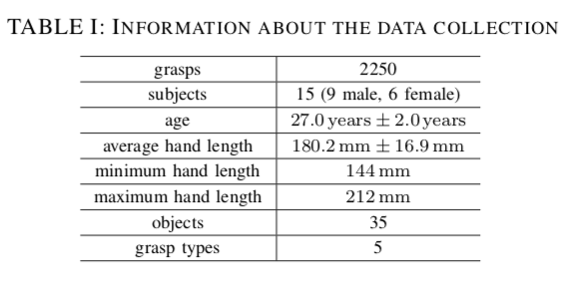
Data Acquisition

Slide 12
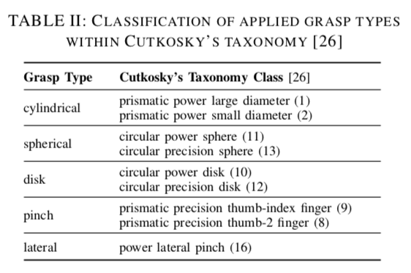
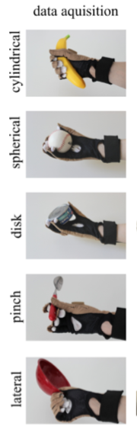
Data Acquisition

Slide 13
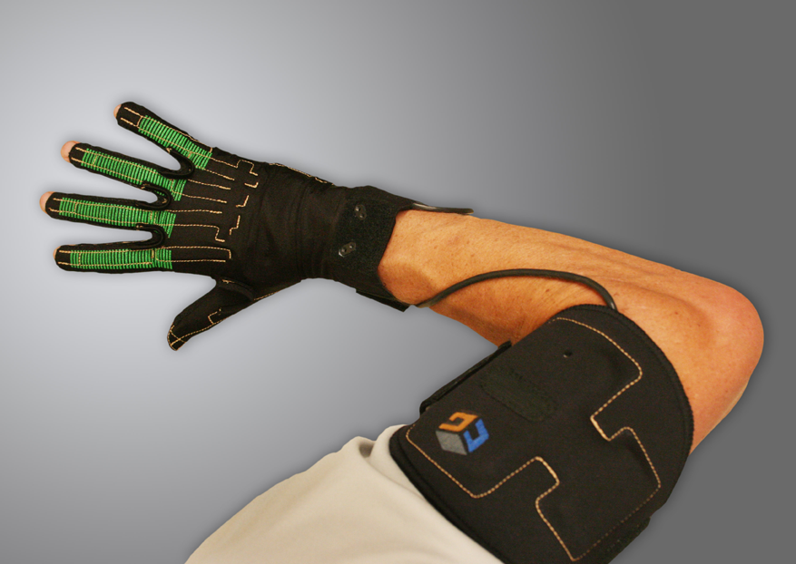
Data Acquisition with the CyberGlove III

Slide 14
Data Acquisition Procedure
each of the five grasp types is conducted with ten objects three times each per subject
the objects are selected from the YCB Object Set and the KIT Object Set
Flat Hand Calibration Pose
Grasp Objects
Record Static Grasp Pose
Flat Hand Calibration Pose

Slide 15
Deep Autoencoder Requirements
the latent space should allow for low-dimensional encoding of grasp poses
the latent space should be encoded in a way that allows intuitive generation of different grasp types for a given object size
vanilla VAEs and AEs are able to reduce dimensionality but fail to cluster grasp types together in the lower dimensional space
add additional constraints to the Loss function to capture the significance of preserving grasp type clusters

Slide 16
Deep Autoencoder Architecture
Original Space Y belongs to R^16
Latent space Z belongs to R^3
Encoder is g: R^16 to R^3
Decoder is h: R^4 to R^16
g(y) = z, h(z, object_size) = y_hat

Slide 17
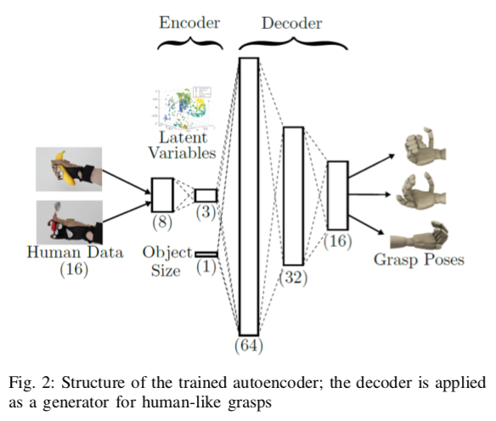

Slide 18
Deep Autoencoder Loss
Mean Square Error: minimize the sum of the squared differences between ground truth and prediction
Add a penalizing term for y belonging to the same grasp type: the MSE between the encoded representations
Remove a penalizing term for y belonging to different grasp types
Loss = alpha*MSE(y, y_hat) + beta*MSE(g(y), g(x belonging to same grasp type)) + gamma*MSE(g(y), g(x belonging to different grasp type))

Slide 19
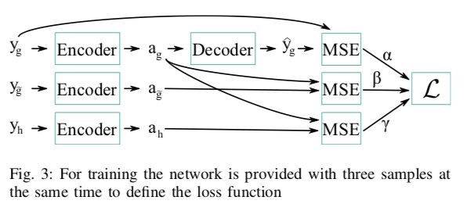
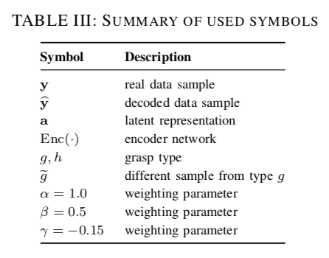

Slide 20
Deep Autoencoder Training
Gaussian noise with standard deviation of 0.1 added to input of AE during training to avoid overfitting and increase the size of the grasp type clusters
decoder is provided with relative size of the object (i.e. object size normalized by the size of the subject’s hand)
90/10 train/test split with a stratified 10-fold-cross-validation
10 iterations of independent training

Slide 21
Deep Autoencoder Performance
outperforms PCA by 5^O
introducing object size as a parameter to the decoder reduces the overall reproduction error by 26 %
a latent space with 3 parameters has marginal gain in performance from 2 parameters, but the distribution of grasp types is more distinct in 3D
reversed AE architecture outperforms conventional mirrored architecture

Slide 22
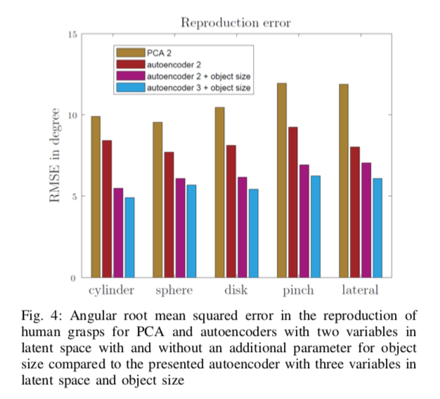

Slide 23
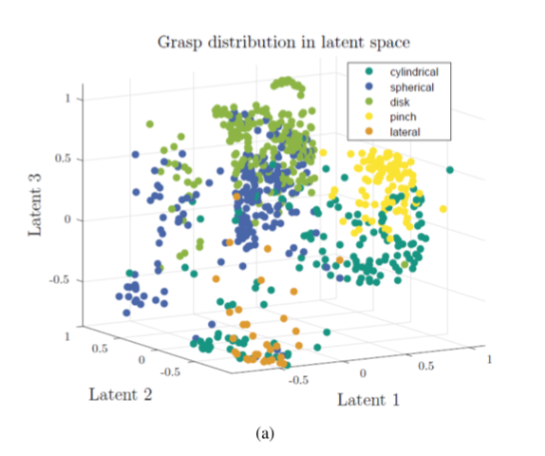
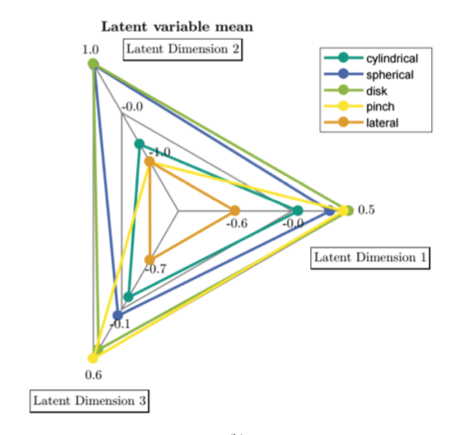

Slide 24
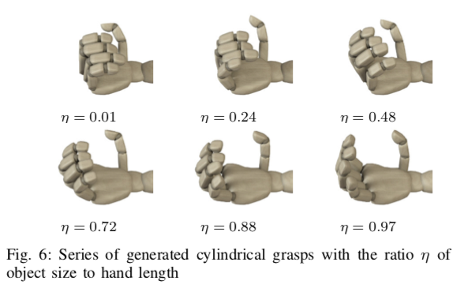
Deep Autoencoder Grasp Generation

Slide 25
Deep Autoencoder Latent Distribution
First Synergy (Latent parameter 1)
  only parameter that controls the thumb in its full range of motion (needed for pinch grasps)
  mainly controls flexion of index, middle, and ring (needed for lateral grasps)
Second Synergy (Latent parameter 2)
  mainly controls finger adduction joints (i.e. spread of fingers needed for spherical and disk grasps)
Third Synergy (Latent parameter 3)
  fine-tuning of proximal interphalangeal joints (needed for cylindrical grasps)

Slide 26
References
Starke, Julia & Eichmann, Christian & Ottenhaus, Simon & Asfour, Tamim. (2018). Synergy-Based, Data-Driven Generation of Object-Specific Grasps for Anthropomorphic Hands. 327-333. 10.1109/HUMANOIDS.2018.8624990.

