Slide 1
TACTILE SENSORS FOR ROBOTIC APPLICATIONS
Pedro Silva Girão, Pedro Miguel Pinto Ramos, Octavian Postolache José, Miguel Dias Pereira
Journal of the International Measurement Confederation (IMEKO) - ELSEVIER
Presented By: Abhinandan Srinivasan (as5630)

Slide 2
TACTILE SENSING
Two main research areas:
  Object manipulation tasks
  Characterizing surface textures
Respond to contact forces – touch, tactile and slip sensing
  Parameters that define the contact b/w sensor and an object – Localized Interaction
  Array of a coordinated group of touch sensors
Haptic Perception – requires both sensory and motor systems
Human touch – 4 type of tactile receptors
  Meissner corpuscles, Merkel cells, Ruffini endings, and Pacinian corpuscles.

Slide 3
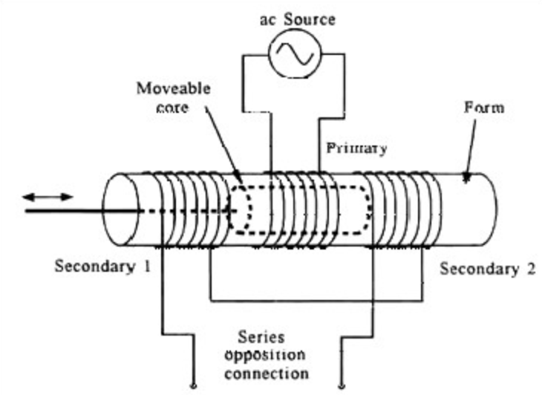
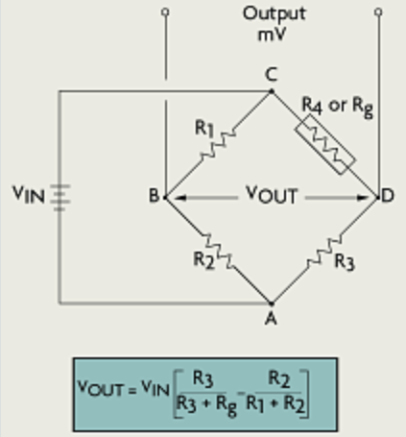
MECHANICAL SENSORS
DEFORMATION BASED SENSORS
Potentiometer
LVDT
- Provide voltage proportional to the local force (Pressure)
Strain gauges attached to deformable material
Deformation – Electric Domain
Calibrated with known force

Slide 4
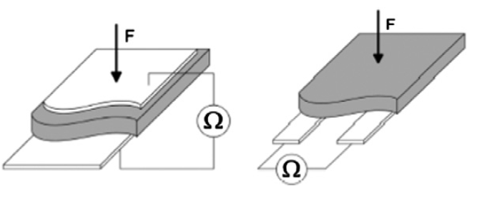
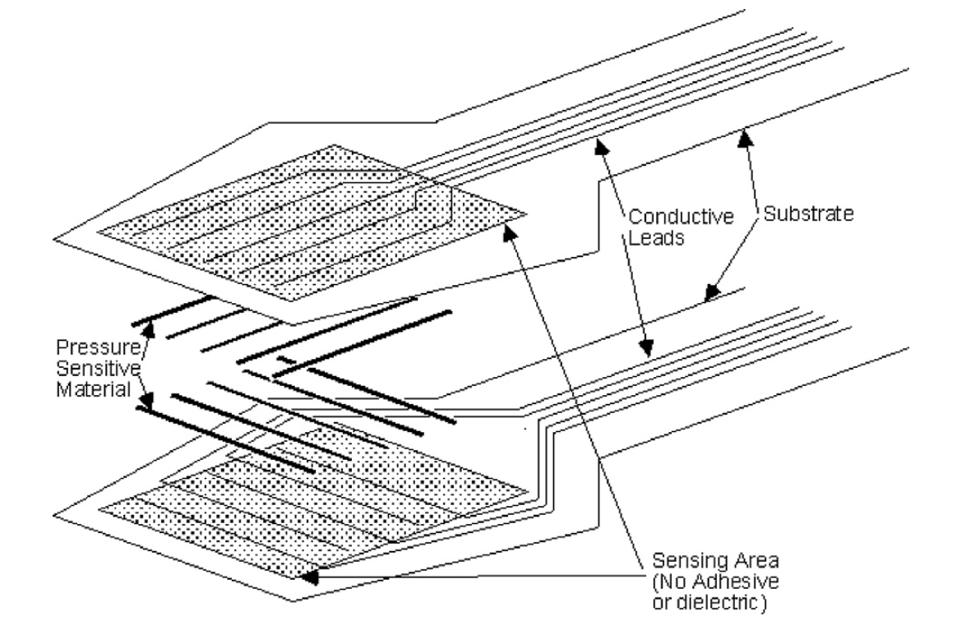
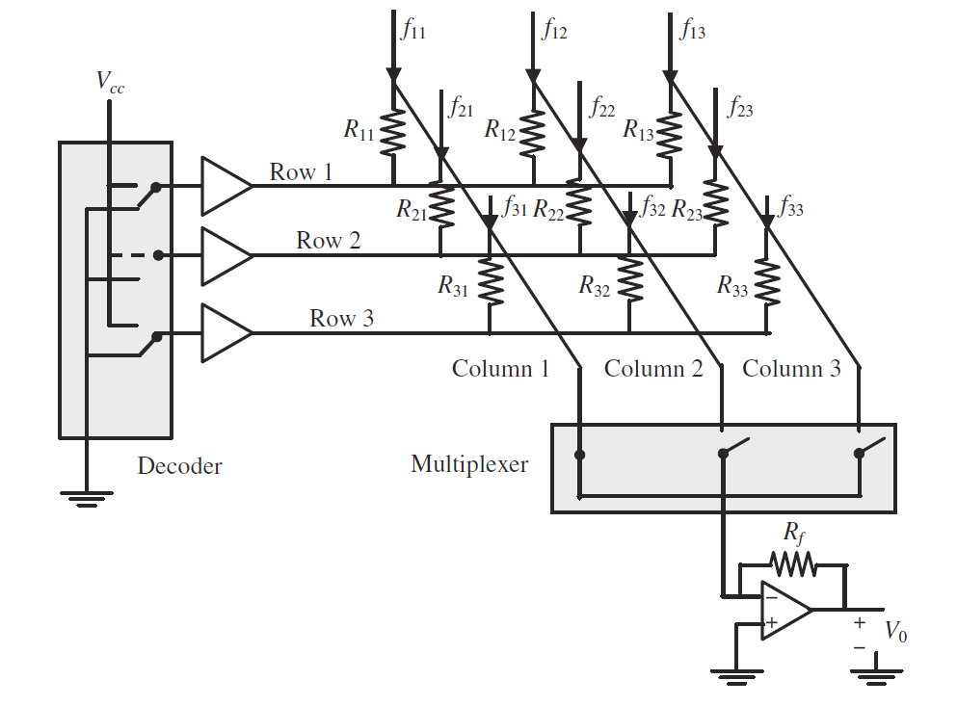
RESISTIVE BASED SENSORS
Change in electrical resistance with pressure of material b/w two electrodes.
Usage of conductive elastomer
  Long non-linear time constant
  Force – resistance characteristics are highly non-linear
  Poor medium and long-term stability
Made using conductive polymers and thin semi-conductive coating (ink)
Notes:
In addition the time constant of the elastomer, when force is applied, is different from the time constant when the applied force is removed;
The conditioning circuits of resistive-based tactile sensors are fairly simple, which is one of their advantages.

Slide 5
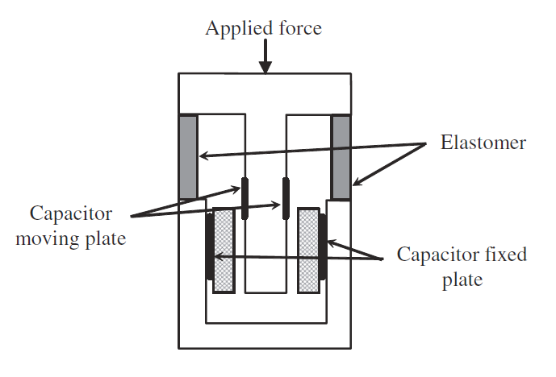
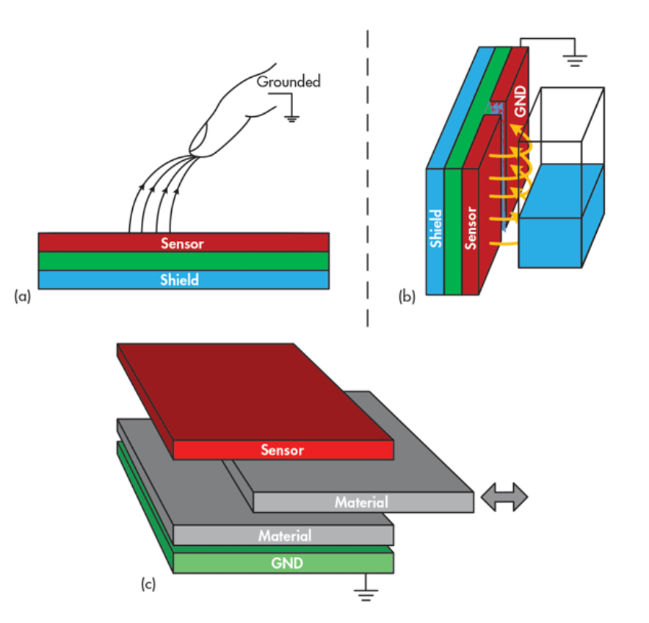
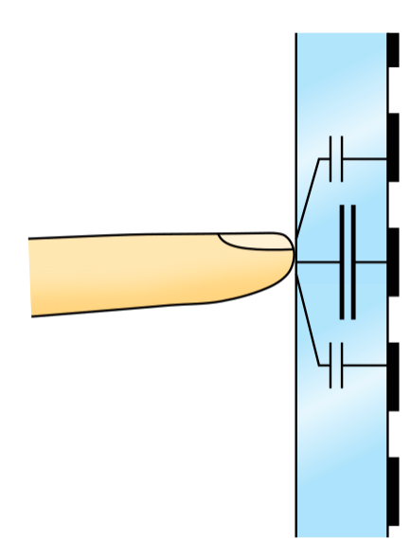
CAPACITIVE BASED SENSORS
Capacitance changes with applied force
  Change in area
  Change in distance b/w the two plates
Design criterion
  Smaller size
  Selection of dielectric
  High sensitivity
Measure change in capacitance
  Charge capacitor – Voltage proportional to inverse of capacitance
  Oscillator frequency
(a) proximity sensor
(b) liquid-level sensing
(c) material detection and analysis

Slide 6
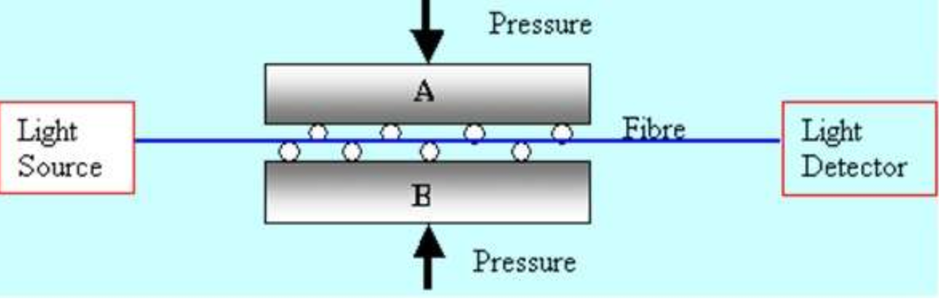
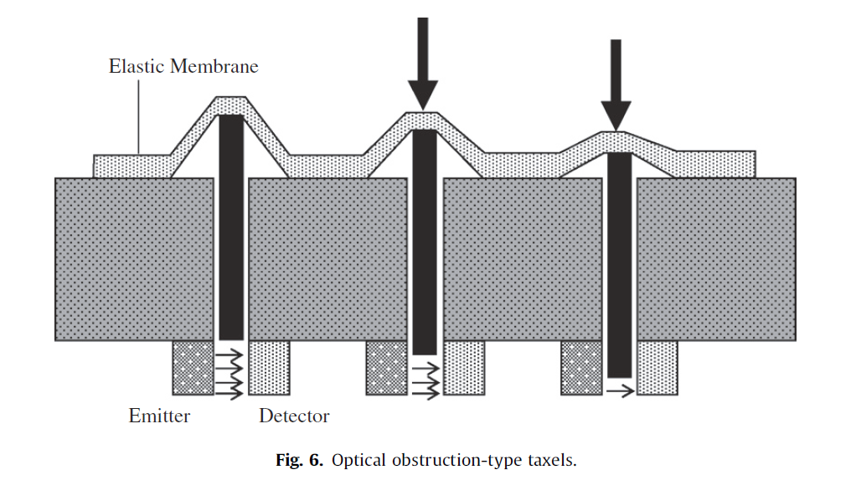
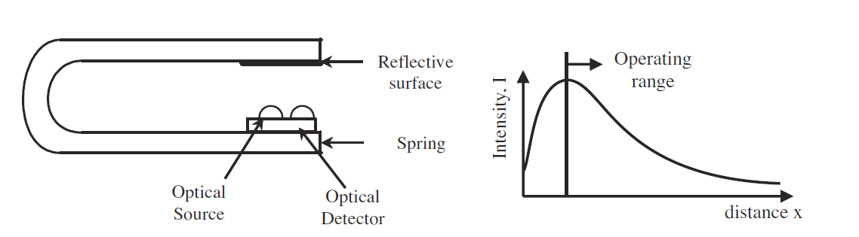
OPTICAL SENSORS
Intrinsic
  Intensity, Phase or polarization – modulated by applied force
  Does not interrupt optical path
Extrinsic
  Force interacts with light external to primary path
  Modulation by moving an obstruction into the light path.
  Moving reflective surface into the light path.

Slide 7
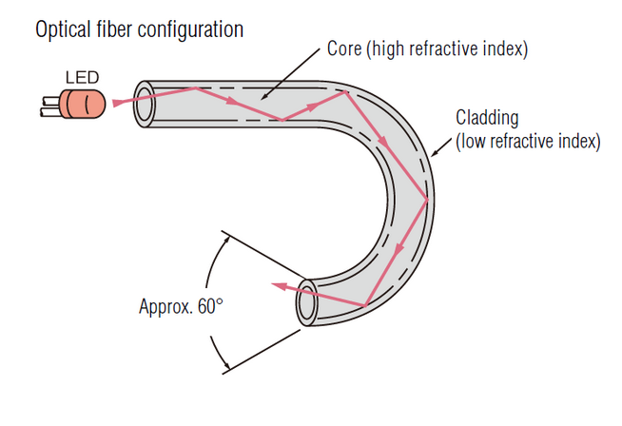
OPTICAL FIBER BASED SENSORS
Not only light transmission
Mechanical bend or perturbation
  Radius of curvature
  Spatial wavelength
  Fiber parameters

Slide 8
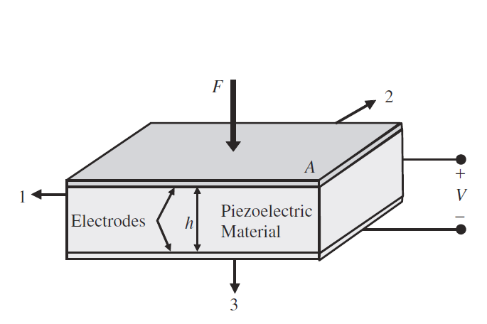
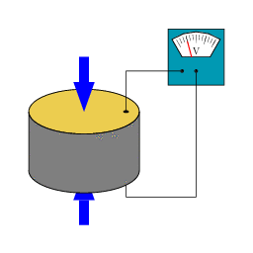
PIEZOELECTRIC SENSORS
Typical Materials:
  Polymer polyvinylidene fluoride (PVDF)
  Ceramic lead zirconium titanate
Not adequate for static force transduction
  Vibrating sensor and calibrating vibration frequency with force

Slide 9
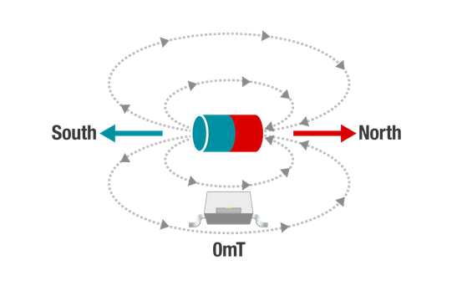
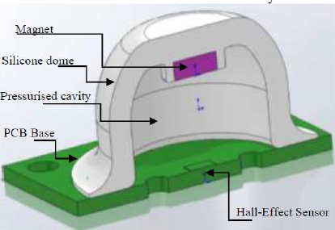
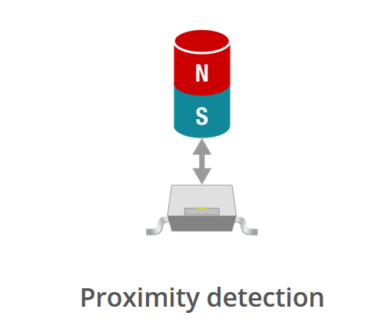
MAGNETIC BASED SENSORS
Measure Magnetic Flux changes
MagOne sensor [1]
  3-axis force measurement
[1] Soft tactile sensors with variable compliance

Slide 10
SIGNAL CONDITIONING PROCESSES
Filtering – Removing Noise
Amplification – Suitable for ADC
Attenuation – Higher Voltages above ADC range
Excitation – External power input
Linearization – Voltage signals related to physical measurement

Slide 11
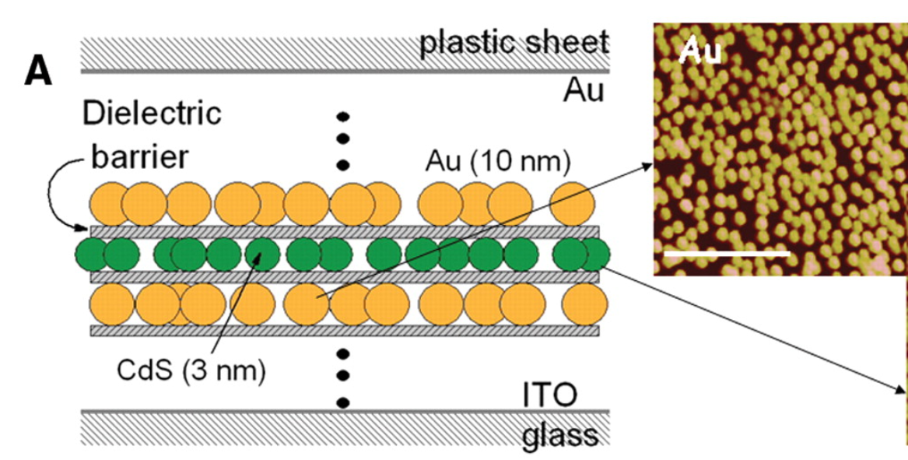
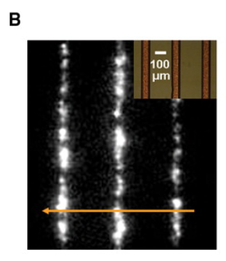
TACTILE SENSORS
Development of tactile sensing
  Touch screen displays
  Medicine – Minimally invasive and remote surgery
MEMS Tactile sensors
  Polymer with material substrate
  Silicon based sensors
Nanotech Tactile sensors
  100nm think film on electrode glass backing
  5 alternating layers of gold and cadmium sulfite
  Electrons bounce of layers – cadmium sulphate particles glow.

Slide 12
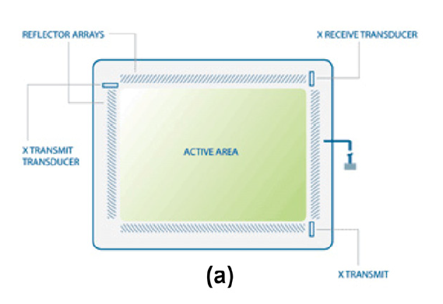
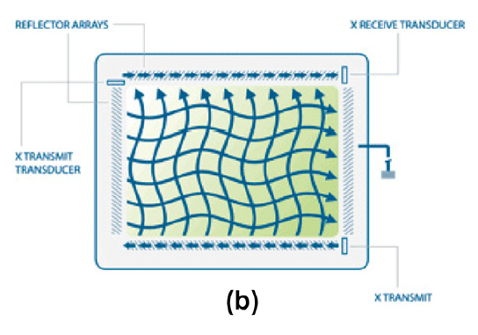
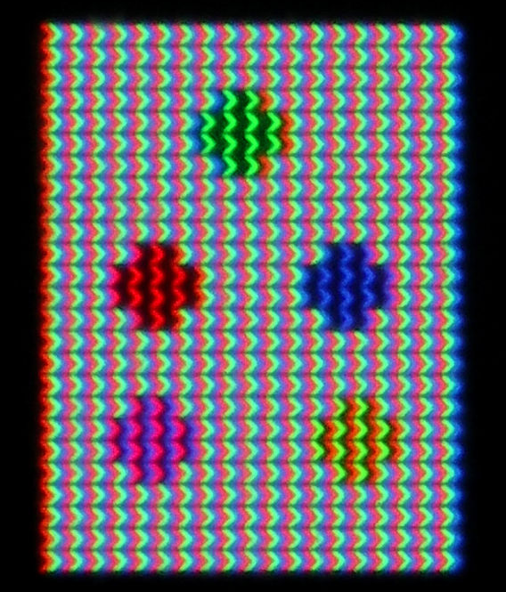
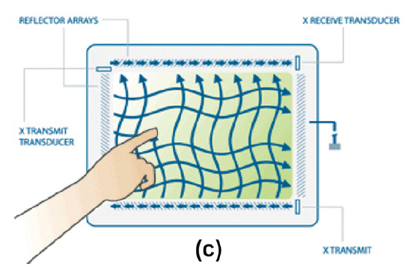
TOUCH SCREEN DISPLAYS
Surface acoustic waves (SAWs)
  Two transducers along both axes
  Reflectors that reflect electrical signals sent b/w transducers
  One’s finger absorbs some energy
  Multi-touch isn’t achievable
In-Plane Switching (IPS)
  Allows multi-touch

Slide 13
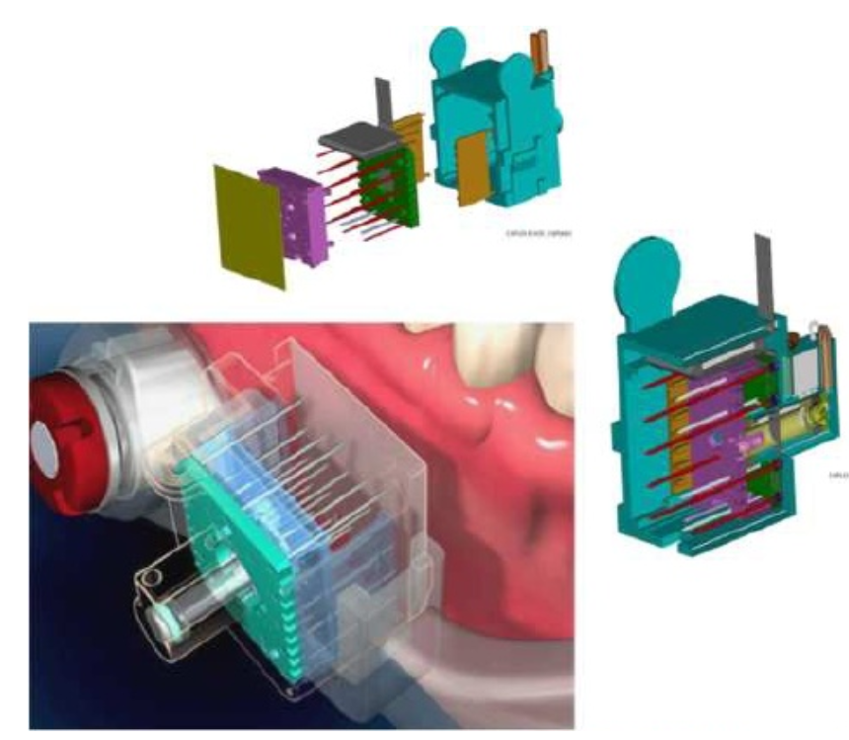
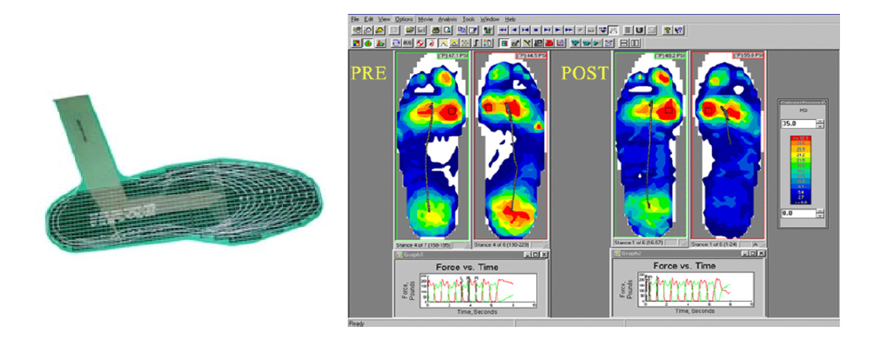
MEDICAL APPLICATIONS
Gait Analysis – In shoe sensor
Dental implants
  Image of maxillary bone contour without removal of gum tissue. [2]
Minimally invasive Surgeries
Optimization of seating and positioning
[2] Kurt. Schicho et al., Evaluation of bone surface registration applying a micro-needle array, Journal of Clinical Periodontology 34 (11) (2007) 991–997.

Slide 14
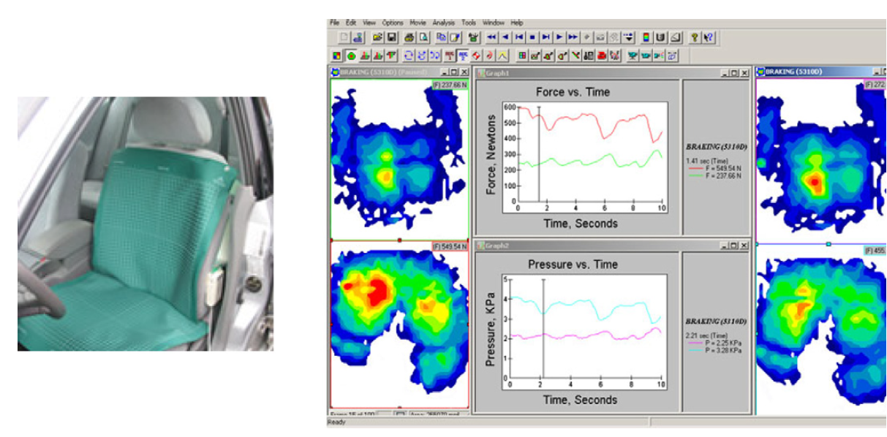
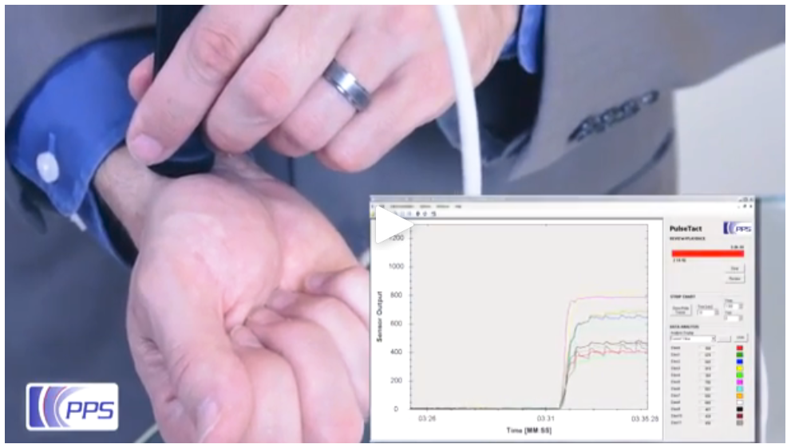
INDUSTRIAL APPLICATIONS
Brake Pad design and performance assessment
Design of sear cushoning
Door mounting quality
Assistance in windshield wiper design
Tire tread performance analysis
Smart watches – Pulse sensors

Slide 15
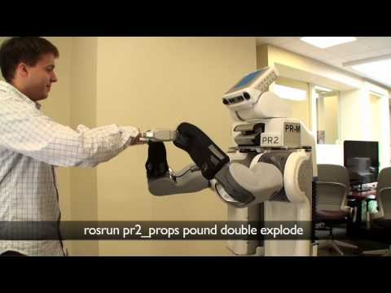
ROBOTIC APPLICATIONS

Slide 16
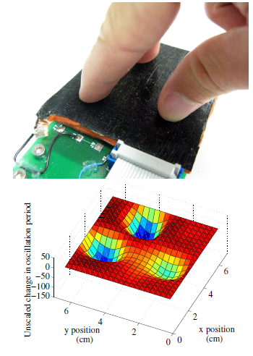
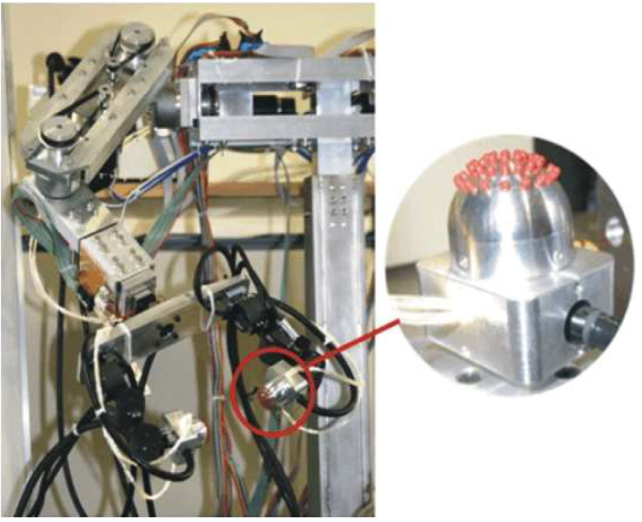
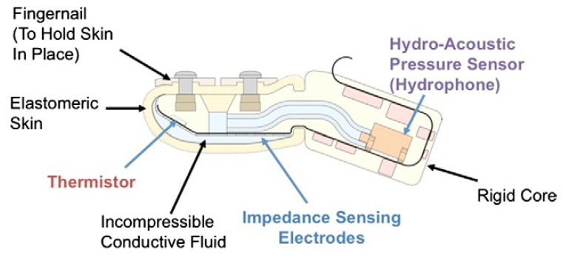
ROBOTIC APPLICATIONS
Capacitive Pressure sensors
  Improves grasping in underactuated mechanisms
Optical sensors
  Adjusts grip based on surface property changes.

Slide 17
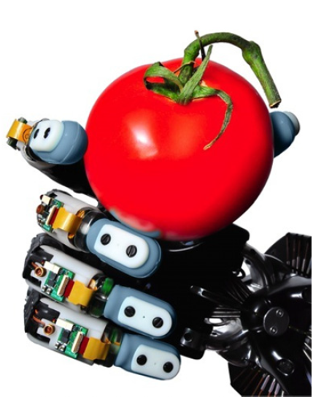
CONCLUSION
Basic tactile sensing transduction principles are well established.
Tactile and particularly haptic sensing - demanding not only in terms of hardware but also of software.
Wireless Tactile sensors development would be useful
Sensors that could also read temperature, texture
MARKET DRIVING R&D
Prefer robust solutions
Medicine and service robots

