Slide 1
Prediction of Whole-Body Movements with AE-PRoMPs¹
Matthew Chan
[1] By Oriane Dermy , Maxime Chaveroche, Francis Colas,, Francois Charpillet , Serena Ivaldi
Notes:
References:
https://www.ias.informatik.tu-darmstadt.de/Research/LearningToPlayPing-pong
http://www.cs.columbia.edu/~allen/S19/predicting_human_motion.pdf
https://link.springer.com/article/10.1007/s10514-017-9648-7
https://www.frontiersin.org/articles/10.3389/frobt.2017.00045/full#h19
https://papers.nips.cc/paper/5177-probabilistic-movement-primitives.pdf
https://brml.org/uploads/tx_sibibtex/CheKarSma2016.pdf
https://arxiv.org/pdf/1807.02350.pdf
https://studywolf.wordpress.com/2013/11/16/dynamic-movement-primitives-part-1-the-basics/

Slide 2
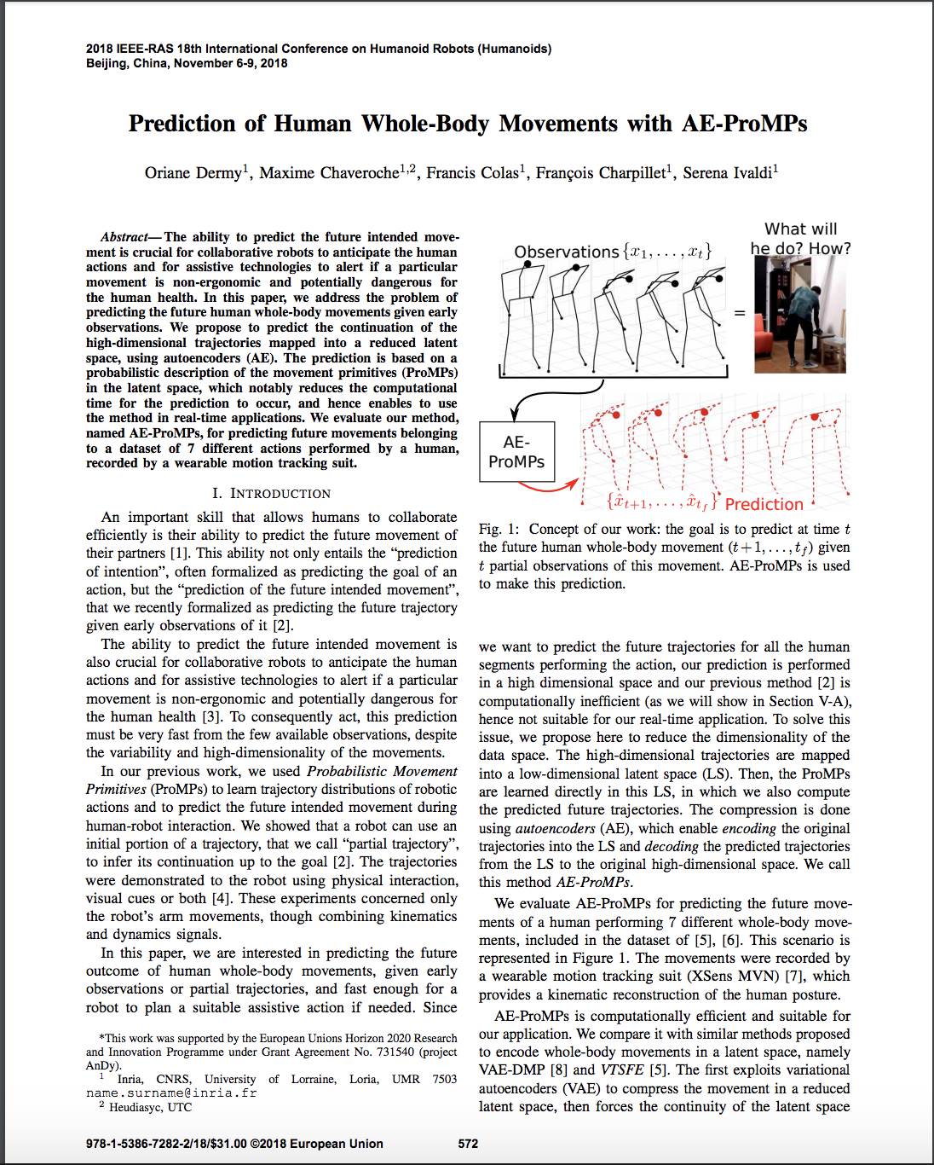
Agenda
Objective
Use Cases
Issues & Assumptions
Background Knowledge
Experiment
Results

Slide 3
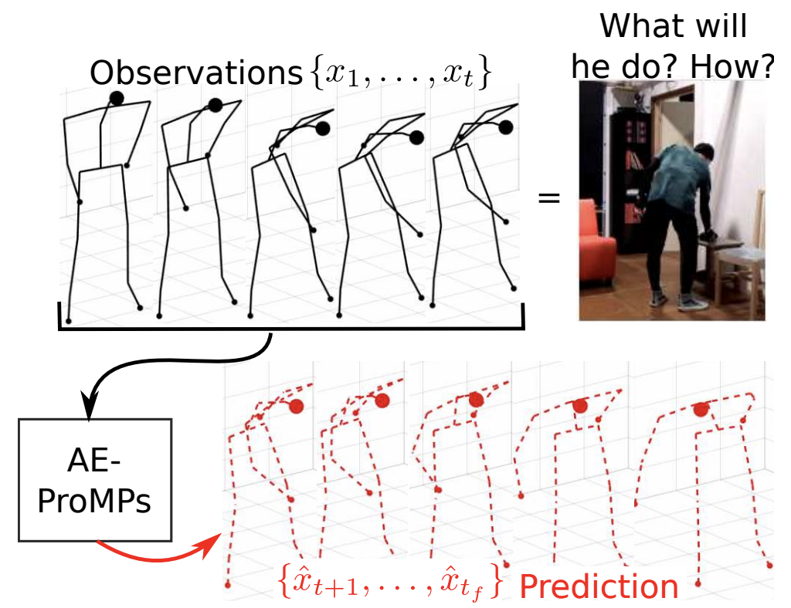
Purpose
Predicting future movements of a human before they happen.
We do this everyday!
Notes:
Give examples, e.g. picking up a pencil from the floor, avoiding walking into other people on the street

Slide 4
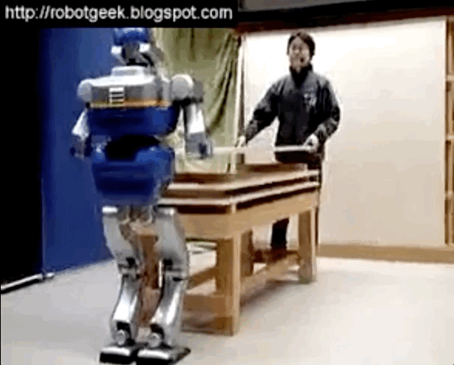
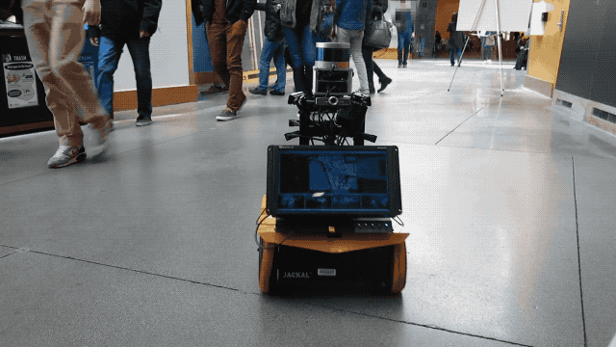
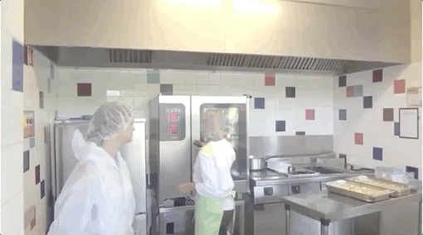
Use cases
Safe robot navigation around humans
Preventing humans from hurting themselves
Perform different actions based on human action

Slide 5
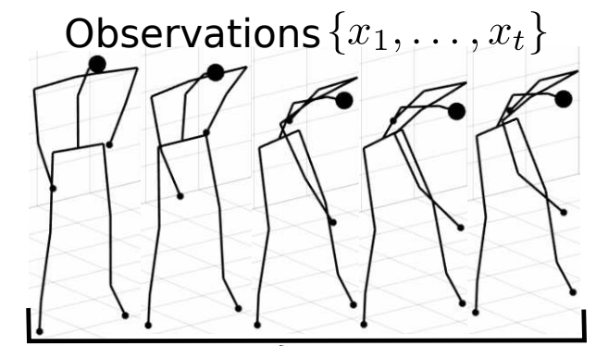
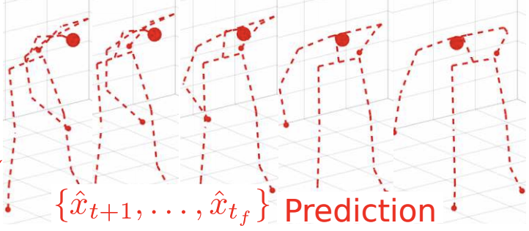

Input
Output
The initial trajectory of the human body (i.e. joint positions for some amount of time t)
The predicted future trajectory of the human body

Slide 6
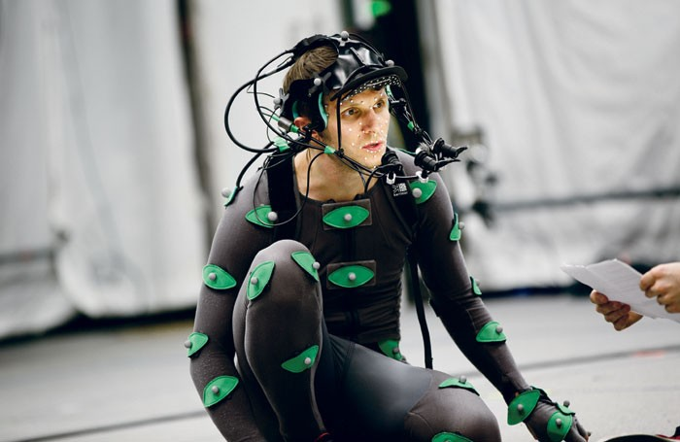
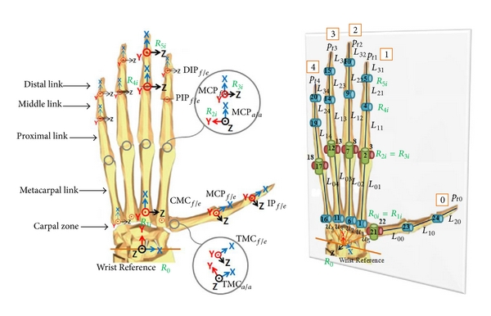
Potential Issues?
How to obtain input trajectory?
High-dimensionality of human body
How to understand the “intent” of a human?
High variability of human movements

Slide 7
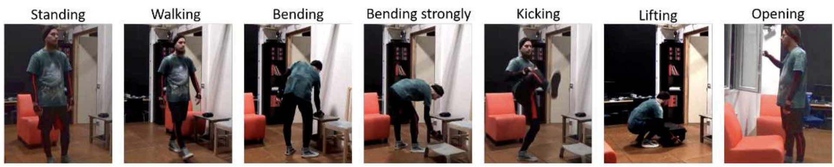
Assumptions
Human is wearing an XSens motion capture suit
Human must be performing 1 of 7 defined movements
We have a set of pre-recorded demos of each movement

Slide 8

How to predict trajectories?
First we must understand movement.
Movement primitives!

Slide 9
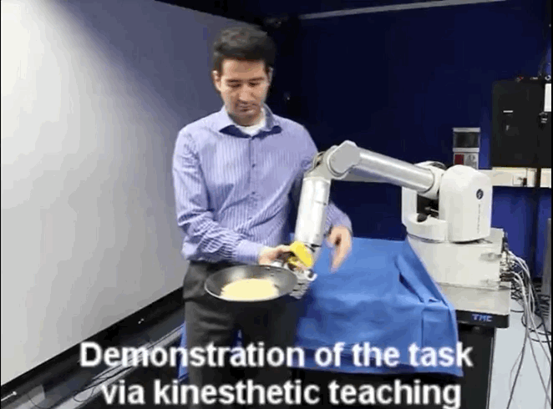
Movement Primitives (MP)
Idea: Break down movements into simple “building blocks”
Teach robot via demonstration
Refine via reinforcement learning
Goal: Combine multiple MPs to perform complex movements

Slide 10

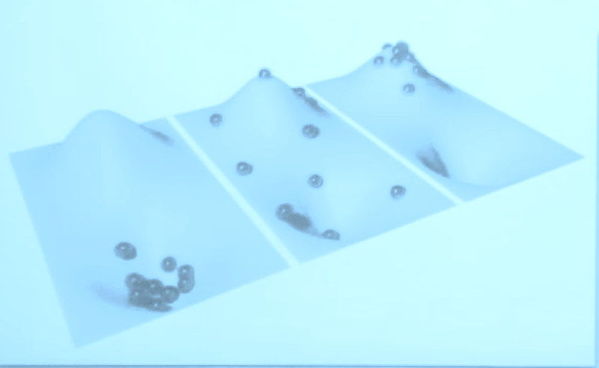
Dynamic Movement Primitives (MP)
System forces balls towards the goal
Damped spring system
f is a function that deforms the surface

Slide 11
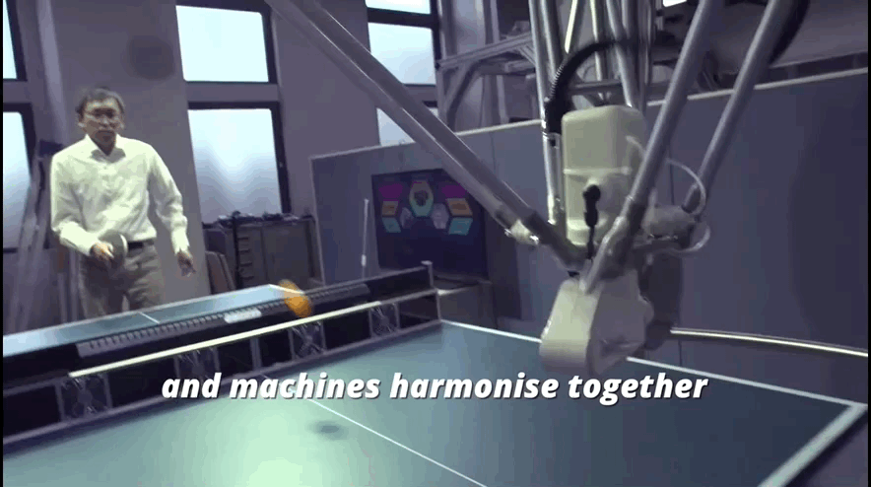
Benefits
Spatial scaling
Temporal scaling

Slide 12
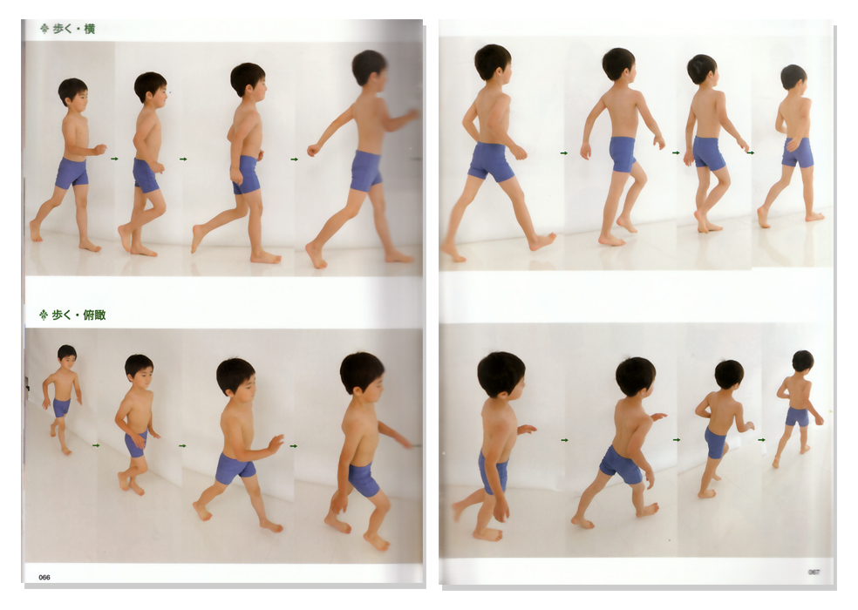
Cons?
No variation in trajectory
Co-activation is not trivial

Slide 13
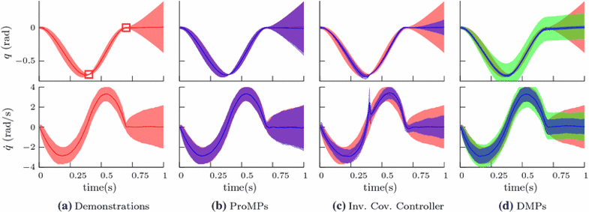
Probabilistic Movement Primitives (ProMPs)
Properties
Encodes variance of trajectories
Stochastic (rather than deterministic)

Slide 14
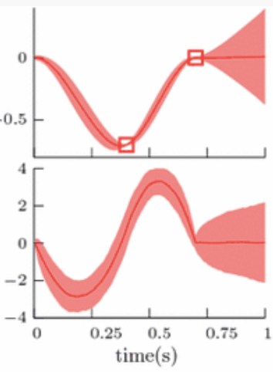
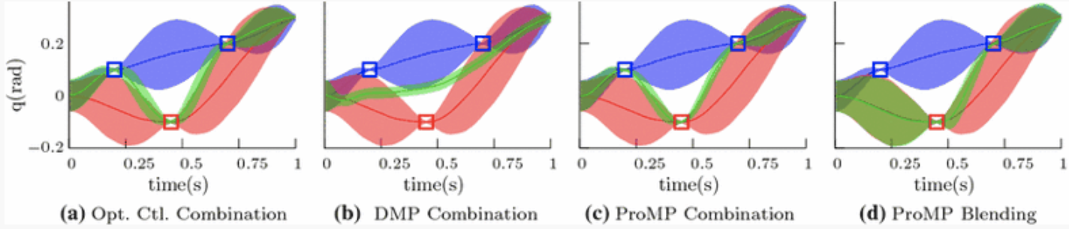
Why is this useful?
Insight into importance of single points in time on overall movement
Improved co-activation
“The variability of the movement, or the variance in distribution terms, is crucial, as it reflects the importance of single time points for the movement execution and it is often a requirement for representing optimal behavior in stochastic systems (Todorov and Jordan 2002). Moreover, capturing the variance of the movement leads to better generalization capabilities and to more natural movements.”
Notes:
The control law is based on the intuition that the gains have to be lower when the variance of the trajectories is higher.

Slide 15
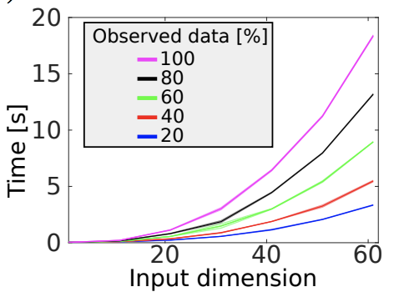
Issues
Requires pre-training and demos for each movement primitive
Computation time grows quadratically with input dimension
Too slow for real-time robot prediction / response
Prediction time should be in the milliseconds-- the robot needs maximum time to act

Slide 16
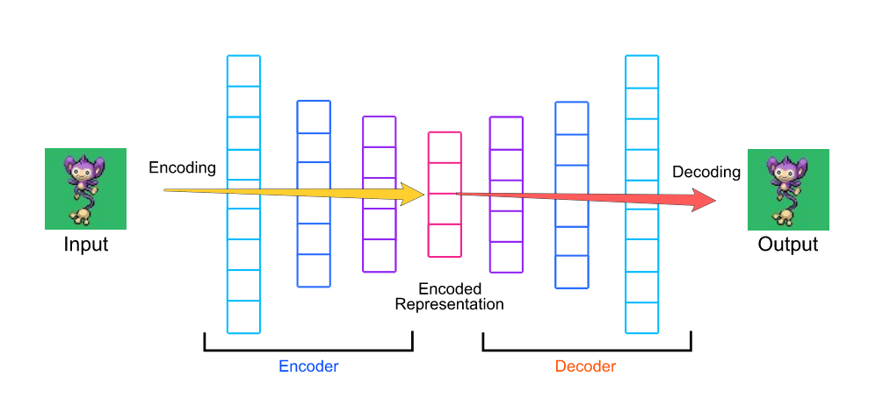
Solution?
Autoencoders!

Slide 17
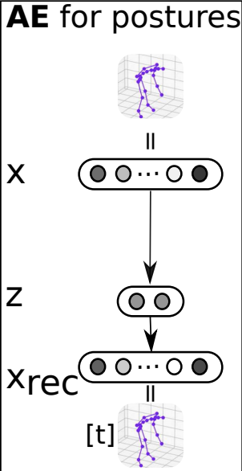
Autoencoders (AE)
“An autoencoder is a type of artificial neural network used to learn efficient data codings in an unsupervised manner.^{[1][2]} The aim of an autoencoder is to learn a representation (encoding) for a set of data, typically for dimensionality reduction, by training the network to ignore signal “noise.” Along with the reduction side, a reconstructing side is learnt, where the autoencoder tries to generate from the reduced encoding a representation as close as possible to its original input, hence its name.”

Slide 18
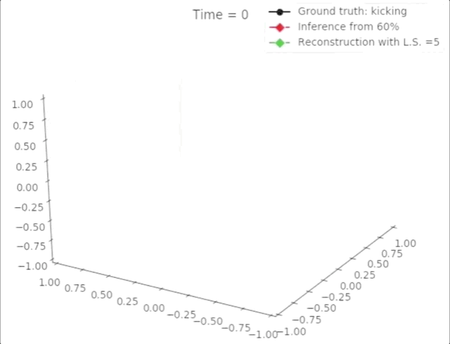

Slide 19
Method
Use 10 human demos to build the trajectory distribution for each movement primitive
Given n% of the trajectory data as input
Encode 69 DOF human skeleton into 5 DOF latent space
Use ProMPs to predict the rest of the trajectory
Decode the last (100 - n)% of the trajectory

Slide 20
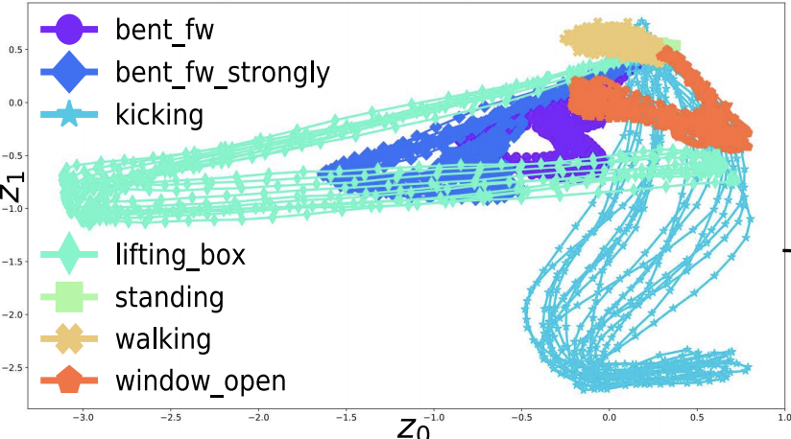

Slide 21
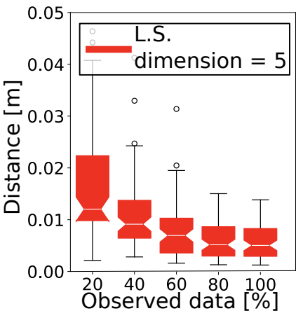
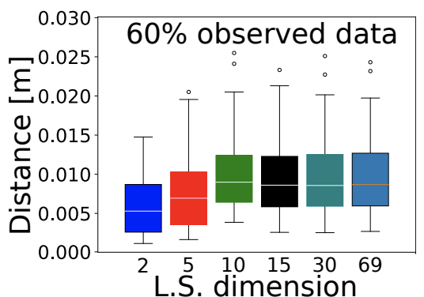
Results

Slide 22
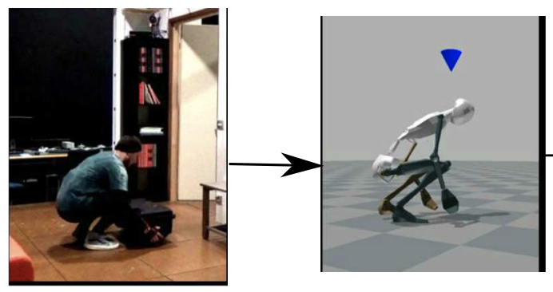
Conclusions
Pros
Handle variation in movement
Reasonable compute time
Cons
Obtaining input
Predicting combinations of MPs
Understanding human intent

Slide 23
Questions?

