Slide 1
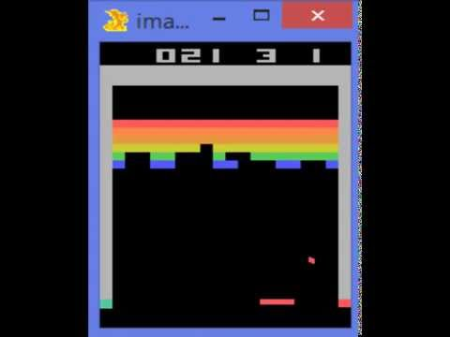
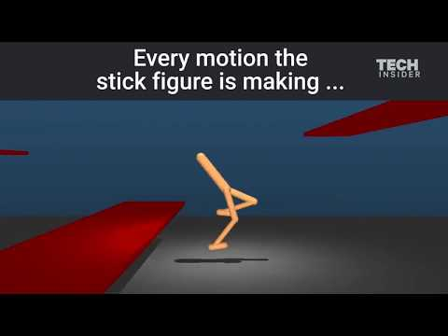

Reinforcement Learning for Robotics
Iretiayo Akinola

Slide 2
Reinforcement Learning for Robotics
Iretiayo Akinola
http://www.cs.columbia.edu/~iakinola/
Notes:
Learning based approaches to robot learning

Slide 3
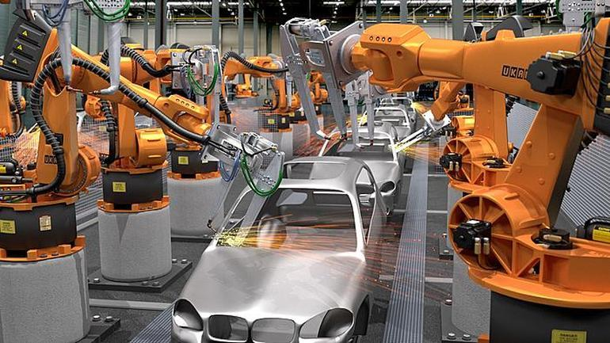
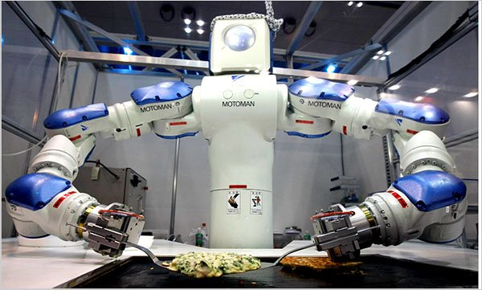
Robot Learning
Robotics: see, think, act
Direct programming can be hard for different tasks
Degree of structure and consistency
Perception
Manipulation
Deformation
Vacuum robots
Lawn mowing
Pool cleaning
Manufacturing robots
Home-cleaning robot
Cooking Robot
Laundry Robot
Warehouse Robot
Notes:
It is impossible to pre-program all the necessary knowledge into a robot operating in a diverse, dynamic and un- structured environment.

Slide 4
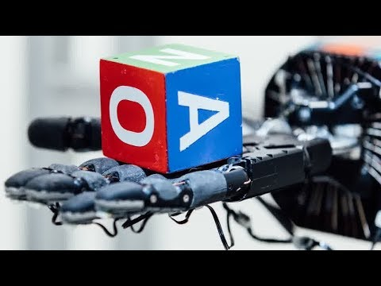
Robot Learning
Robotics: see, think, act
Direct programming can be hard for different tasks
Degree of structure and consistency
Perception
Manipulation
Deformation
Vacuum robots
Lawn mowing
Pool cleaning
Manufacturing robots
Home-cleaning robot
Cooking Robot
Laundry Robot
Warehouse Robot
Notes:
It is impossible to pre-program all the necessary knowledge into a robot operating in a diverse, dynamic and un- structured environment.

Slide 5
Robot Learning
LfD
RL
An alternative to direct programming is learning-based methods:
Learning from Demonstration
Reinforcement Learning
Notes:
It is impossible to pre-program all the necessary knowledge into a robot operating in a diverse, dynamic and un- structured environment.

Slide 6
Robot Learning
LfD
RL
An alternative to direct programming is learning-based methods:
Learning from Demonstration
Reinforcement Learning
Notes:
It is impossible to pre-program all the necessary knowledge into a robot operating in a diverse, dynamic and un- structured environment.

Slide 7
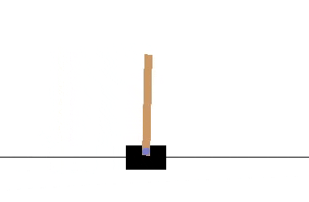
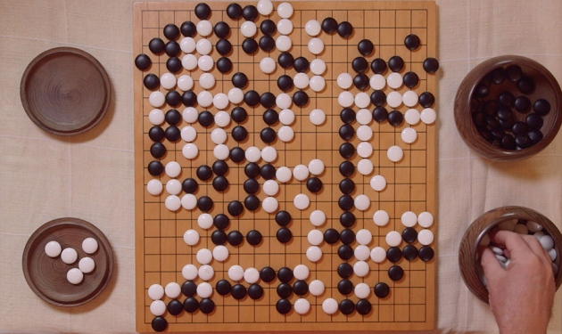
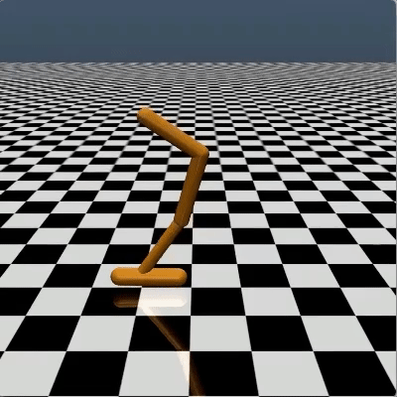
Reinforcement Learning
Learning by trial and Error
Maximize cumulative rewards
Learn a policy
Reinforcement Learning Progress
Classical Control
Games: Atari, Go
Robotics
  continuous space, complex transition dynamics, complex rewards
Notes:
Reinforcement Learning is one of main pillars of Robot Learning
Robotics: continuous space, complex transition dynamics, complex rewards

Slide 8
Reinforcement Learning
Learning by trial and Error
Maximize cumulative rewards
Learn a policy
Reinforcement Learning Progress
Classical Control
Games: Atari, Go
Robotics
  continuous space, complex transition dynamics, complex rewards
Notes:
Reinforcement Learning is one of main pillars of Robot Learning
Robotics: continuous space, complex transition dynamics, complex rewards

Slide 9
Reinforcement Learning
Learning by trial and Error
Maximize cumulative rewards
Learn a policy
Reinforcement Learning Progress
Classical Control
Games: Atari, Go
Robotics
  continuous space, complex transition dynamics, complex rewards
Notes:
Reinforcement Learning is one of main pillars of Robot Learning
Robotics: continuous space, complex transition dynamics, complex rewards

Slide 10
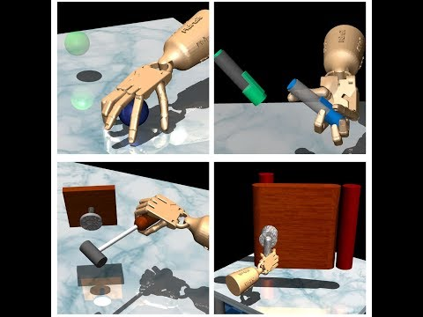
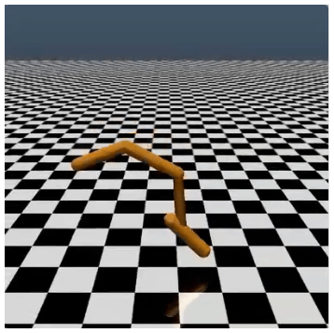
Reinforcement Learning
Robotics
  continuous space
  complex transition dynamics
  complex rewards

Slide 11
Reinforcement Learning
Robotics
  continuous space
  complex transition dynamics
  complex rewards

Slide 12
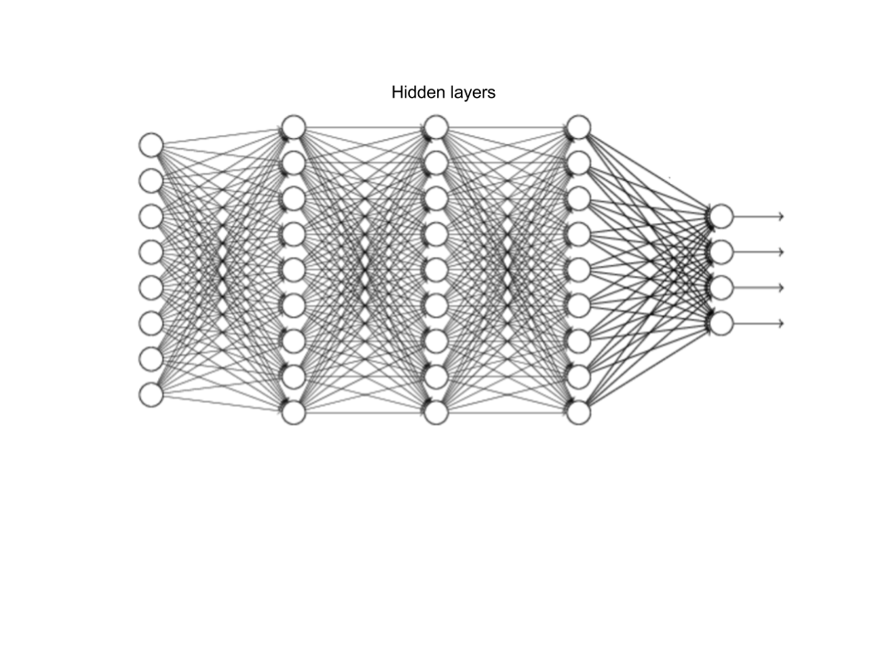
Reinforcement Learning in Robotics
Key Elements of recent Success
Deep Learning
Simulators (mujoco, bullet, roboschool, dart, gazebo, carsim)
Action/ Controls
Observation/States
Notes:
Reinforcement Learning Recent Enablers
Simulators are better, nice interfaces

Slide 13
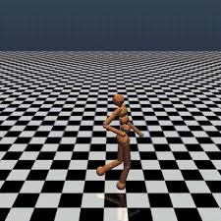
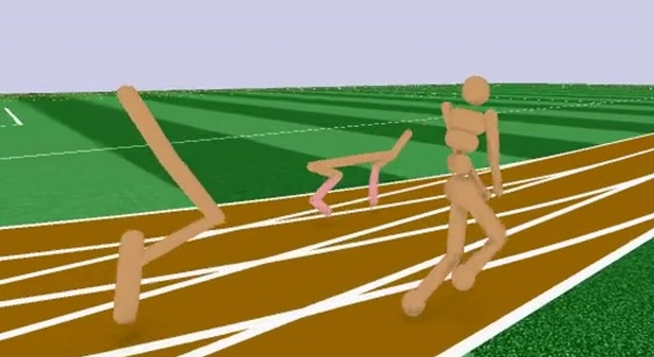
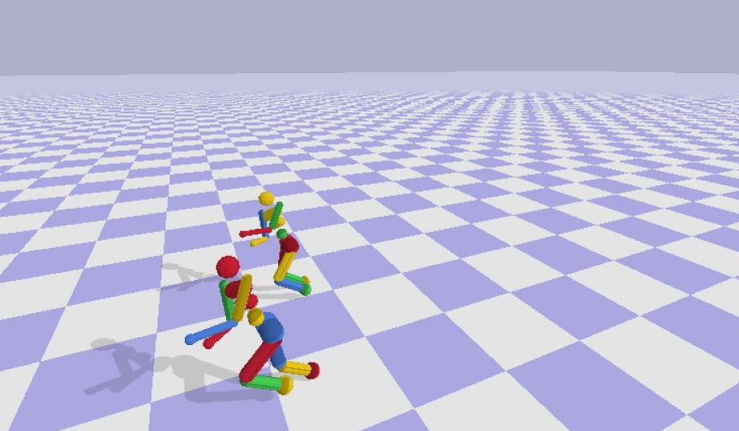
Reinforcement Learning in Robotics
Key Elements of recent Success
Deep Learning
Simulators (mujoco, pybullet, roboschool, gazebo)
mujoco
roboschool
pybullet
Notes:
requires alarge amount of experience which is impractical outside of simulation
Reinforcement Learning Recent Enablers
Simulators are better, nice interfaces
RL systems takes tens of thousands steps trials

Slide 14
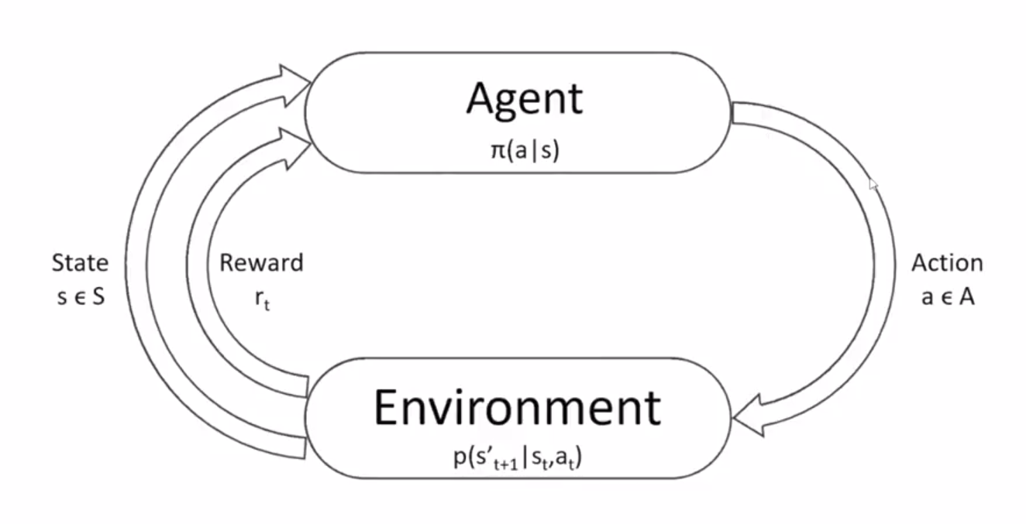
Reinforcement Learning Formulation
Markov Decision Process

Slide 15



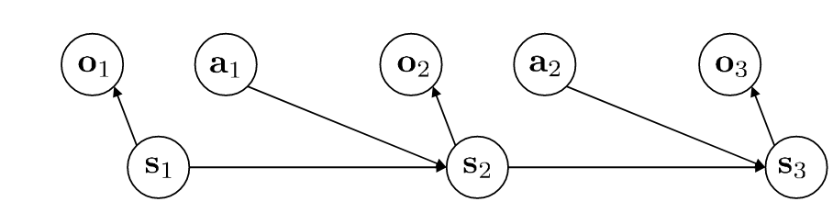
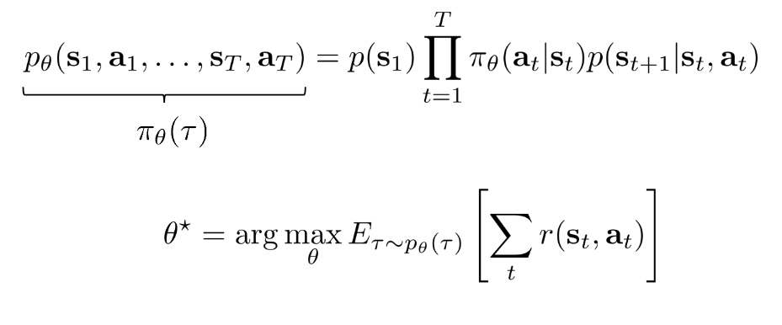
Reinforcement Learning Formulation
LfD
RL
HR
The goal of RL is to get a policy:
Notes:
Explore, Exploit or Listen

Slide 16
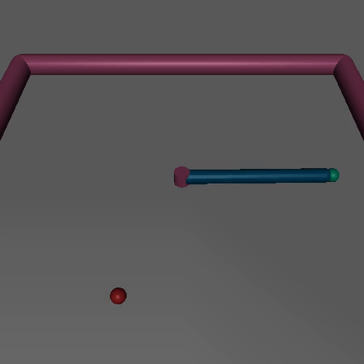
Reinforcement Learning Formulation
RL
The goal of RL is to get a policy:
Reward function:
Joint states
Joint Torque
Notes:
Theta is the parameter of the network.

Slide 17
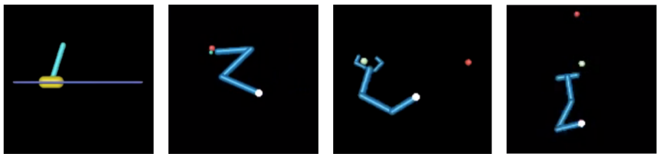
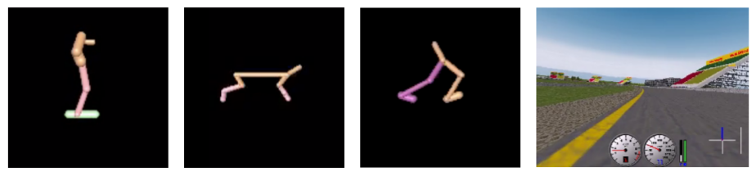
Reinforcement Learning in Robotics
RL
Deterministic Policy Gradient Algorithms (David Silver et al. 2014)
  DPG Algorithm
  Experiments: continuous bandit, pendulum, mountain car, 2D puddle world and Octopus Arm
Continuous Control with Deep Reinforcement Learning (Lillicrap et al. 2016)
  DDPG
Notes:
Reinforcement Learning Recent Enablers
Simulators are better, nice interfaces

Slide 18
Quiz 1: Write down a reward function for each
RL
Example:
a
b
c
d
e
f
g
Notes:
Reinforcement Learning Recent Enablers
Simulators are better, nice interfaces

Slide 19
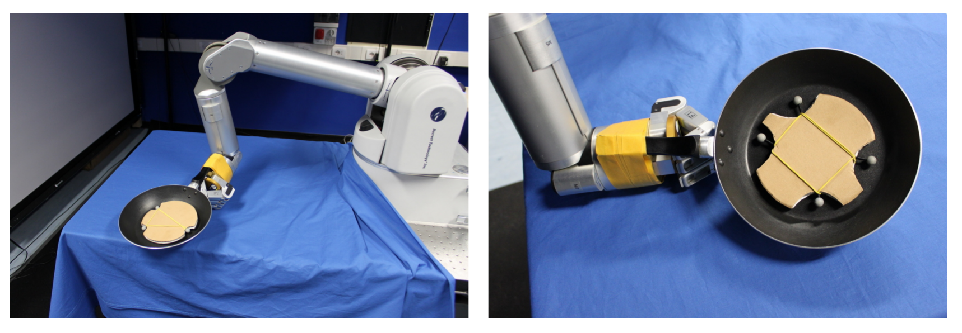
Reinforcement Learning in Robotics
RL
Pancake Flipping Task
Notes:
Reinforcement Learning Recent Enablers
Simulators are better, nice interfaces

Slide 20
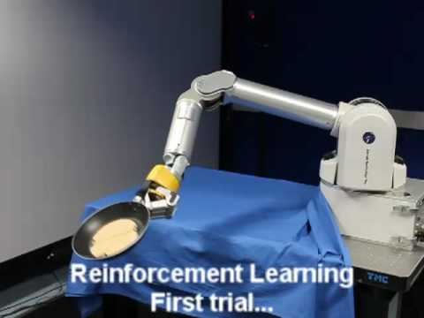
Reinforcement Learning in Robotics
RL
Pancake Flipping Task
Notes:
Reinforcement Learning Recent Enablers
Simulators are better, nice interfaces

Slide 21
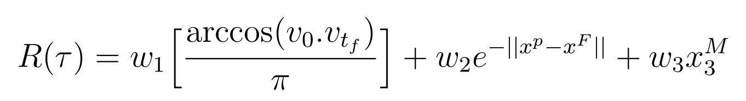
Reinforcement Learning in Robotics
RL
Pancake Flipping Task
Reward
  Orientational reward
  Positional reward
Notes:
Reinforcement Learning Recent Enablers
Simulators are better, nice interfaces

Slide 22
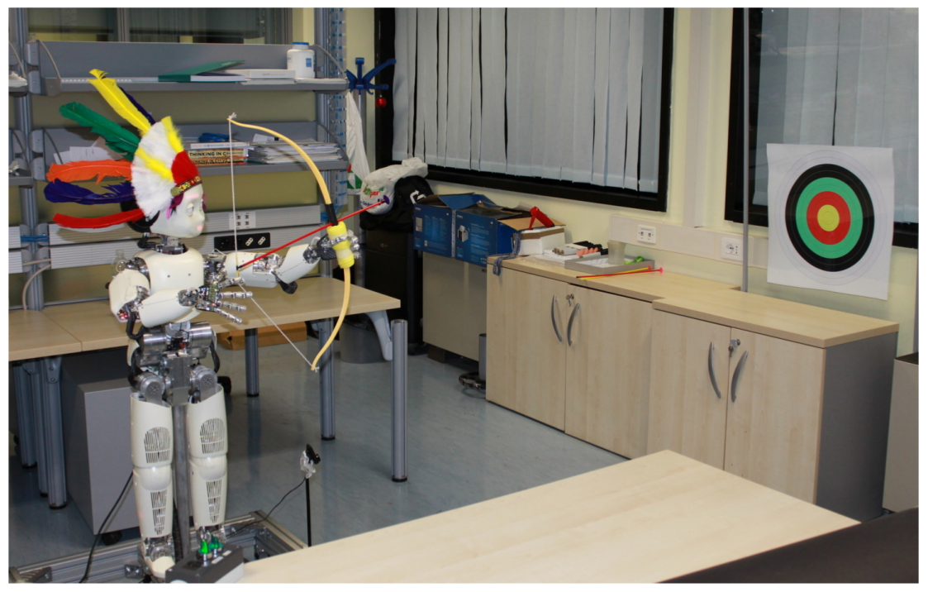

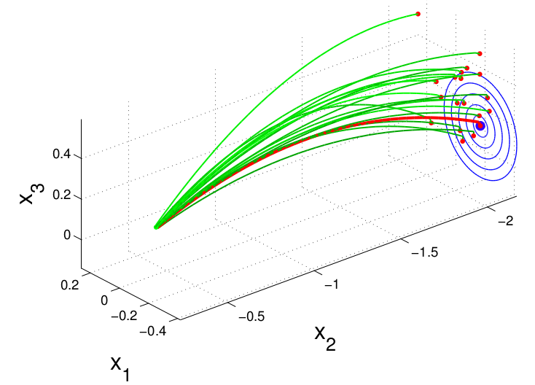
Reinforcement Learning in Robotics
RL
Archery Task
Notes:
Reinforcement Learning Recent Enablers
Simulators are better, nice interfaces

Slide 23
Reinforcement Learning
RL
Pros
Fully autonomous
Skills not explicit coded
No demonstration needed
Cons
Reward definition: Where does the R come from?
Curse of Dimensionality: Exploration cost increases exponentially with dimension
Generalization issues: Simulation to Real??
Convergence

Slide 25
RL Class of Methods
RL
Value Iteration methods (Q-Learning, SARSA)
Policy Gradient Methods (REINFORCE)
Actor-Critic Methods (DDPG, TRPO, PPO, A3C)
Model-based RL (Guided Policy Search, Dyna)
Notes:
Where does the R come from
Methods exists: categorized to Value Iteration/Policy gradients and some hybrids. Happy to discuss but I
Find theta that maximizes J

Slide 27
Reinforcement Learning in Robotics
LfD
RL
HR
Deterministic Policy Gradient Algorithms (David Silver et al. 2014)
  DPG Algorithm
  Experiments: continuous bandit, pendulum, mountain car, 2D puddle world and Octopus Arm
Continuous Control with Deep Reinforcement Learning (Lillicrap et al. 2016)
  DDPG
Notes:
Reinforcement Learning Recent Enablers
Simulators are better, nice interfaces

Slide 28
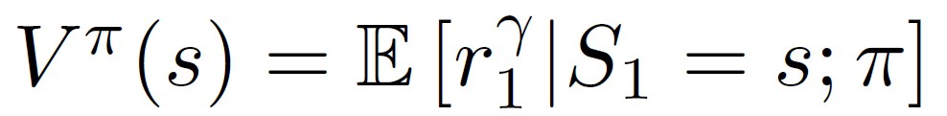
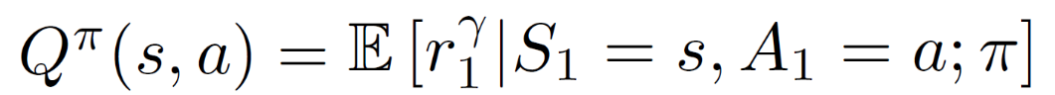
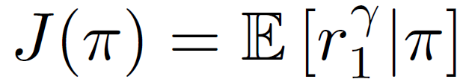
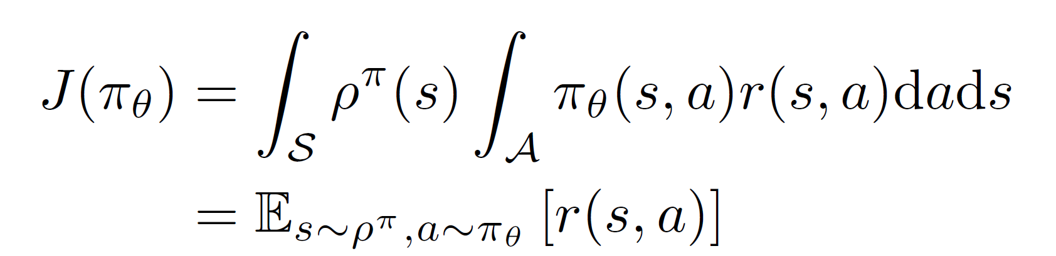
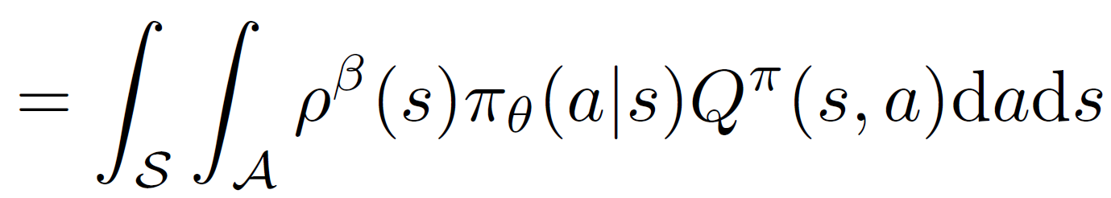
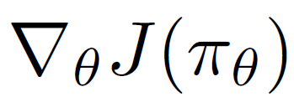

DPG (Silver et al. 2014)
LfD
RL
HR
Deterministic Policy Gradient Algorithms (David Silver et al. 2014)
Total discounted reward
Value functions:
Performance Objective:
Policy Gradient:
Notes:
Reinforcement Learning Recent Enablers
Simulators are better, nice interfaces
http://web.cs.ucla.edu/~sherstov/pdf/sara05-tiling.pdf
Tile coding- a type of overlapping discretizations

Slide 29
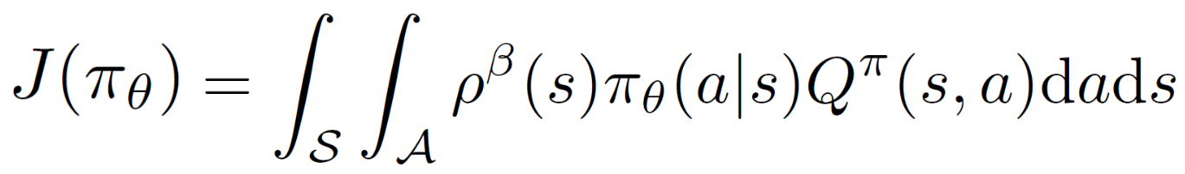
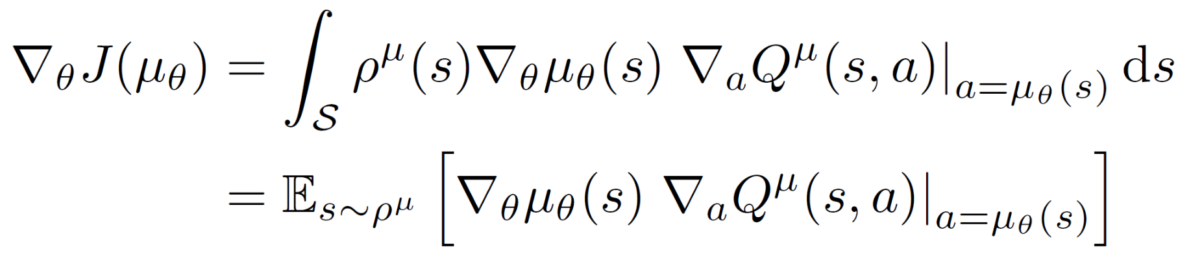

DPG (Silver et al. 2014)
LfD
RL
HR
Deterministic Policy Gradient Algorithms (David Silver et al. 2014)
Performance Objective:
Policy Gradient:
Deterministic Policy Gradient:
Actor
Critic
Notes:
Reinforcement Learning Recent Enablers
Simulators are better, nice interfaces
http://web.cs.ucla.edu/~sherstov/pdf/sara05-tiling.pdf
Tile coding- a type of overlapping discretizations

Slide 30

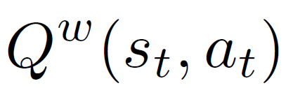
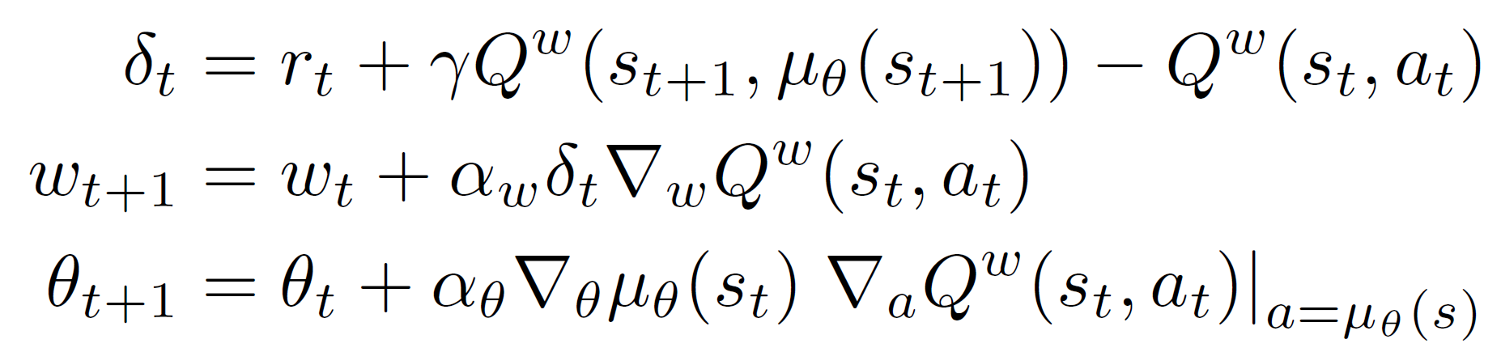
DPG (Silver et al. 2014)
LfD
RL
HR
Deterministic Policy Gradient Algorithms (David Silver et al. 2014)
Actor: Critic:
DPG Algorithm:
Notes:
Reinforcement Learning Recent Enablers
Simulators are better, nice interfaces
http://web.cs.ucla.edu/~sherstov/pdf/sara05-tiling.pdf
Tile coding- a type of overlapping discretizations

Slide 31
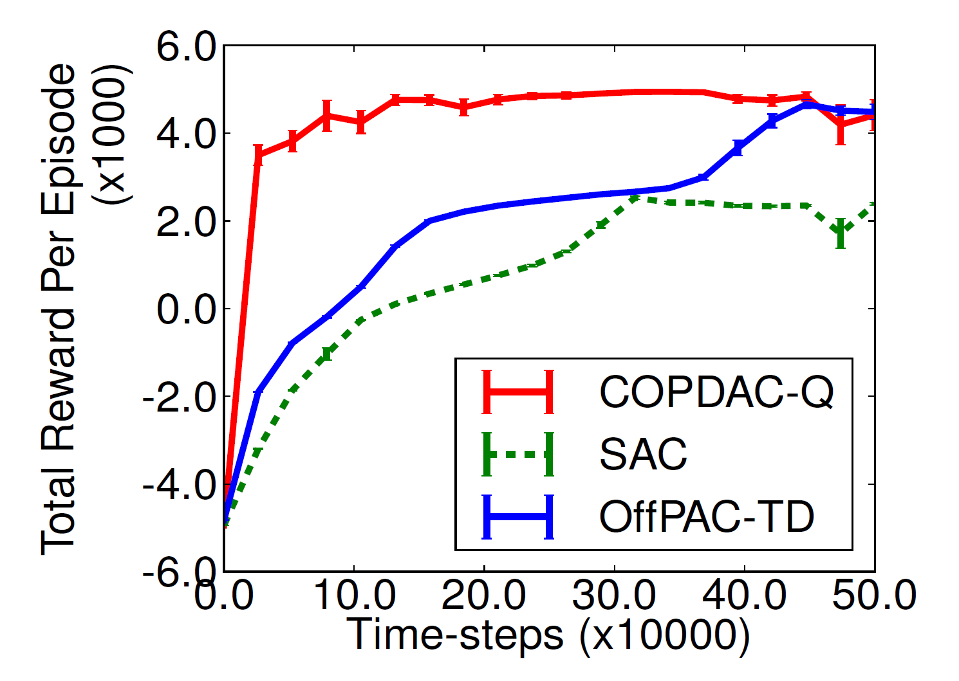
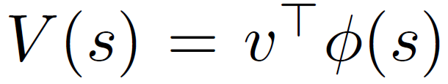
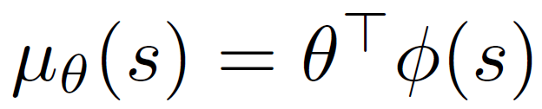

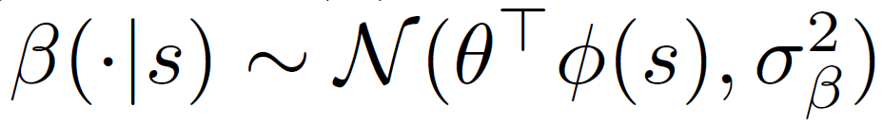
DPG (David Silver et al. 2014)
LfD
RL
HR
Experiments:
  continuous bandit, pendulum, mountain car, 2D puddle world, Octopus Arm
Pendulum:
State: joint position/velocities
Action: move left or right
Reward: +1 for every step while rod is upright
Critic:
Actor:
  Target policy:
  Behavior policy:
state-space features (tile-coding)
Notes:
The plot shows how they compare with stochastic policies
Reinforcement Learning Recent Enablers
Simulators are better, nice interfaces
http://web.cs.ucla.edu/~sherstov/pdf/sara05-tiling.pdf
Tile coding- a type of overlapping discretizations

Slide 32
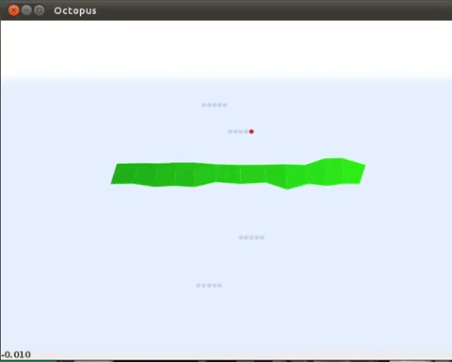
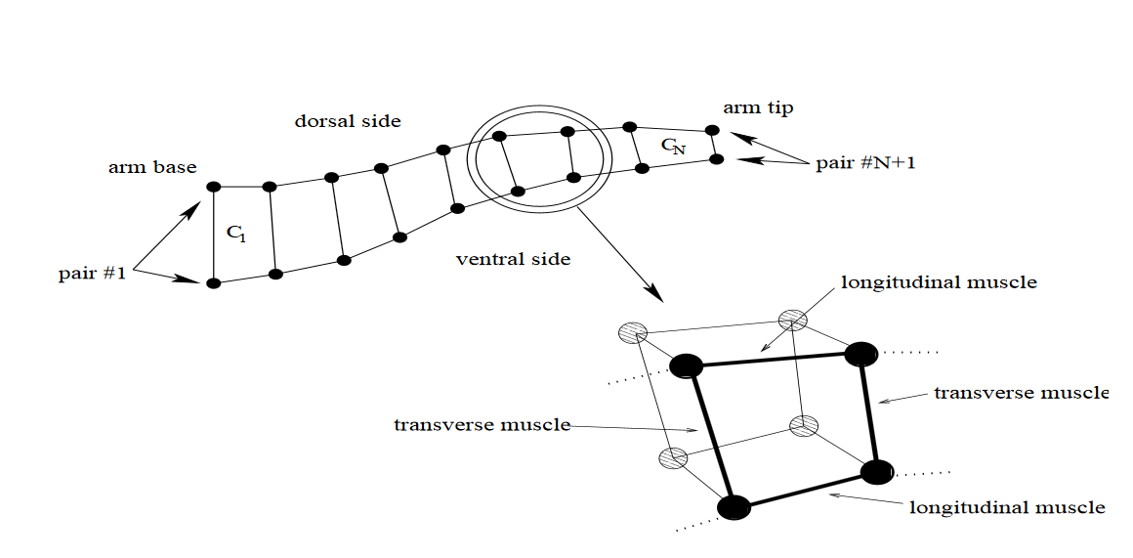
DPG (David Silver et al. 2014)
LfD
RL
HR
Experiments:
  continuous bandit, pendulum, mountain car, 2D puddle world, Octopus Arm
Octopus Arm:
State: 50 continuous joint state variables
Action: 20 variables to control muscles
Reward: change in distance between arm and target
Critic: NN Multilayer Perceptron (MLP)
Actor: MLP (8 hidden units)
Octopus Arm
Notes:
Reinforcement Learning Recent Enablers
Simulators are better, nice interfaces
http://web.cs.ucla.edu/~sherstov/pdf/sara05-tiling.pdf
Tile coding- a type of overlapping discretizations

Slide 33
Reinforcement Learning in Robotics
LfD
RL
HR
Deterministic Policy Gradient Algorithms (Silver et al. 2014) DPG
  Critic: linear function, Actor: Gaussian policy
  Critic: NN(MLP), Actor: NN(MLP)
Continuous control with deep reinforcement learning (Lillicrap et al. 2016) DDPG
  Critic: DNN, Actor: DNN
Notes:
Trust Region Policy Optimization
High-Dimensional Continuous Control Using Generalized Advantage Estimation

Slide 34
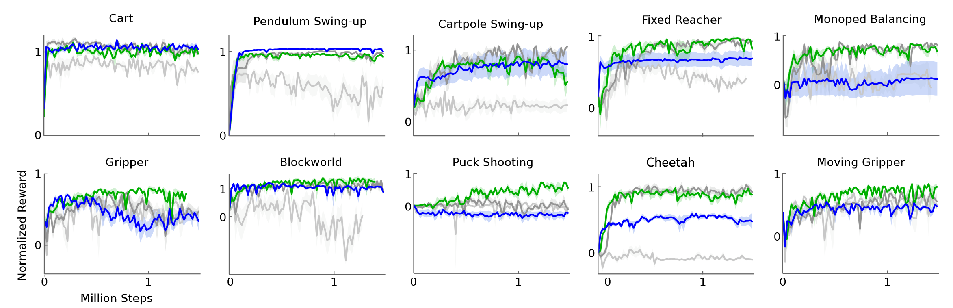
DDPG (Lillicrap 2016)
LfD
RL
HR
Batch normalization
Target Networks
original DDPG with batch normalization (light grey),
with target network (dark grey),
with target networks and batch norm (green),
with target networks from pixel-only inputs (blue)
Notes:
Millions of steps
It has to be done in simulation

Slide 35
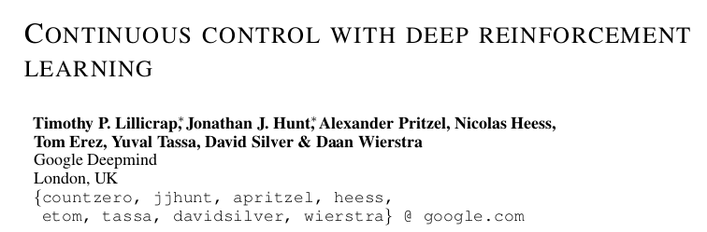
Case-Study: Actor-Critic Methods (DDPG)
RL
Initialize Actor and Critic networks
Generate samples from actor policy
Fit Critic model based on samples
Calculate actor gradients
Update actor
Notes:
Trust Region Policy Optimization
High-Dimensional Continuous Control Using Generalized Advantage Estimation

Slide 36

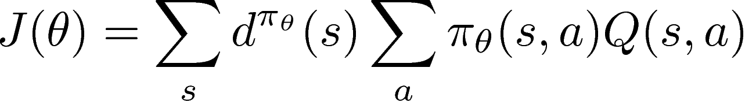

RL Class of Methods
RL
Actor-Critic Methods (DDPG, A3C, TRPO, PPO)
Network
State
Critic
Q-value
Network
State
Actor
Action
Continuous control with deep reinforcement learning (Lillicrap etal Deepmind 2016)
Notes:
How to calculate grad Q??
Back propagation using a maximum likelihood loss function with

Slide 37
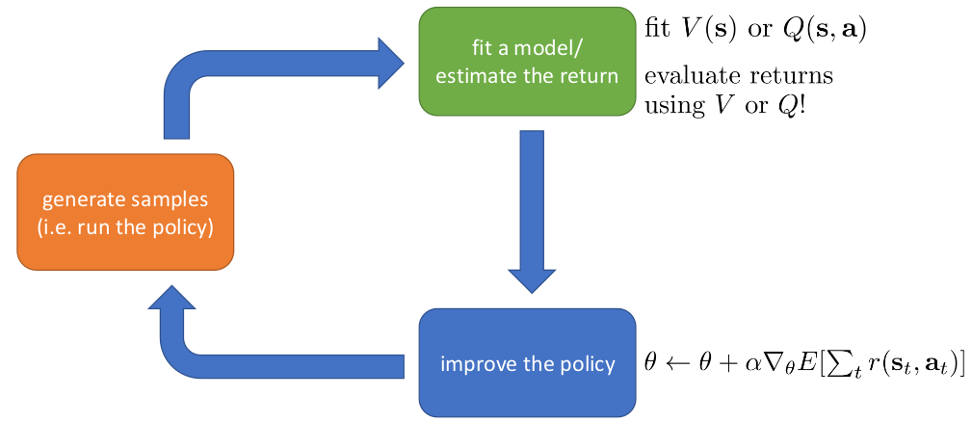
RL Class of Methods
RL
Actor-Critic Methods (DDPG, TRPO, PPO, A3C)
Image from Levine’s RL class
Notes:
Where does the R come from
Methods exists: categorized to Value Iteration/Policy gradients and some hybrids. Happy to discuss but I
Find theta that maximizes J

Slide 39
RL Class of Methods
RL
Value Iteration methods (Q-Learning, SARSA)
Policy Gradient Methods (REINFORCE)
Actor-Critic Methods (DDPG, TRPO, PPO, A3C)
Model-based RL (Guided Policy Search, Dyna)
Notes:
Where does the R come from
Methods exists: categorized to Value Iteration/Policy gradients and some hybrids. Happy to discuss but I
Find theta that maximizes J

Slide 40
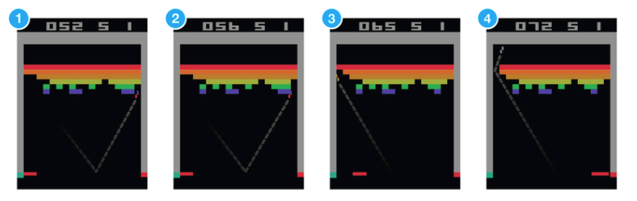

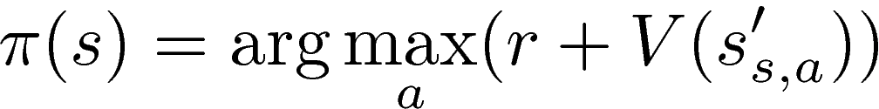
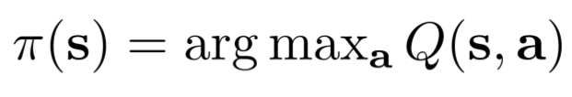
RL Class of Methods
RL
Value Iteration methods (Q-Learning, SARSA)
Network
Q-value
State
Network
Network
Q-value
State
Network
Q-value
Action
Q-value
Playing Atari with Deep Reinforcement Learning (Mnih etal 2015)
Notes:
Where does the R come from
Methods exists: categorized to Value Iteration/Policy gradients and some hybrids. Happy to discuss but I
Find theta that maximizes J

Slide 41
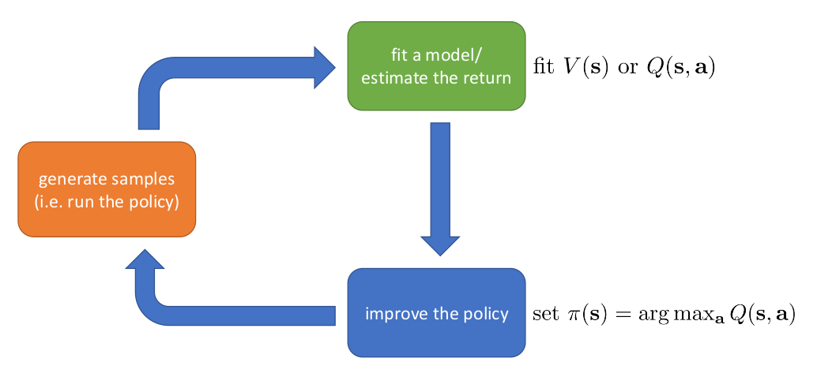
RL Class of Methods
RL
Value Iteration methods (Q-Learning, SARSA)
Image from Levine’s RL class
Notes:
Where does the R come from
Methods exists: categorized to Value Iteration/Policy gradients and some hybrids. Happy to discuss but I
Find theta that maximizes J

Slide 42
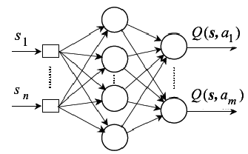
RL Class of Methods
RL
Value Iteration methods (Q-Learning, SARSA)
DQN: Playing Atari with Deep Reinforcement Learning (Mnih etal 2015)
Move Left
Move Right
Works well with Games- choose between discrete actions but robotics need continuous actions
Notes:
Discretize

Slide 44



QT-Opt
Q-Learning for Robotics
off-policy deep RL for closed-loop dynamic visual grasping
data collection on real robot
generalize to previously unseen objects

Slide 45

QT-Opt: Problem definition
MDP
observations:
  over-the-shoulder monocular RGB image
  Gripper status
  Height to bin
actions:
  end-effector Cartesian motion
  gripper opening and closing commands.
  Termination command
Reward:
  End of episode r= {0, 1} grasp success
  Penalty per episode step:

Slide 46


QT-Opt: Method
A continuous generalization of Q-learning
Learn a Q function:
Policy: choose action that maximizes learned Q function
Notes:
two target networks to improve stability, by maintaining two lagged versions of the parameter vectorθ, ̄θ1and ̄θ2, where ̄θ1 is the exponential moving averaged version ofθwith an averaging constant of 0.9999, and ̄θ2is a lagged version of ̄θ1, which is lagged by about 6000 gradient steps.

Slide 47
QT-Opt: Method
A continuous generalization of Q-learning
Learn a Q function:
Policy: choose action that maximizes learned Q function
Bellman Error to learn a Q function:
Notes:
two target networks to improve stability, by maintaining two lagged versions of the parameter vectorθ, ̄θ1and ̄θ2, where ̄θ1 is the exponential moving averaged version ofθwith an averaging constant of 0.9999, and ̄θ2is a lagged version of ̄θ1, which is lagged by about 6000 gradient steps.

Slide 48
QT-Opt: Method
A continuous generalization of Q-learning
Learn a Q function:
Policy: choose action that maximizes learned Q function
Policy derivation: CEM steps applied to Q-value neural network
  Action is selected via two iterations of CEM (cross entropy method)
  The action is then used to calculate the next value for the target network
CEM- a simple derivative-free optimization algorithm
samples a batch of N values at each iteration,
fits a Gaussian distribution to the best M < N of these samples, and
then samples the next batch of N from that Gaussian
Notes:
two target networks to improve stability, by maintaining two lagged versions of the parameter vectorθ, ̄θ1and ̄θ2, where ̄θ1 is the exponential moving averaged version ofθwith an averaging constant of 0.9999, and ̄θ2is a lagged version of ̄θ1, which is lagged by about 6000 gradient steps.
we use N= 64 and M= 6, and perform two iterations of CEM.

Slide 49

QT-Opt

Slide 50
QT-Opt
QT-Opt is a Q-learning based method for continuous actions
uses only RGB vision-based perception from an over-the-shoulder camera,
Automatically learns regrasping strategies
  (probing, repositioning, and other non-prehensile pre-grasp manipulations)
responds dynamically to disturbances and perturbations.
7 robots over four months (total of 800 robot hours)

Slide 51

From Simulation to Real World
Learn in simulation, transfer to real
Domain gap Problem
Simulation world is different from real
Particularly for color (RGB) images

Slide 52



From Simulation to Real World
Notes:
Key Ideas:
Domain Randomization
Render different images in sim
Vary position of the camera, basket and cube;
Vary color of basket, cube and scene textures/renderings
Distractor shapes added

Slide 53
From Simulation to Real World
Notes:
Key Ideas:
Domain Randomization
Render different images in sim
Vary position of the camera, basket and cube;
Vary color of basket, cube and scene textures/renderings
Distractor shapes added

Slide 54

Sim-to-Real via Sim-to-Sim
Sim-to-Real
  Running Robotics hardware for data-hungry learning methods is time-consuming
  Data is cheap in simulation and simulators are getting better
  Still, domain gap exists between simulation and real world
Domain randomization
  Hard to use some methods (RL), because of huge high dimensional variation during training

Slide 55

Key Idea
Translate Randomized image to standard “canonical” image
Train a policy on the standard image
Real-world becomes another randomized setting
  Real world is translated to standard image
  Policy trained on the translated version
Notes:
Decouple randomization problem from policy training

Slide 57


Key Idea
Translate Randomized image to standard “canonical” image
  Generator Network: multi-head UNET style (3 outputs)
  Predicts canonical image, semantic label and depth image
Train a policy on the standard image
  Qt-Opt
Real-world becomes another randomized setting
  Real world is translated to standard image
  Policy trained on the translated version or a concatenation of random and translated images

Slide 58


Mathematical Formulation/Details
Generator Network
L_{eqx}: mean pairwise squared error (MPSE), L_{eqm} and L_{eqd}: L2 loss
For sharpness: GAN
Total Loss:

Slide 59

Generator for Randomized to Canonical

Slide 60

Policy Learning: QT-Opt

Slide 61
Experimental Details
Comparison of RCAN with other methods with varying levels of randomization.
  Direct Sim-to-Real transfer
  Sim-to-Real plus fine-tuning
Builds on Qt-Opt paper

Slide 62
Results
One-shot transfer performance: 70%
  With real-world fine tuning: 91% (after 5k trials) and 94% (after 28k trials)
  Simulation performance: 99%
Interpretable intermediate output
Can be used with RL without stability issues
Big difference is interpretability and one-shot transfer
After fine-tuning, performance not much difference with other domain randomization methods (Figure 6)

Slide 63

Robot Learning Frontiers
Learning for Robotics
Grasping moving objects
Obstacle avoidance
Sensors Integration for RL: Depth, Tactile
Human reinforcement input modalities: eye-tracking, BCI
Hierarchical Reinforcement Learning for Multi-stage tasks
Generalizing across robots
Inverse Reinforcement Learning

Slide 64
Reinforcement Learning for Robotics
Iretiayo Akinola
http://www.cs.columbia.edu/~iakinola/
Notes:
Learning based approaches to robot learning

Slide 65
Thanks

Slide 66

QT-Opt

Slide 67
QT-Opt
Q-Learning for Robotics

